Slide 1
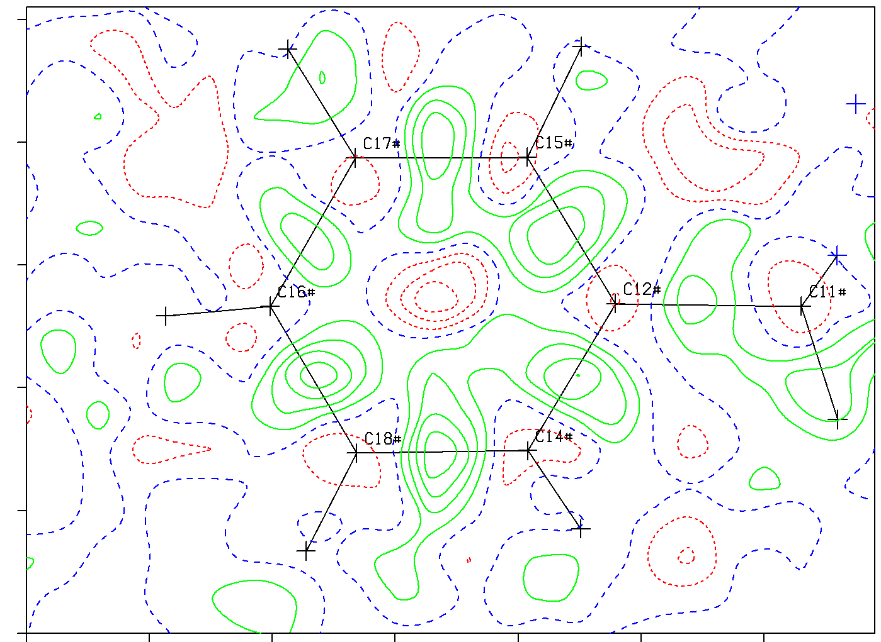
The PLATON checkCIF and SQUEEZE Tools
Ton Spek
Utrecht University, NL
Rigaku/Oxford Diffraction Usermeeting
Wroclaw, june 20, 2016
Notes:
Thanks to the organizers

Slide 2
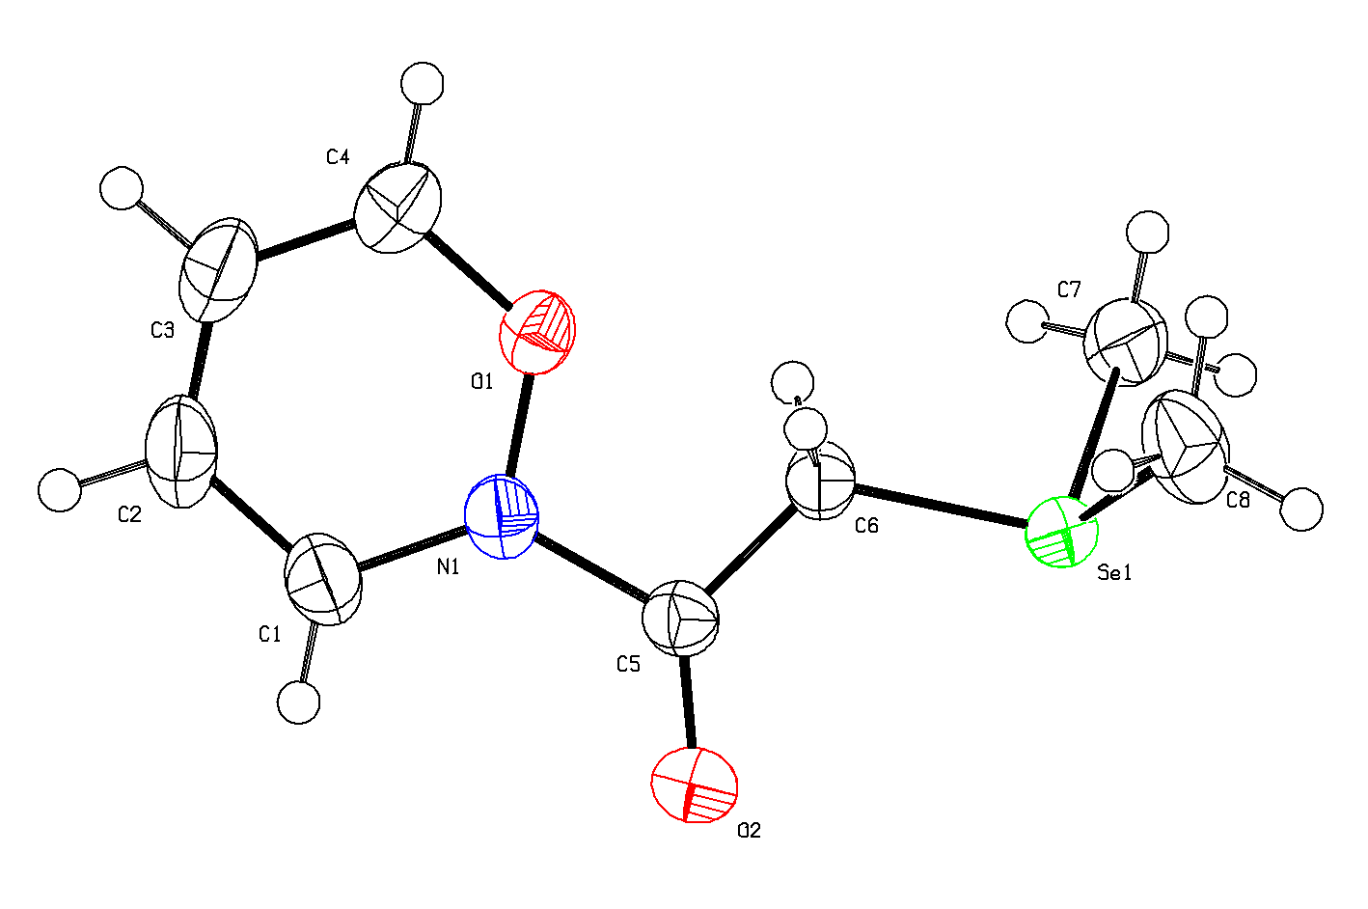
QUESTION: Is this Structure Correct ?
The Aug. 2015 IUCr/checkCIF reports no serious ALERTS
R1 = 0.0111
wR2 = 0.0339
S = 1.042
Rhomin -0.43
Rhomax 0.47
No Voids
No Unusual Contacts
Normal? Difference Density Range

Slide 3
No, The Structure was Deliberately INVENTED
This devious structure
was clevery created by
Natalie Johnson et al.,
Newcastle, UK, aiming to
beat checkCIF. It was
presented as an excellent
Poster during the
2015 ECM Congress
in Rovinj, Croatia.
But: Every crime leaves its traces …..

Slide 4
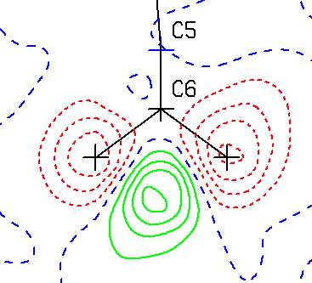
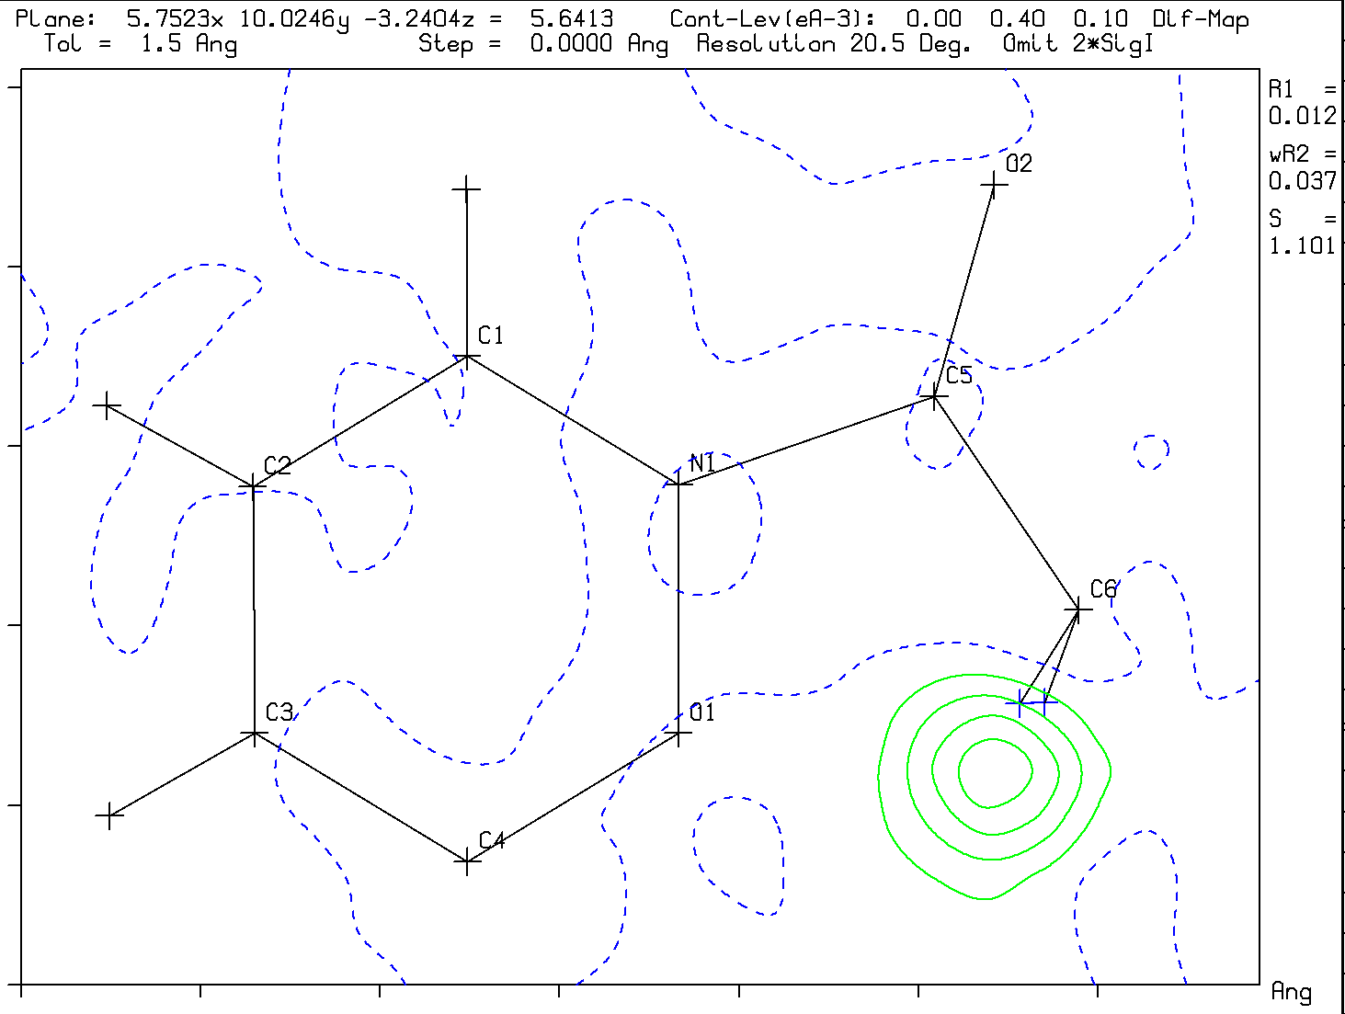
Clear traces of the ‘Crime’ are
in the Difference Density Map
Expected type of difference map
Difference map in the CH2 plane
The CH2 Hydrogen atoms at calculated
positions are definitely not in F(obs)
Unusual Actual difference map Density

Slide 5
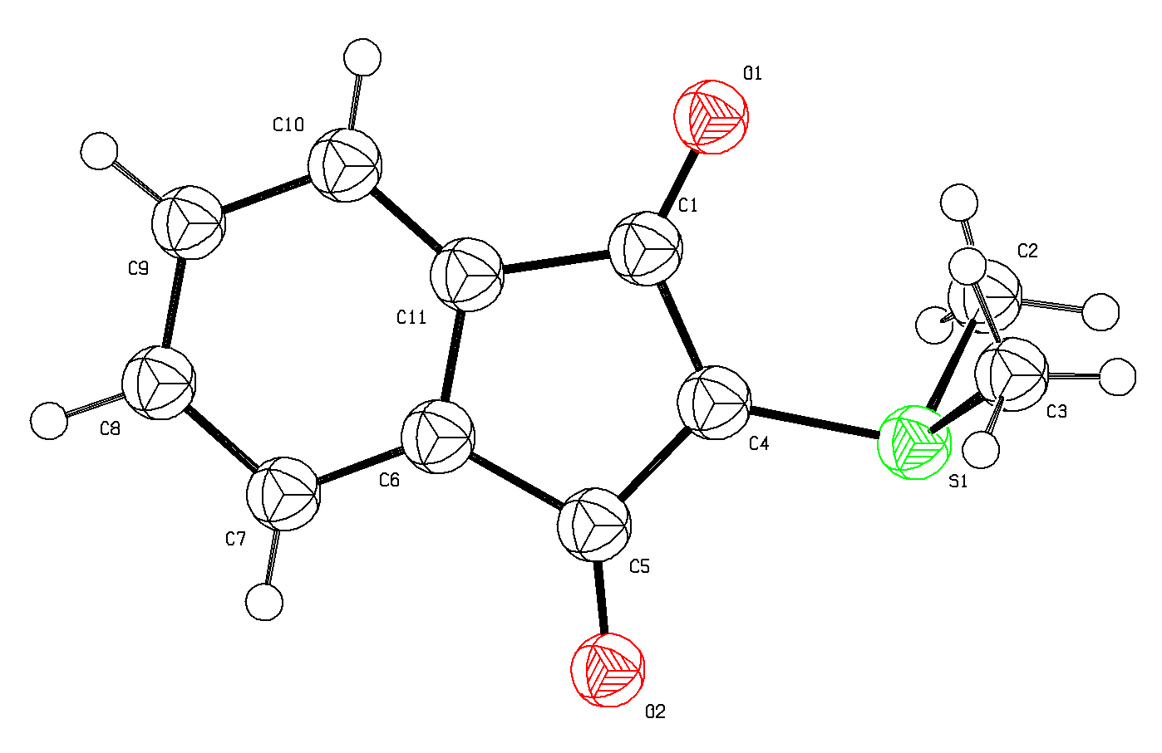
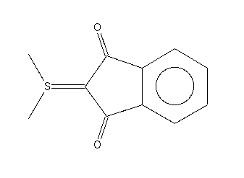
How was Structure ‘Natalie’ created ?
YLID
YLID
‘Starting Material’ (Bruker)
Chemical issue: Se⁺
No example in the CSD
for the 6-membered ring
System
Mogul : Se – C outlier
NATALIE

Slide 6
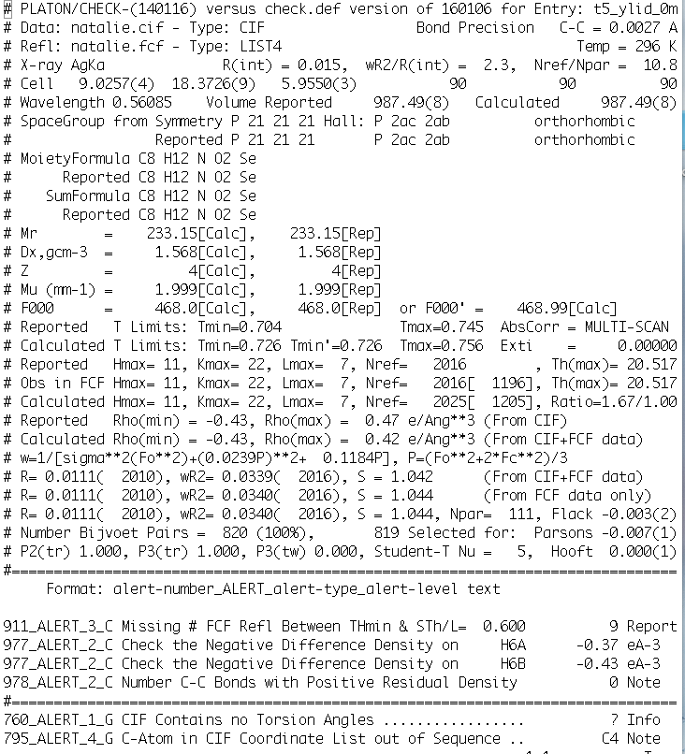
CURRENT
PLATON/CHECKCIF
VALIDATION
REPORT FOR
‘NATALIE’

No H-density

No Density on Bonds

Slide 7
What is PLATON
A collection of SHELX compatible tools bundled in a single program
The Toolset includes:
CheckCIF (Structure Validation)
SQUEEZE (Handling Disordered Solvents)
ADDSYM (Missed Symmetry)
TwinRotMat (Twinning Detection)
Bijvoet (Absolute Structure – Hooft(y))

Slide 8
PLATON/CHECKCIF
Is currently the major validation engine behind the IUCr driven checkCIF validation project of crystal structures.
It Checks and Reports on (with ALERTS)
Completeness of the supplied information
Problems with the experimental data
Problems with the interpretation of the data
Problems with the reported structure model
Unusual structural features

Slide 9
Structure Validation now over 20 Years
The introduction of the CIF standard for data archival made automatic structure checking possible.
Structure validation provides authors, referees and readers with a list of possibly interesting issues with a structure report that might need to be addressed.
Currently about 500 tests have been implemented in checkCIF and that number is still increasing on the basis of newly detected issues with supplied CIF’s.
ALERTS are not necessarily errors. They often point at interesting structural features to be discussed.

Slide 10
Some Validation Issues
A CIF essentially archives the authors interpretation of the underlying experimental diffraction data.
Archived reflection data are needed for a meaningful evaluation of unusual results and for test calculations.
Archival of Fo/Fc data (FCF) already solves part of this issue (side effect of its availability: detection and prove of cases of a few hundred seriously frauded structures in Acta Cryst. E)
Recently: embedding of refinement instructions (res) and unmerged reflection data (hkl) in the CIF urged.
The embedding of the .res & .hkl into the CIF with SHELXL2014 currently voids the need to supply an FCF.
IUCr/checkCIF and hkl deposition are now also part of the CSD deposition and archival procedures.

Slide 11
FCF-Validation adds:
Analysis of the quality of the refinement
Analysis of the difference map (peaks)
Detection of void content (SQUEEZE)
Detection of missing reflections
Detection of outliers
Detection of missed twinning
Check of the absolute structure

Slide 12
Benefits of the SHELXL2014 standard embedding of .res, .hkl (&.fab)
No need to supply an FCF file along with the CIF as part of a data deposition. The FCF can be created from the embedded data.
When supplied, the FCF should be ‘LIST 4’ or
‘LIST 8’ type
SHELXL2014 CIF + FCF are the recommended files to run the SQUEEZE tool since the original reflection data are retained in the CIF

Slide 13
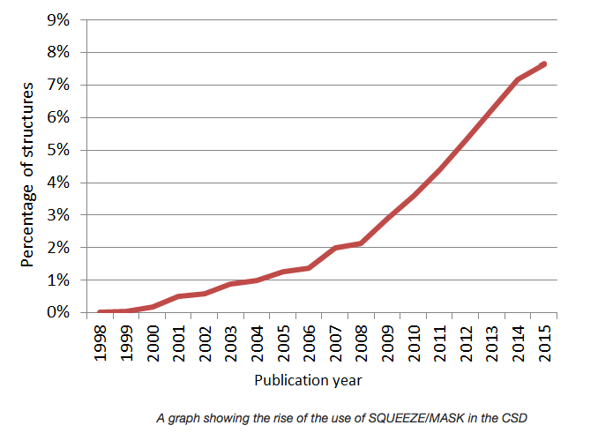
The SQUEEZE Tool
STATISTICS PREPARED BY THE CCDC
ON SQUEEZEd or OLEX2-MASKd
STRUCTURES in the CSD

Slide 14
PLATON/SQUEEZE
The current implementation of the SQUEEZE tool to handle disordered solvents is the third generation of a method published by us more than 25 years ago.
Interfacing with SHELXL2014 refinement solves many earlier issues with SHELX76 & SHELXL97 using .res & .hkl data. [e.g. Modification of the observed data]
Documentation of the recommended procedure: A.L.Spek (2015) Acta Cryst. C71, 9-18
http://www.platonsoft.nl/PLATON_HOW_TO.pdf

Slide 15
The Disordered Solvent Problem
The calculated structure factor Fc can be spit into two parts: Fc = Fc(model) + Fc(solvent)
Fc(solvent) can be parametrized with an (elaborate) disorder model and refined along with the other model parameters.
Fc(solvent) can also be approximated with the SQUEEZE tool and used as a fixed contribution to the structure factors in the refinement.
In simple cases, the first approach is preferred

Slide 16
The PLATON/SQUEEZE Tool
SQUEEZE, as implemented in PLATON, analyses the content of solvent accessible VOID(s) in a crystal structure. (Q: are the voids empty ?).
The VOID content will generally involve (heavily) disordered solvent(s) that might be difficult to parameterize meaningfully (e.g. unknown solvents).
The solvent contribution to the calculated structure factors is approximated by Fourier transformation of the density in the VOID(s) as part of the least-squares refinement of the model parameters. (.fab)
SQUEEZE does not refine the Fc(model)

Slide 17
The Proper use of SQUEEZE
It is important that the final CIF archives both the details of the SQUEEZE calculation and the unmerged reflection data. In that way, the calculations can be reconstructed and/or alternative refinement models attempted.
SHELXL2014 offers all what is needed for that.
SQUEEZE uses the model parameters taken from .cif and merged observed structure factors from the LIST 4 or LIST 8 .fcf to calculate solvent F(calc) on .fab.
Final SHELXL refinement will be based on the CIF embedded .res, .hkl files along with the .fab file.

Slide 18
How to SQUEEZE with SHELXL2014
Refine a non-solvent model with name.ins & name.hkl (Include ACTA record, NO LIST 6) .
Run PLATON/SQUEEZE, based on name.cif & name.fcf from 1 as ‘platon –q name.cif’.
Continue SHELXL refinement with the files name_sq.ins, name_sq.hkl & name_sq.fab from 2 as ‘shelxl name_sq’
Inspect the .lis & .lst files and Validate

Slide 19
SQUEEZE Disordered Solvent + Twinning
Step 1: SHELXL refinement based a name.ins (that should include ‘ACTA’, ‘LIST 8’, ‘BASF’ and ‘HKLF 5’ [or ‘TWIN’] records) and a name.hkl file
Step 2: Run SQUEEZE with the name.cif and name.fcf files produced in Step 1 (i.e. run: platon –q name.cif)
Step 3: Continue SHELXL refinement with the files name_sq.ins, name_sq.hkl and name_sq.fab produced by PLATON in step 2 ➔ name_sq.cif & name_sq.fcf
Note: The name_sq.fab file contains the solvent contribution to the SF and the details of SQUEEZE.

Slide 20
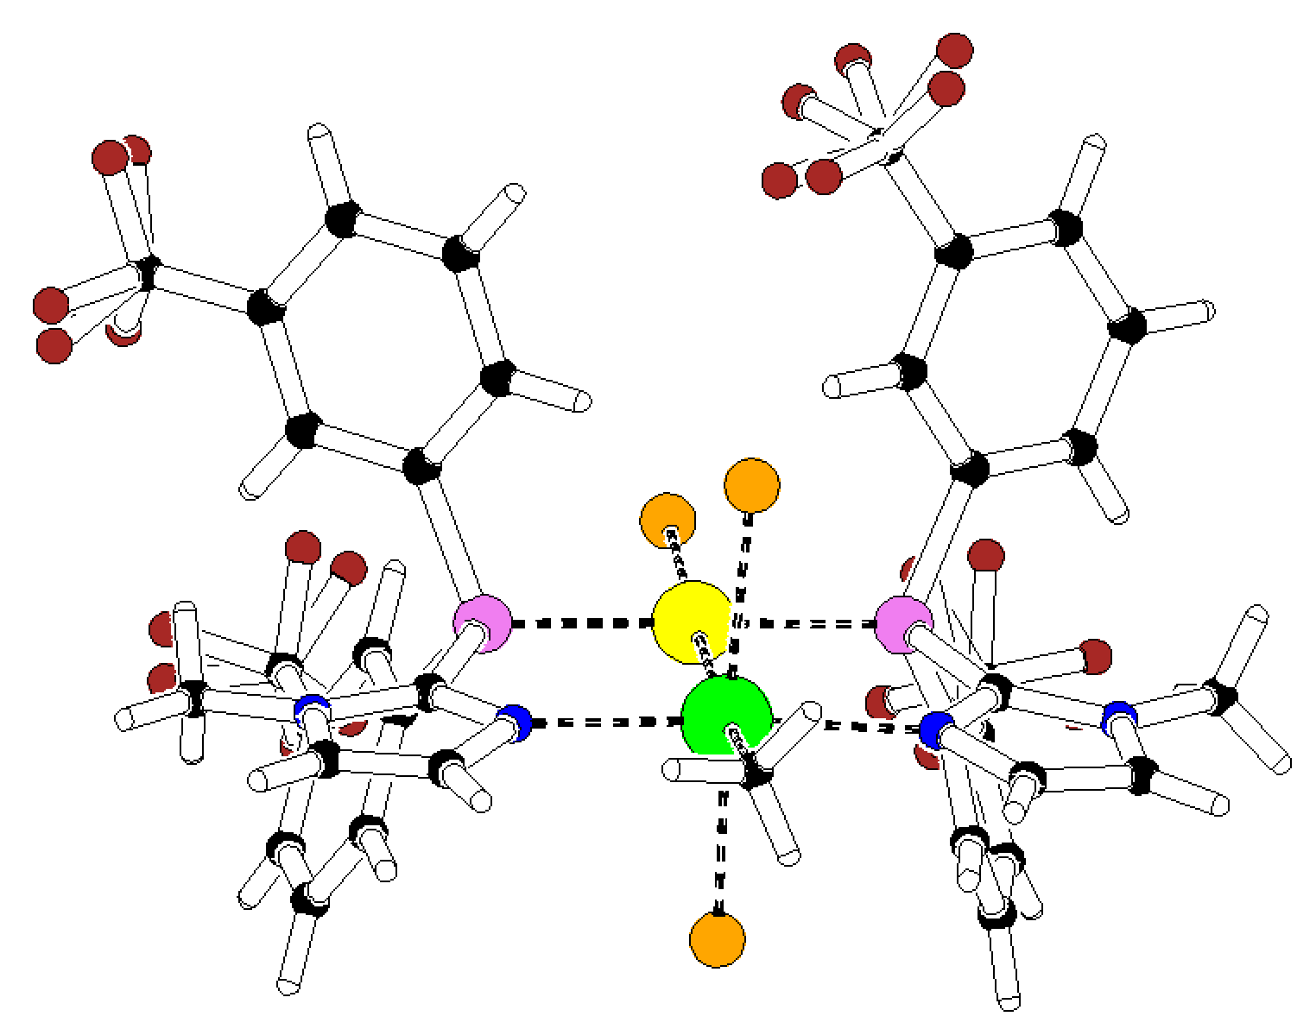
SQUEEZE-2016 Example: Coordination Compound
Acetonitril Model: R = 0.0323, wR2 = 0.0889, rho(max) = 1.34 e/A-3
Space Group P2₁
Z = 4, Z’ = 2
60:40 Twin
Twin axis: (0 0 1)
150 K
TWINABS hklf5 data
Acetonitril solvate
Step 1 (SHELXL2014) ➔ R1 = 0.047, wR2 = 0.1445
Step 2 (SQUEEZE) ➔ 177 electrons found in unit cell
Step 3 (SHELXL2014) ➔ R1 = 0.0275, wR2 = 0.0679, S = 1.064

Slide 21
Effect of on R(F) before and after SQUEEZE as a function of sin(theta)/lambda

Slide 22
Requirements
There should be no residual unresolved density in the discrete model region of the structure because of its impact on the difference map in the solvent region.
The data set should be reasonably complete and with sufficient resolution [i.e. sin(theta)/lambda >0.6].
There should be no unresolved charge balance issues that might effect the chemistry involved (e.g. The valency of a metal in the ordered part of the structure)

Slide 23
Limitations
The reported electron count in the solvent region is meaningful only with the supply of a complete and reliable reflection data set.
The SQUEEZE technique can not handle properly cases of coupled disorder effecting both the model and the solvent region.
The solvent region is assumed not to contain significant anomalous scatterers (Friedels averaged)

Slide 24
Thank you !
Please send suggestions and examples (with data) of
(annoying) issues to:
a.l.spek@uu.nl
More info:www.platonsoft.nl
(including this powerpoint presentation)

