Slide 1

Fourty Years of Marshing: A name turned into a verb
Richard E. Marsh (1922-2017)
Ton Spek, Utrecht University, NL.
24-2-2018-MIT Symposion

Slide 2
Publications
A Science Citation Index search can be helpful to see how someone’s reseach interests developed over time.
Unfortunately, there are several publishing ‘R.E. Marsh’ authors, complicating that search.
I used the selection keywords Marsh & CalTech.
That gave a list of at least 189 papers that are cited 5700 times in total.
That count is likely not complete but sufficient for our purpose.

Slide 3
Shift in Interest
Clearly, a period before 1979 and a period of 35 years thereafter can be distinguised in his work.
The relevant ‘turning point’ paper in that context is: R.E. Marsh & Verner Schomaker, Inorg. Chem. (1979) 18, 2331-2336, Some Incorrect Space groups in Inorg. Chem, Volume 16 (1977)
Probably related to a sabbetical of Schomaker

Slide 4
The Period before 1979
A significant number of relevant and well cited structures were reported in that period such as Cytosine (1964), Glycine (1966), L-Alanine (1966).
Several hundred citations for a single structure report were not uncommon.
Structure determination was still non-trivial (in particular those of organic compounds). [pre-MULTAN times ….]

Slide 5
A Structure Master Piece
A master piece was the structure determination of trimesic acid, C₉H₆O₆, with Z’ = 6 in C2/c, together with David. J. Duchamp. (Acta Cryst. (1969), B25, 5-8).
The stucture consists of heavily intertwined chickenwire hydrogen-bonded networks

Slide 6
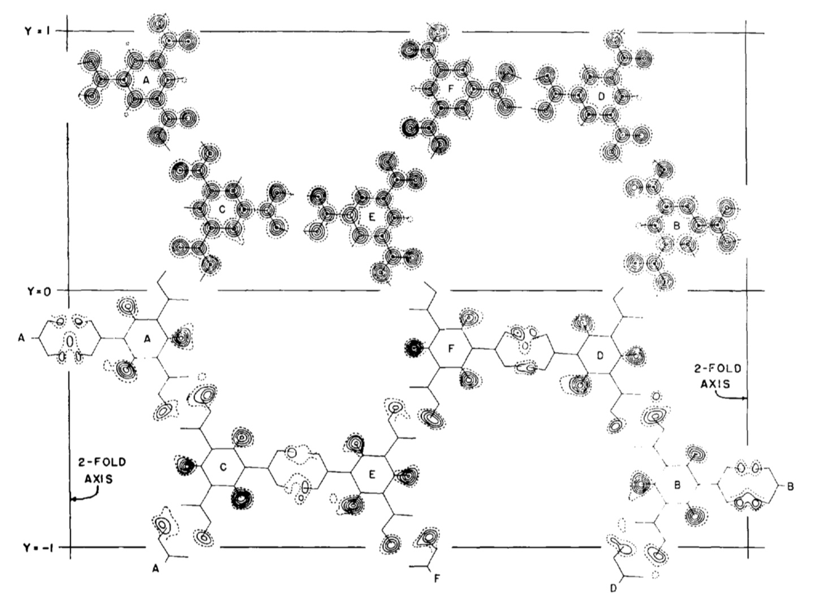
One of the intertwined trimesic acid nets

Slide 7
The period 1979-2014
By 1979, structure determination starts to become routine. (Direct Methods).
Erroneous structure reports, due to inexperience, started to appear, in particular in non-crystallographic Journals.
The 1979 ‘missed symmetry’ paper was the first in a series of similar papers, often in collaboration with other ‘older’ scientists. Other authors picked up the same subject as well.

Slide 8
The Missed Symmetry Problem
Correct space group assignment to a crystal structure is not always trivial (in particular concerning the centro/non-centro choice case).
As a result, many (still uncorrected) errors can be found in the literature and databases.
Some errors are harmful, others are of a more esthetic nature.
Pseudo-symmetry, disorder, poor data and twinning may confuse the issue.

Slide 9
How Large is the Problem ?
An under-bound can be gleaned from the searchable information available in the CSD
Searching the CSD for the tekst ‘REINT_OF’, that stands for ‘reinterpretation’, reports 1800 entries (89 between 2013-2017)
1061 of those of the indicated re-interpretations are (co)authored by Dick Marsh
However, there are many more not marked (and corrected) in the CSD (e.g. those reported in Dick’s last Acta Cryst. (2014). C70, 834 paper).

Slide 10
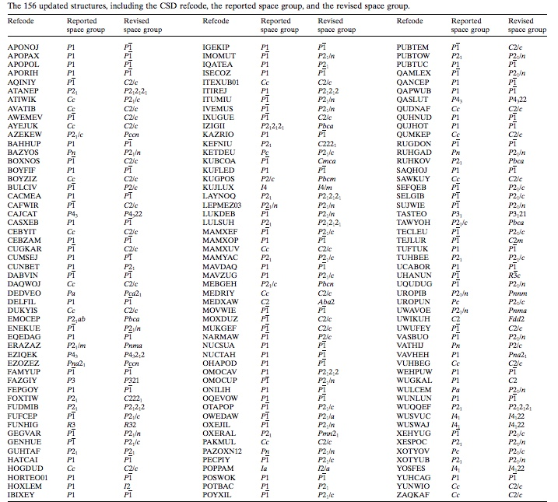
Last 2014
ACTA Cryst.
C70,834-836
paper with
156 new
corrections
In recent
Papers.
No warning
Info added
in the CSD !

Slide 11
Why Bother ?
Space group re-interpretation papers have always been controversial (and sometimes considered pedantic ..) Dick’s early rebuttal on this is already given in the Acta Cryst. (1979) B35, 1094-1099 paper:
“Some will argue that the mishap was harmless; afterall, the reported structure is essentially correct, as far as we know, except for the symmetry and the divergent lengths and angles. We can understand, but hardly agree.”

Slide 12
Space Group Corrections
Space group corrections include:
Change of crystal system
Change of Laue group
Centro or non-centrosymmetric
(Pseudo-) translation
The last two cases are the more problematic ones since they may lead to structure artefacts rather than less optimal results.

Slide 13
The Problem
The problem is that the correct assignment is often only possible after the structure is preliminary ‘solved’.
For proper evaluation of a space group assignment, we will need the primary reflection data.
Those data are not always archived for published papers, making ‘correction reports’ based purely on coordinates tricky.

Slide 14
Post Space Group Assignment
Preliminary structure determination often succeeds only in a lower symmetry subgroup assignment such as P1. Authors should follow that up with a search for possible higher symmetry in their model. That step is often ignored.
The procedure that was used by Dick was looking by hand for special relations in the coordinates of similar independent atoms.

Slide 15
Sources of the Problem
EDUCATION: Acta Cryst. Author query about a validation ALERT:
Please teach me: what does it mean ‘space group incorrect’
Authors do often not know how to manage a transformation to higher symmetry space groups. E.g. the needed origin shift (P-1) or origin choice (C2/c) problems.
The centro/non-centro symmetry choice needs often some expertise.

Slide 16
New Computer Algorithms
1982: CREDUC, Y Le Page J.Appl.Cryst.,15,255.
Determination of the Metrical Symmetry of the lattice from the number of compatible two-fold axes. E.g. 1 → monoclinic, 5 → tetragonal, 9 → cubic
Two-axis = coinciding low-index (0,1,2) direct and reciprocal lattice vectors within a tolerance.
Actual symmetry can be lower, not higher than the metrical symmetry.
PLATON/LEPAGE is Modelled on CREDUC

Slide 17
The MISSYM Algorithm
Y. Le Page published in 1987 a follow-up to CREDUC called MISSYM (J.Appl.Cryst.,20,264).
MISSYM Looks for support in the actual structure (I.e. coordinate set) for the proposed metrical symmetry elements of the lattice.
Liberal tolerances are used in general to catch outliers and pseudo-symmetry cases.

Slide 18
MISSYM Implementation
Originally as part of the NRCVAX package.
Leaves evaluation and implementation of the reported additional symmetry to the researcher.
In PLATON as the ADDSYM routine
ADDSYM is also part of the IUCr/checkCIF tool

Slide 19
PLATON/ADDSYM Extensions
Suggests automatically a revised space group, unit cell and origin transformation.
May Generate a new ‘.res’ file for SHELXL refinement.
Allows for a percentage of non-fitting atoms in order to catch pseudo-symmetry cases.
Handles sub-cells. (structure prediction)
Accepts input data in ‘.res’ and ‘.cif’ format.
Runs on files with multiple entries (CSD/CIF).
Display of the revised (averaged) structure.

Slide 20
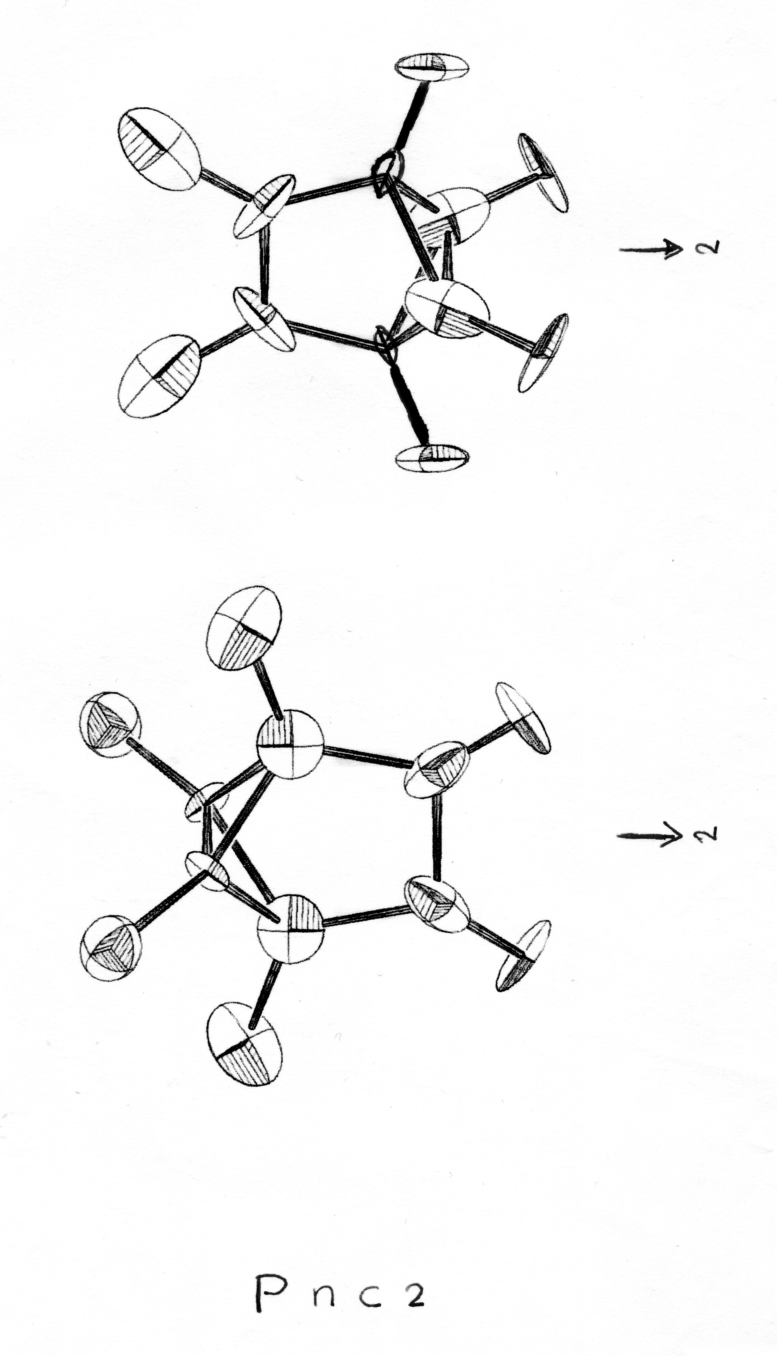
Retro Inspection of my own early Publications with the ADDSYM tool
One Hit ! in papers published prior to the Marsh & Schomaker (1979) paper.
Cryst. Struct. Commun. (1977) 6, 259-262
(Journal was the forerunner of Acta Cryst. C)
Refined with XRAY76 in the Non-Centro Space Group Pnc2. Poor structure: R_{F} =0.08
No inversion implemented in view of
Hk0, h=2n+1 outliers up to 30 sigma(I)
Re-Refined with SHELX76 in Space Group Pnca. R_{F} = 0.049, wR_{F} = 0.077

Slide 21
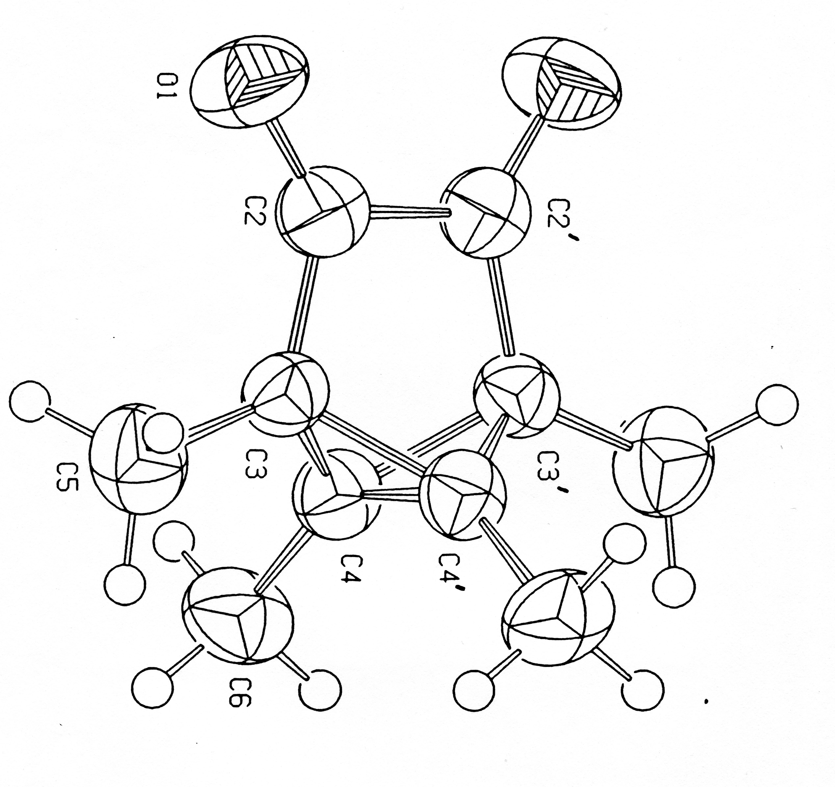
Refinement Result with the Proper Space Group Assignment
Pnc2 ==> Pnca
Acta Cryst. (1990). C46, 1357-1358
Better geometry and Displacement Parameters

Slide 22
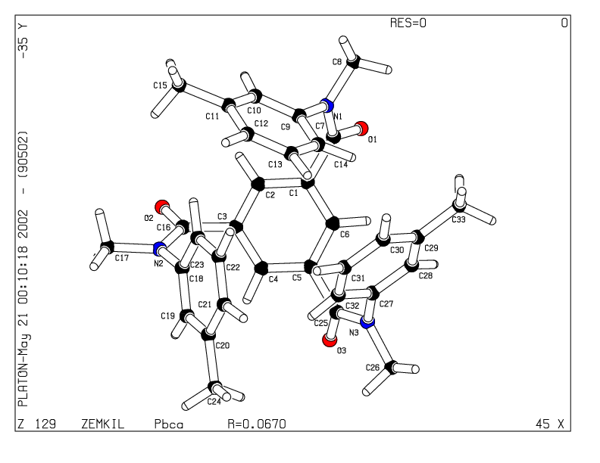
Change of Crystal System Example proposed by ADDSYM

Slide 23
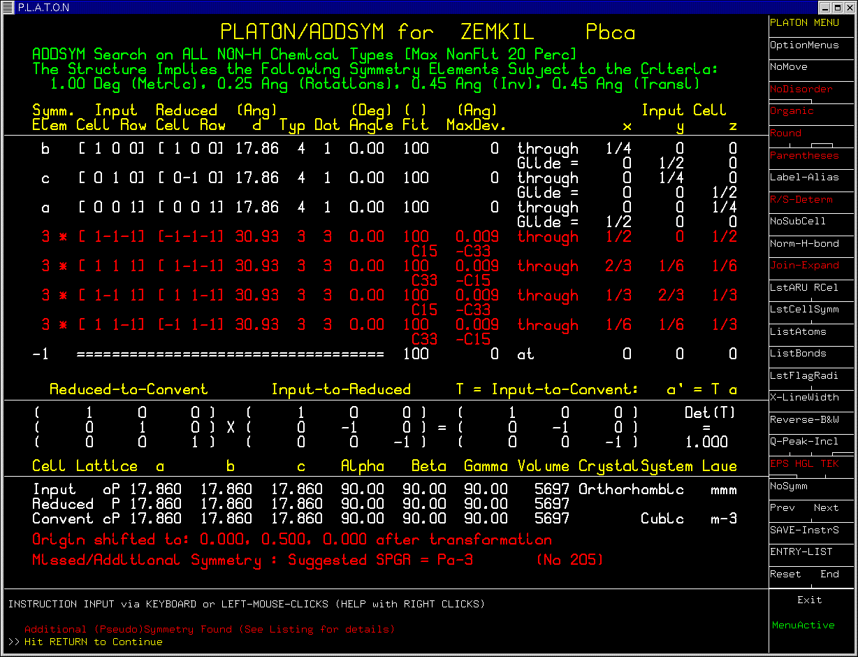

Slide 24
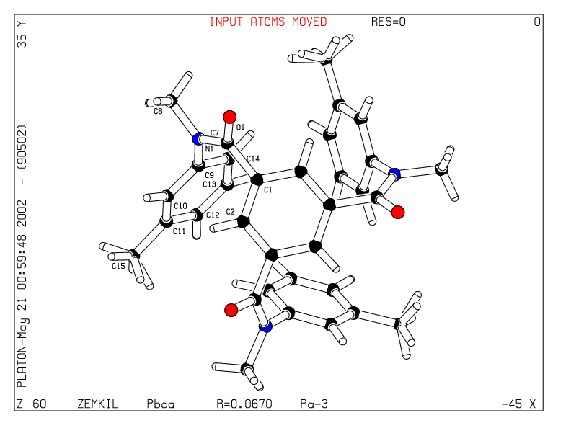
Orthorhombic Pbca ➔ Cubic Pa-3

Slide 25
Survey’s of the Issue
A survey by Dick Marsh in 1997 of all structures published in space group Cc showed that about 10% of the assignments was wrong.
A new survey by Dick Marsh in 2004 surprisingly showed that this percentage was still around 10%.
Note: none of the additional 164 corrected assignments were from Acta Cryst. journals.
Revisions to C2/c, Fdd2, R-3c etc.

Slide 26
Two ‘Polymorphs’ in the CSD for the Same Compound ?
PAPCAK: Organometallics: Fdd2
‘Orthorhombic Polymorph’: PAPCAK
PAPKAK01: Private Commun. to the CSD: I-42d
Tetragonal Polymorph: PAPCAK01
ADDSYM for PAPCAK: Fdd2 ➔ I-42d
Identical Simulated Powder Patterns !!

Slide 27
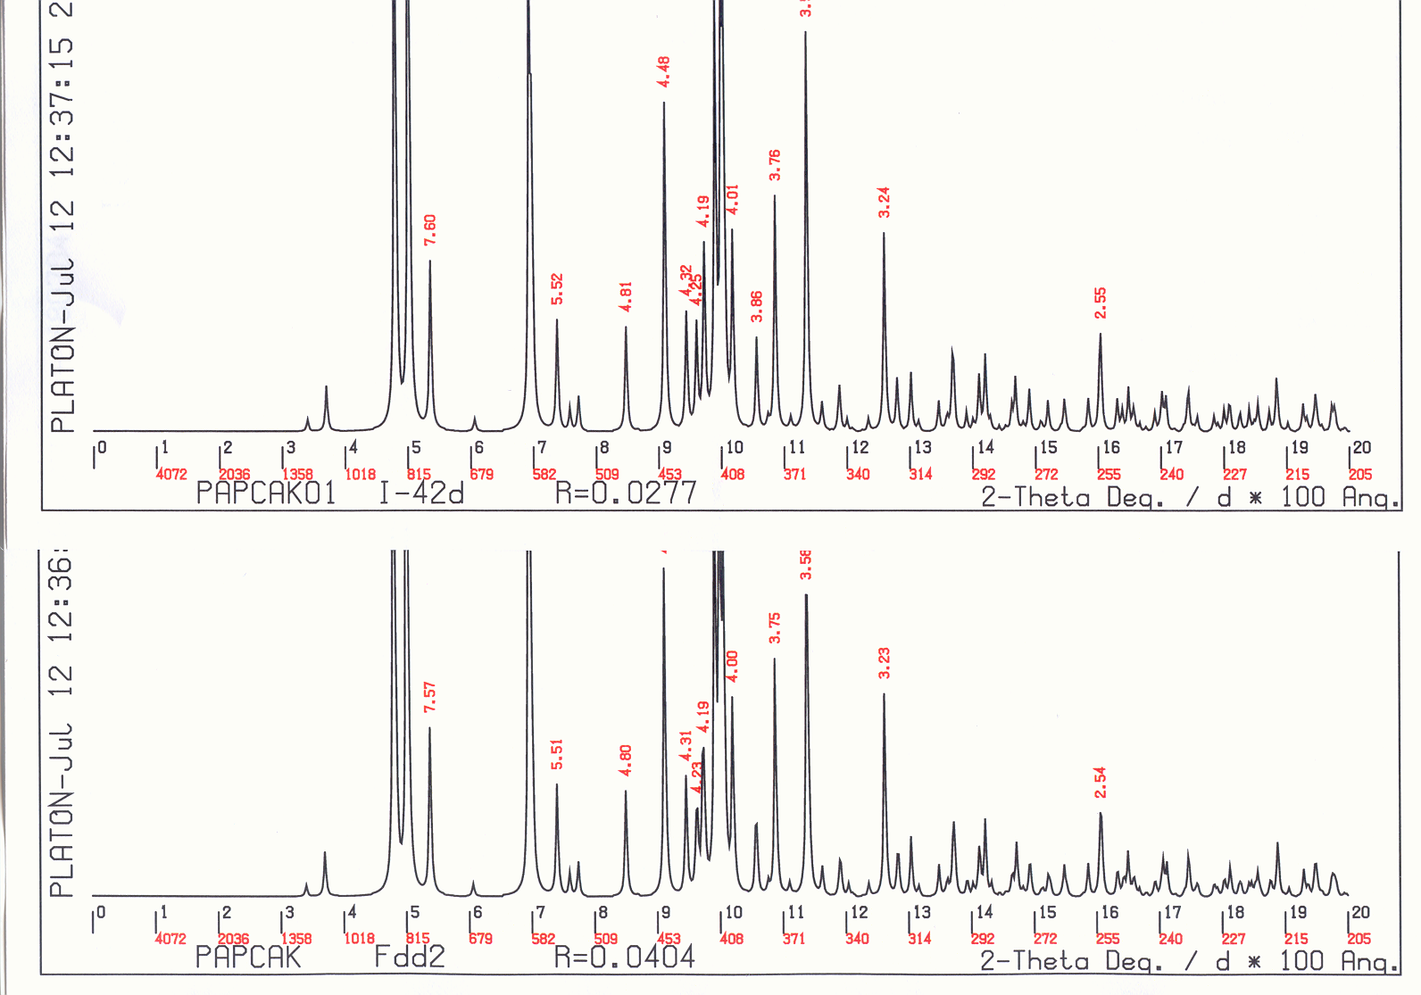
Tetragonal
“Orthorhombic”

Slide 28
Residual Problems
Chemists Perception: Space Group Terror ….
Crystallographic data ‘hidden’ in suppl.mat.
and not readily available for the referee.
Pseudo-symmetry:
- chiral molecules with Z’=2,
- Angle close to 90 degrees but not exactly.
e.g. ‘Orthorhombic with 90 90 89.50(1)
No observed structure factors etc. available for detailed analysis. (Needed for a final verdict!)

Slide 29
Centro or Non-centrosymmetric ?
Correct assignment is not always trivial.
Refinement of (close to) centrosymmetric structures in P1 is mathematically unstable.
Mis-assignment -> geometry artifacts.
Dick Marsh: Borderline cases are best treated as centro-symmetric (static/dynamic disorder)
Inspect Fo/Fc of weak reflection data.
In general: chiral molecules-> non-centro SpGr.
Literature Example P1 <-> P-1.

Slide 30
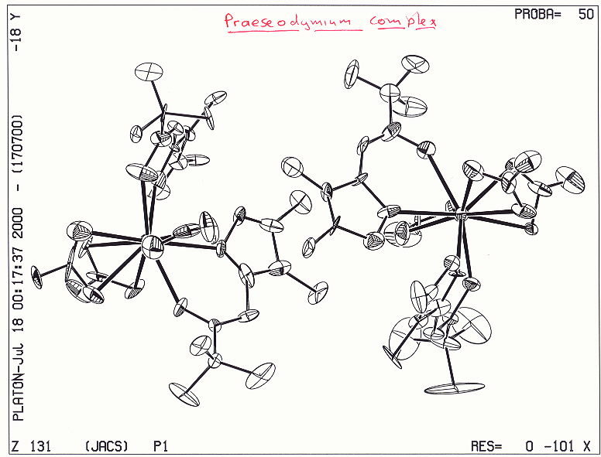
Praseodymium complex
J.A.C.S. (2000),122,3413 – P1, Z’ = 2

Slide 31
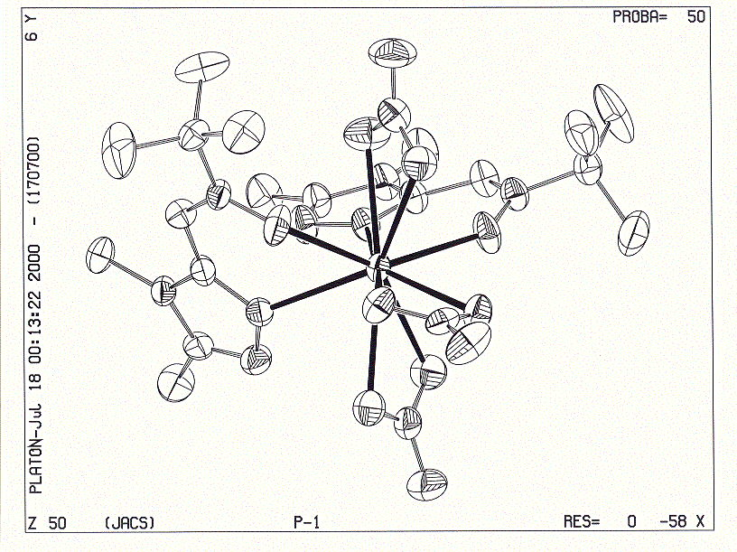
QIMRIN02
P-1, Z’=1

Slide 32
Follow-up
Sometimes I contact authors on issues like this as an opportunity for them to correct the literature.
Reactions vary from ignoring, ‘you are wrong’ or ‘thanks, I will act on it’ (and sometimes forgetting to act)
In the J.A.C.S. paper case, we followed up the issue with contacting the editors of J.A.C.S. They approached the authors for comment.
In response, a correction appeared in J.A.C.S.
Its content is telling …

Slide 33
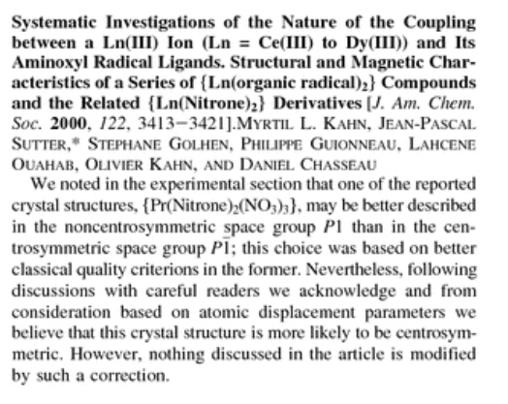

Slide 34
Interesting Story
PLATON/ADDSYM can analyse automatically a CIF file containing multiple entries exported from the CSD. In 1999, in response to the paper “P1 or P-1 or something else” I send Dick my automatically created “P1” list. He immediately started to work on that list and indeed found some more missed symmetry cases. Interestingly, one of the entries (NAXQAM) that he had previously updated to Cc was ‘Marshed’ again to Fdd2. I did not realize that when I supplied my list. I was told that he enjoyed being Marshed.

Slide 35
Joint Paper
As a follow-up, Dick asked me to send him my automatically generated list for space group corrections to structures published in C2.
This resulted in a one time long distance internet based collaboration and paper:
“Use of software to seach for higher symmetry: space group C2”. Acta Cryst. (2001). B57, 800-805.
It was an honor and an enjoyable experience

Slide 36
ADDSYM runs for all 2013-2017 CSD Entries: Is the problem solved ?
Year #New ENTRIES ‘HITS’
2013 47233 797
2014 49546 890
2015 52652 860
2016 54333 832
2017 40496 618
‘HITS’ = Number of entries satisfying default criteria for
closer inspection

Slide 37
ADDSYM Criteria
Default criteria are set to values to also catch large outliers (in cell dimensions or near singular refinement parameters), pseudo-symmetry, incorrectly assigned atom types etc.
All reported cases of additional symmetry should be investigated, acted upon, reported and discussed in a structure report.
Next: subset of hits for 2017 as illustration

Slide 38
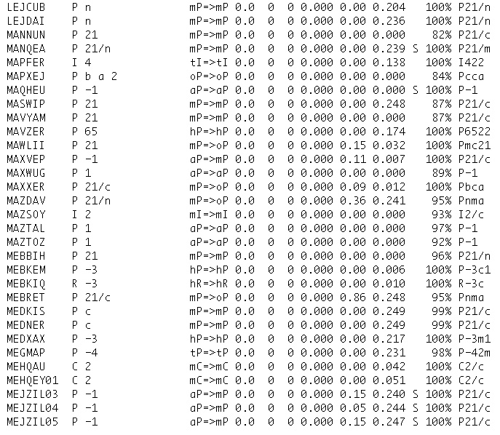
*
*

Slide 39
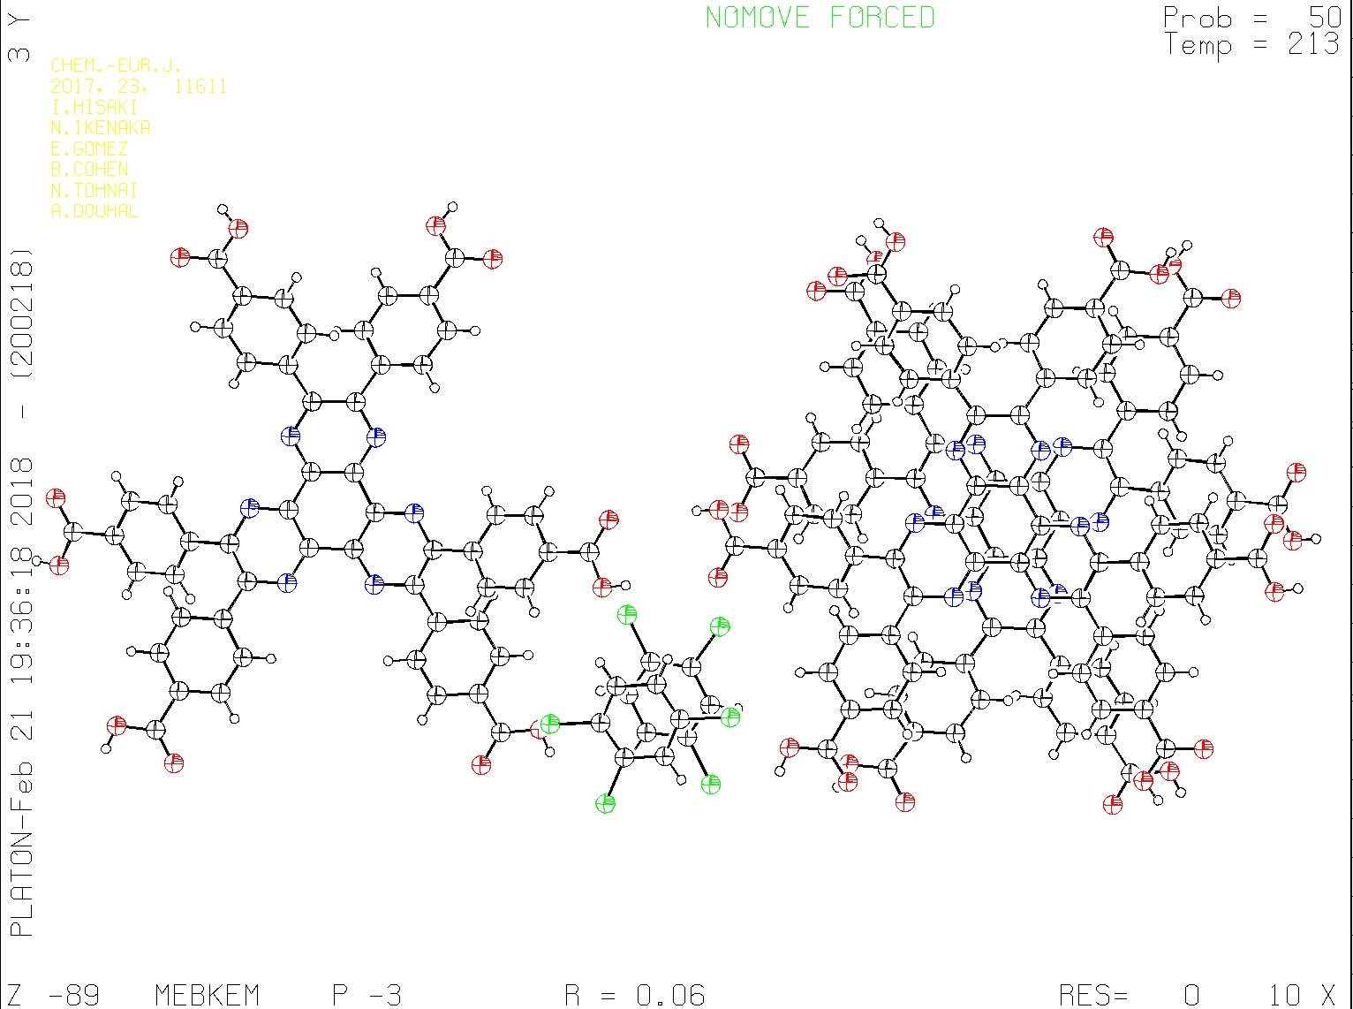
Chem. Eur.J. (2017) 23, 11611

Slide 40
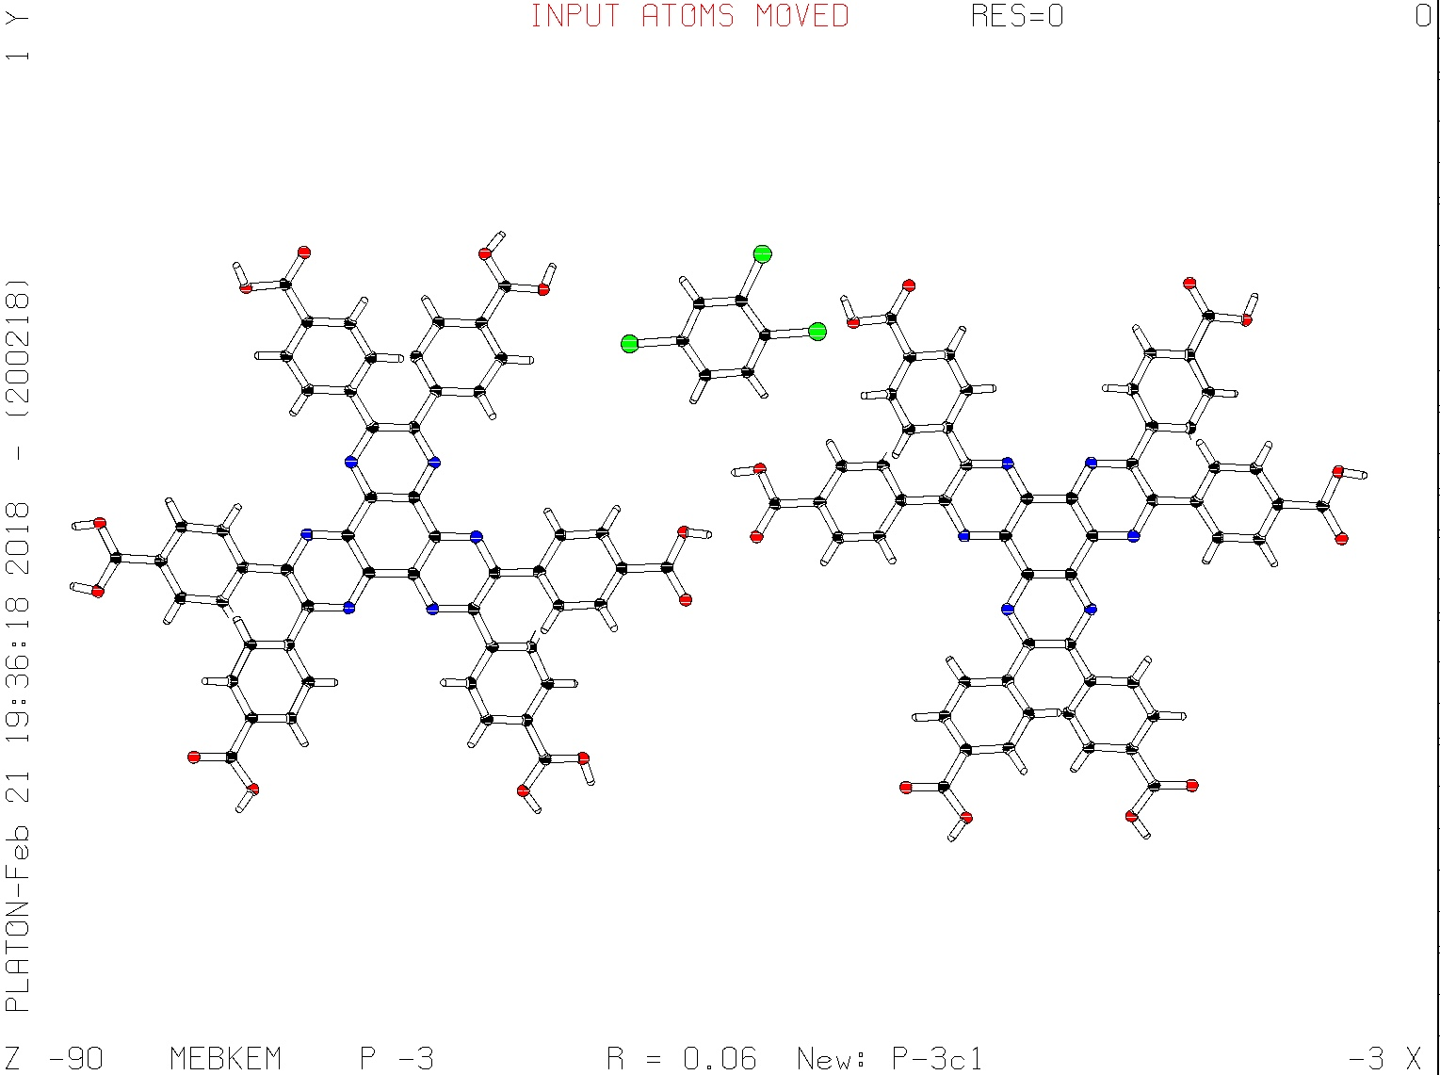
Change of LAUE class: Low to high trigonal -3 ➔ -3m1 , P-3 ➔ P-3c1

Slide 41
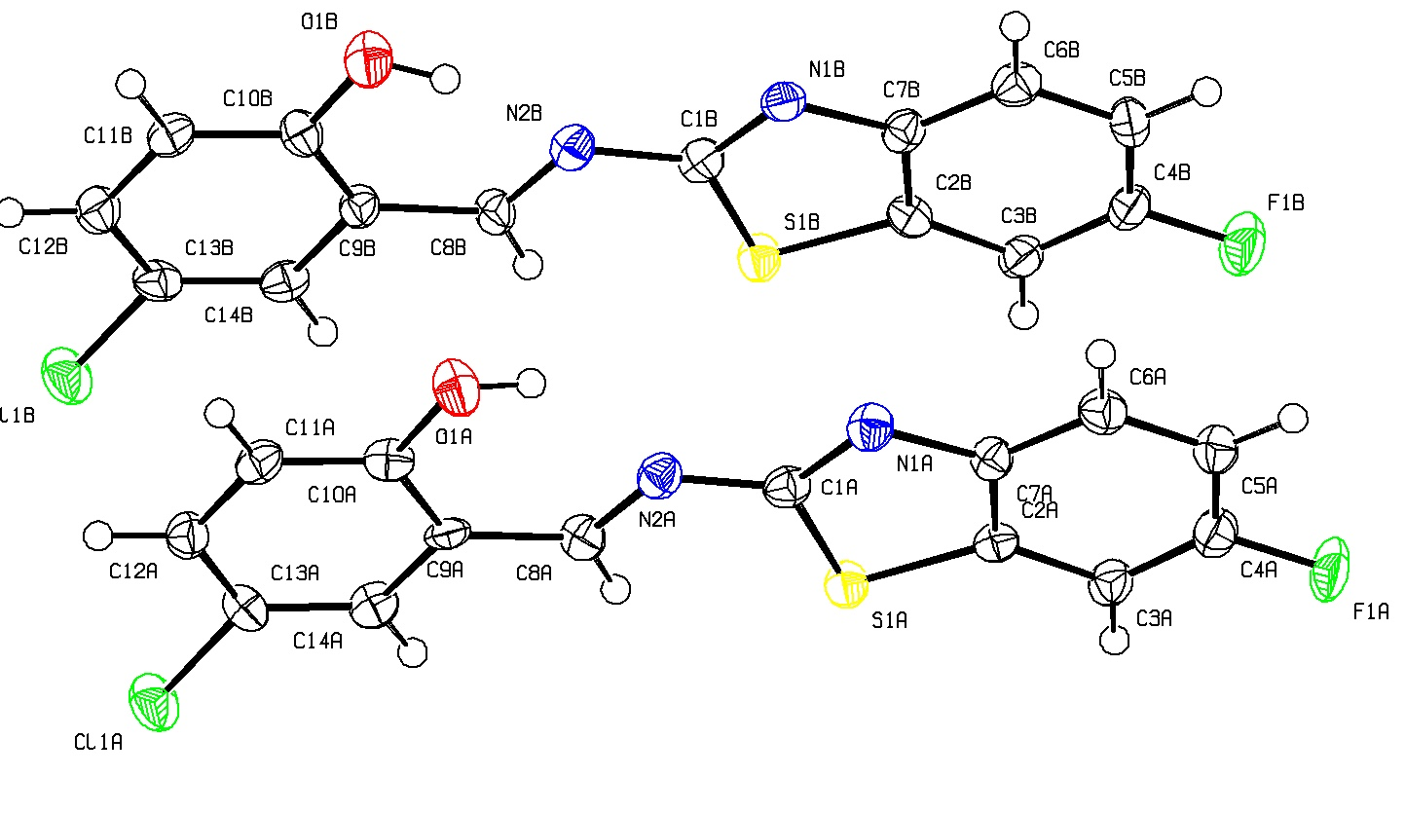
MAQHEU: J.Mol.Struc. (2017) 1142, 293
^{P-1}
P-1, Z’ = 2, R=0.10,wR2=0.33,S=1.070,rho(max)=2.5eA-3

Slide 42
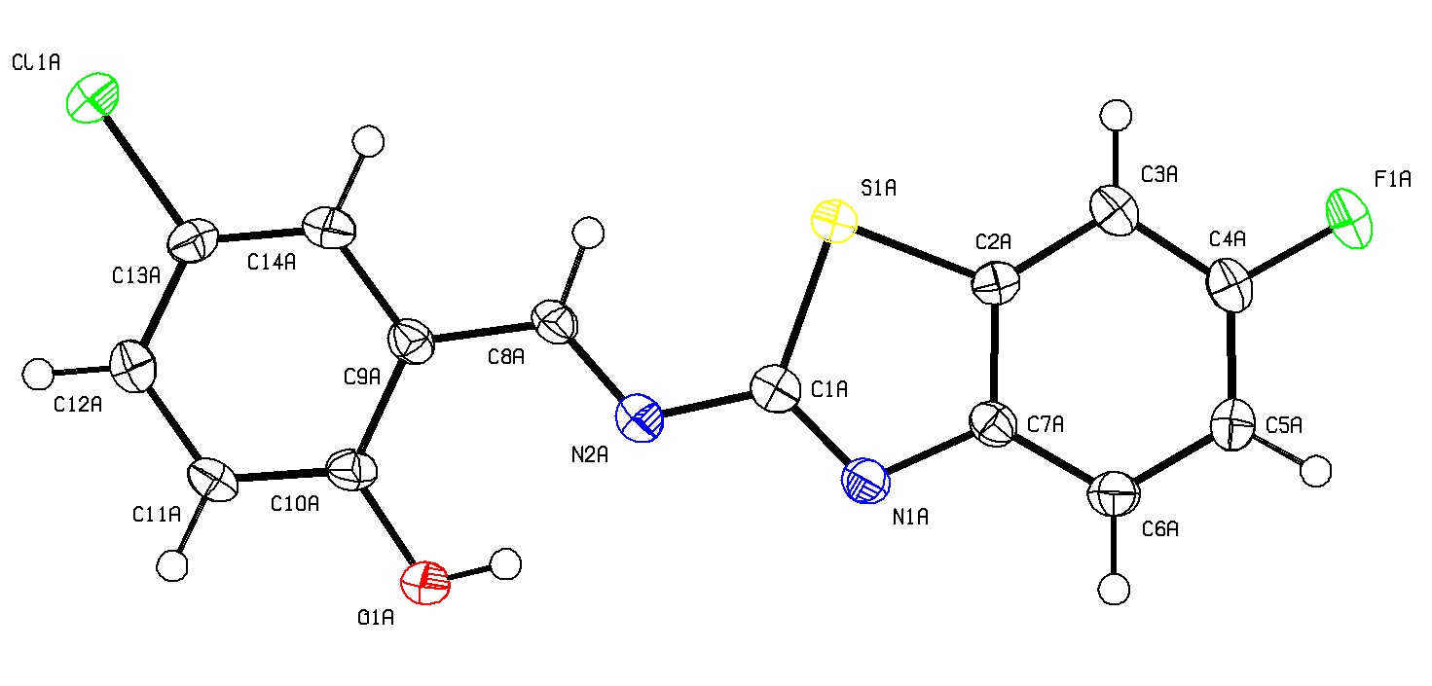
Cell halved. Based on ADDSYM and supported by hkl,l=2n:1 very weak
P-1, R = 0.10, wR2 = 0.27, S = 1.12, rho(max) = 2.5 e/A³
Strange residual density between molecules in
The a-axis diection.

Slide 43
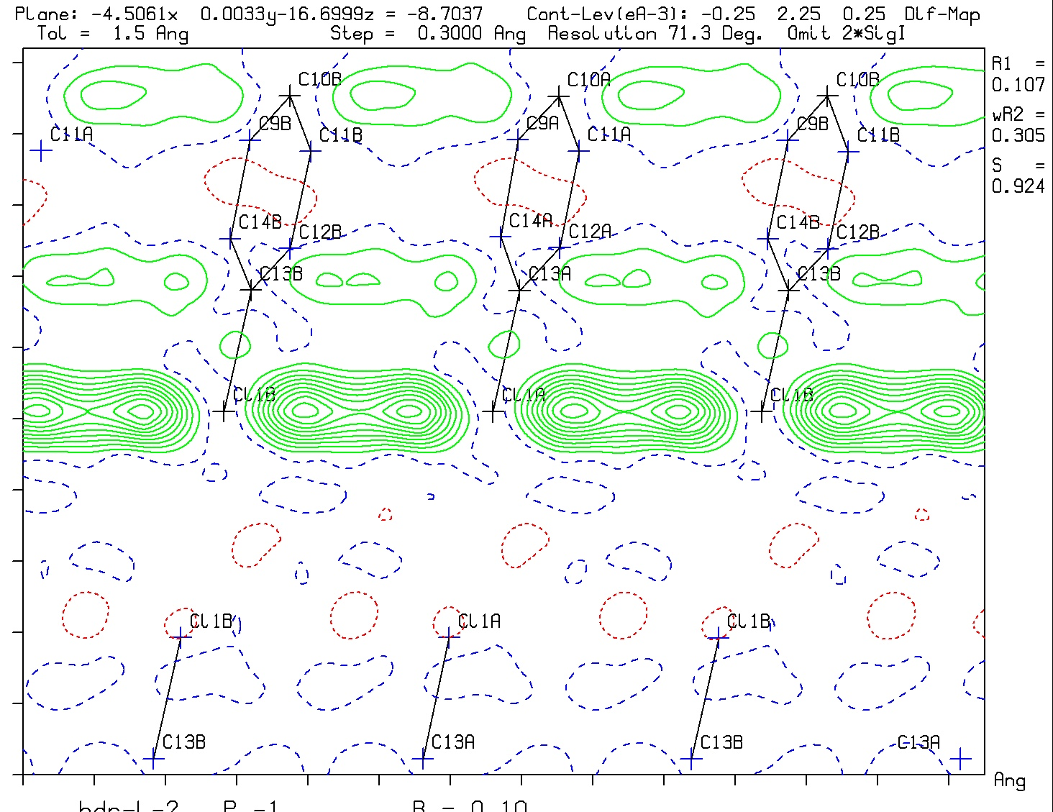

Slide 44
Residual Problems
Chemists Perception: Space Group Terror ….
Crystallographic data ‘hidden’ in suppl.mat.
and not readily available for the referee.
Pseudo-symmetry:
- chiral molecules with Z’=2,
- Angle close to 90 degrees but not exactly.
e.g. ‘Orthorhombic with 90 90 89.50(1)
No observed structure factors etc. available for detailed analysis.

Slide 45
The Problem of too High Symmetry
In particular with point detector data, it was easy to miss weak diffraction spots, resulting in artificial disorder (i.e. Averaged structures)
Pseudo-symmetry may lead to structure solutions in too high symmetry groups and artificial disorder.
Twinning may lead to similar issues
Some pseudo-symmetry cases next

Slide 46
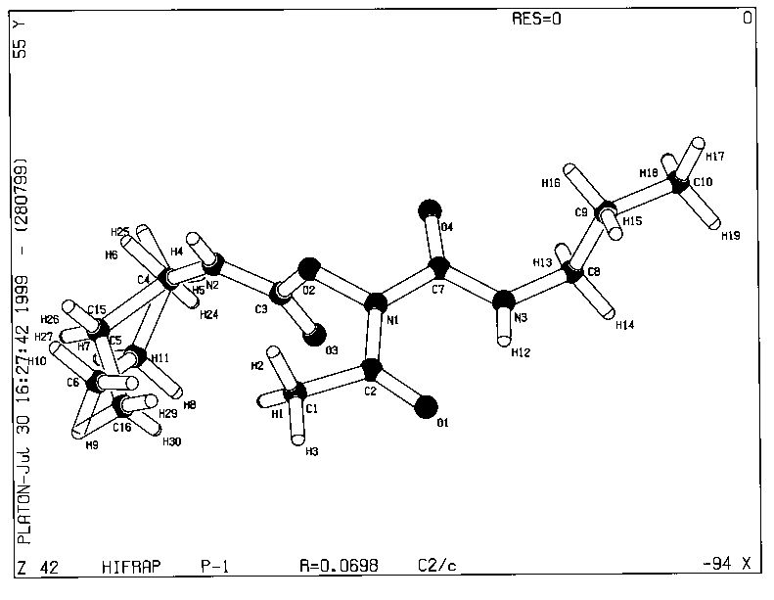
Pseudo Symmetry Example

Slide 47
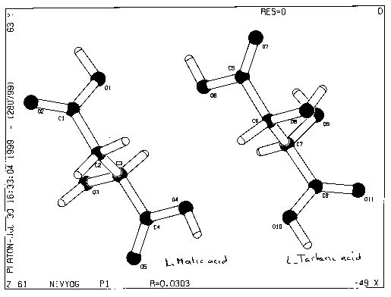
ADDSYM Analysis of Co-Crystal

Slide 48
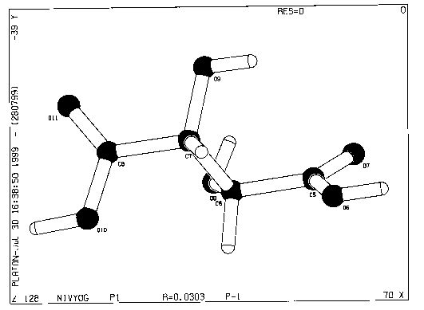
P1 to P-1 average ‘structure’

Slide 49
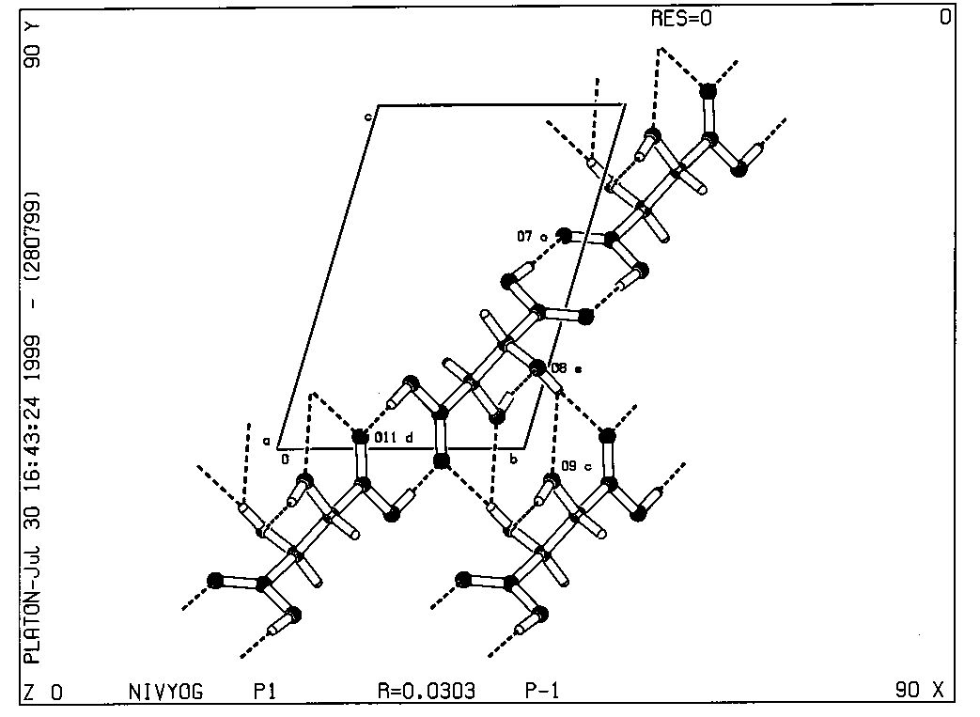

Slide 50
Comments
Hydrogen atoms and disordered atoms are not included in the ADDSYM analysis.
Pseudo-symmetry can be both problematic and/or interesting (Inorganic Structures)
Missed symmetry claims should always be supported with the primary reflection data.
In the past, those data were deposited (and some retyped in support of Dick’s early symmetry corrections).
Currently embedded in SHELXL cif’s (should not be deleted)

Slide 51
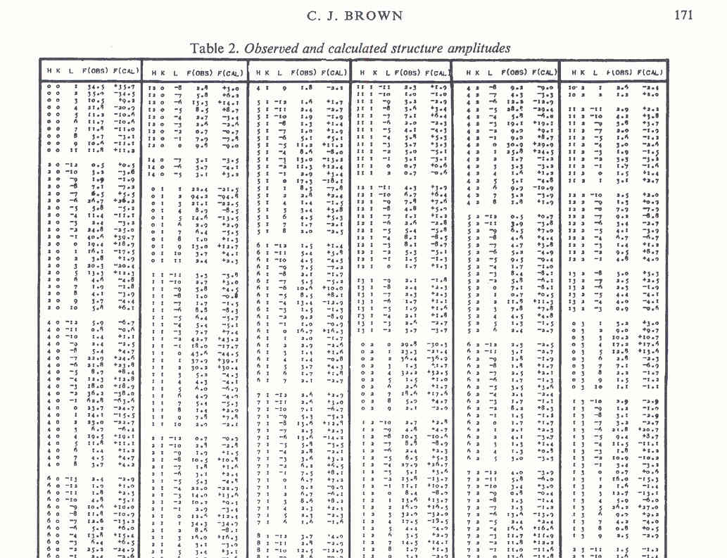
Past Archival of Reflection Data in a Publication (Acta Cryst.)
Notes:
51

Slide 52
Software Availability
Software to check for missed/pseudo symmetry is now readily available
e.g. www.platonsoft.nl/platon/
ADDSYM is included in IUCR/CHECKCIF
Proposed higher symmetry should either be implemented or convincingly discussed as pseudo-symmetry in a structure report.

Slide 53
40 Years of Marshing
Obvious Question:
Is the Missed Symmetry Issue now Solved after 38 years ?
Answer:
-Yes: For Publications in the IUCr Journals.
- No: For Publications in Chemical Journals.
It is amazing that, given the availability of tools like IUCr/checkCIF, the issue is still often ignored by authors, editors and referees

Slide 54
Thanks Dick for Keeping our Science to Standards and You for listening !
http://www.cryst.chem.uu.nl/spek
http://www.platonsoft.nl/spek
Email: a.l.spek@uu.nl

