Slide 1
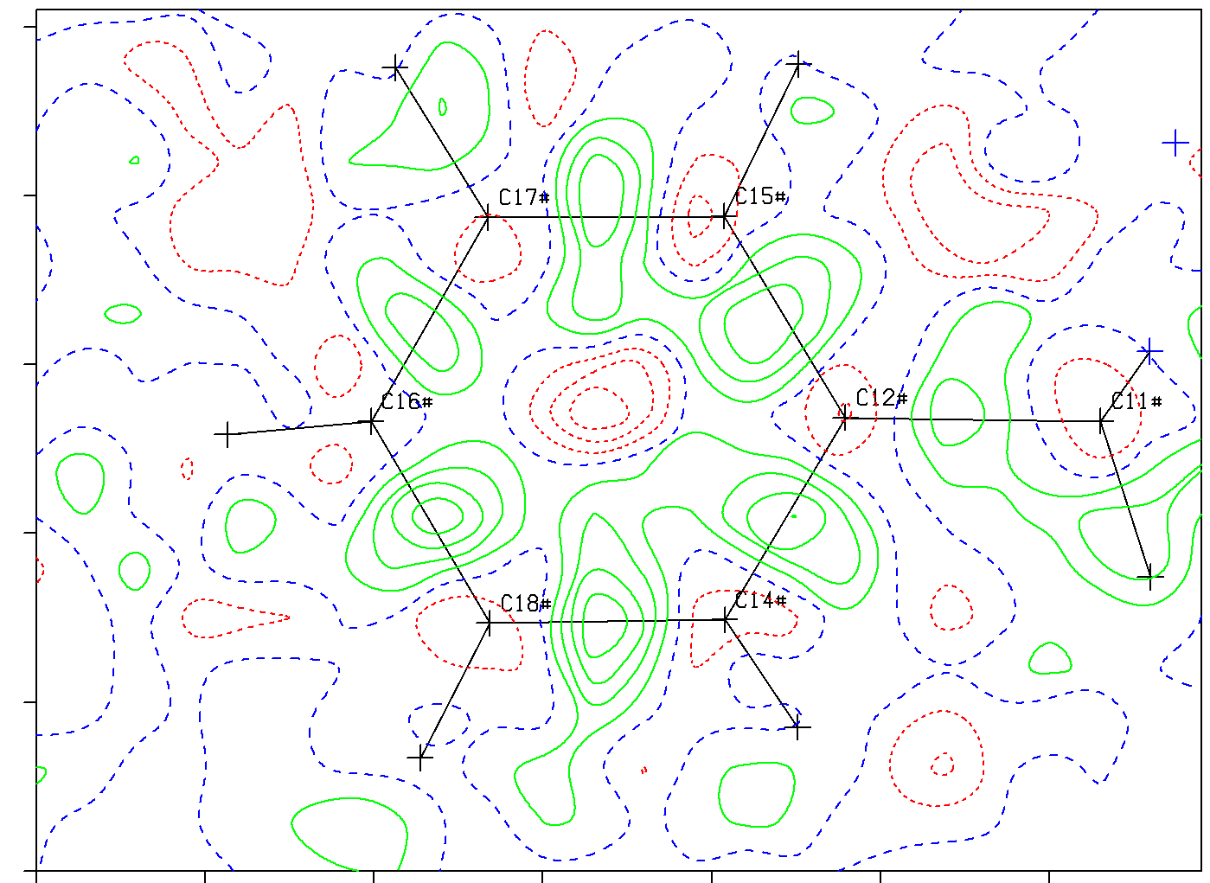
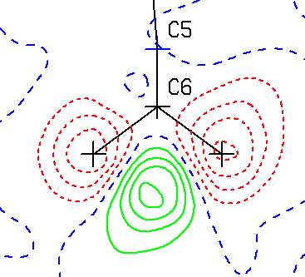
What Makes a
Crystal Structure Report Valid?
Ton Spek
Utrecht University
Utrecht, Netherlands
IUCr2017, Hyderabad, India, Aug. 27

Slide 2
The Central Message of this Talk
A valid crystal structure report should not only present the authors interpretation of the experimental data but also include the experimental data on which the report is based.
Sounds obvious, but not always done

Slide 3
A Valid Report should also include:
A discussion of all non-standard methods used in the data collection, data reduction and refinement procedure.
A discussion of major validation issues.
The set of refined model parameter values is insufficient for proper validation.

Slide 4
WHY?
All published crystal structures are archived in the CSD. Their quality ranges from excellent to questionable, but sufficient for their purpose.
Analysis errors are difficult to detect, investigate and correct by referees and users of the data without access to the experimental data.
Note: Many ‘new’ and ‘unexpected’ results turn out to be artifacts and wrong.
Full documentation facilitates independent use of the (possibly unique) data for follow-up research.

Slide 5
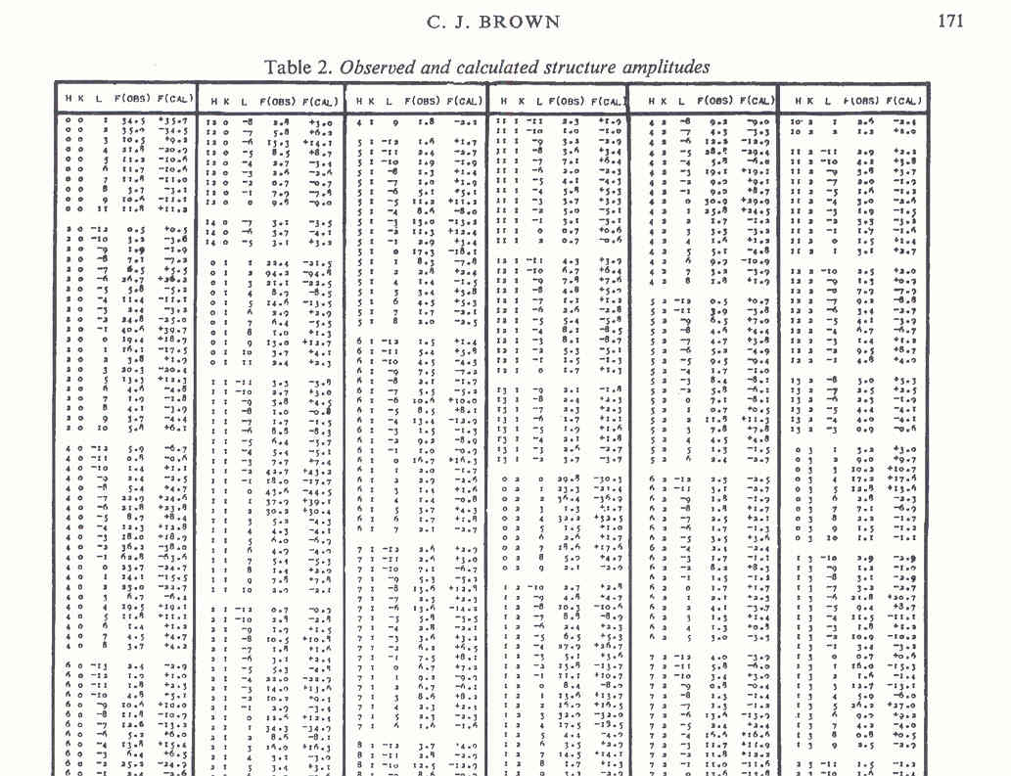
Archival up to the 1990s
Refinement results printed and retyped and checked for data entry in the CSD. Fo/Fc tables printed or archived as supplementary material. Five copies for referees! Difficult to do anything meaningful with it.

Slide 6
Archival starting in the 1990s
Computer readable CIF/FCF files introduced. CIF gradually required for publication and used for CSD archival. FCF deposition required for IUCr journals but rarely for chemical journals. CIF (parameter value) based validation introduced.
Starting around 2014: Embedding the refinement instructions and (unmerged) reflection data into the CIF. Fully archived with the CSD. Adopted now by major refinement programs, suitable for checking & reuse. Standard with IUCr journals.

Slide 7
‘res’ & ‘hkl’ file Embedding in CIF
SHELXL201x style: Include the res-file and hkl-file as value between between ;; for the datanames _shelx_res_file and _shelx_hkl_file. An FCF file can be calculated automatically with those data.
For Non=SHELXL Refinements: embed similar data with datanames _iucr_refine_instructions_detalls & _iucr_refine_reflections_details or as a CIF style reflection loop.
_iucr_refine_fcf_details

Slide 8
Selected Validation Tools
R-value checks for ‘quality’
ORTEP plot to check for unusual ellipsoids
Analysis-of-Variance (based on CIF + FCF)
CSD search & MOGUL for similar structures
The VOID/SQUEEZE test for completeness
Difference electron density map for ‘peaks’
IUCr-checkCIF Validation Report
Experience with pitfalls and chemical insight

Slide 9
R₁, wR₂, S & Weighting Checks
R-value checks measure the fit of the refined structure model with the observed data, but not necessarily the correctness of the model.
Errors with atom type assignment and misassigned hydrogen atoms may have little effect on R in the presence on a heavy atom in a structure such as Uranium, but with large chemical implications.

Slide 10
Ellipsoids showing unresolved problem
JACS (2000), 122, 3413 [P1,Z’=2 => P-1, Z’=1]

Slide 11
Difference Electron Density Map
Should be essentially flat with density excursions of |ρ_{min}| ~ ρ_{max} , say < 0.5 eÅ⁻³
Deviations may be due to (not exhaustive)
  Absorption artifacts (pos/neg near heavy atoms)
  Unresolved twinning
  Unresolved disorder
  Unaccounted for solvents
  Wrong atom type assignments
  Missing or too many H-atom
  ‘Bonding’ density on bonds

Slide 12
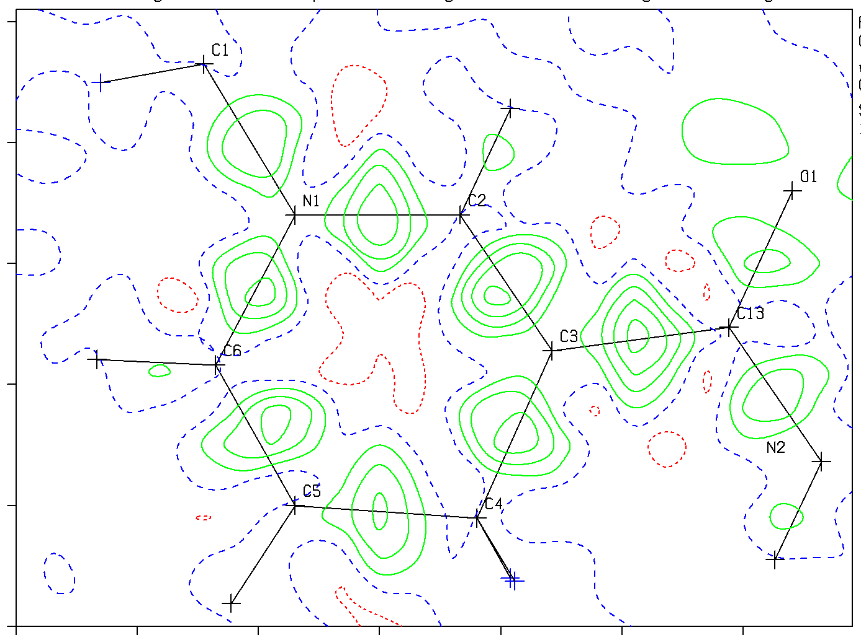
Density on Bonds for a Quality Structure
Difference density map for AIM style refinement

Slide 13
Wrong Hydrogen Atom Positions
Red:
Too much
density
In model
Green:
Too little
density
In model

Slide 14
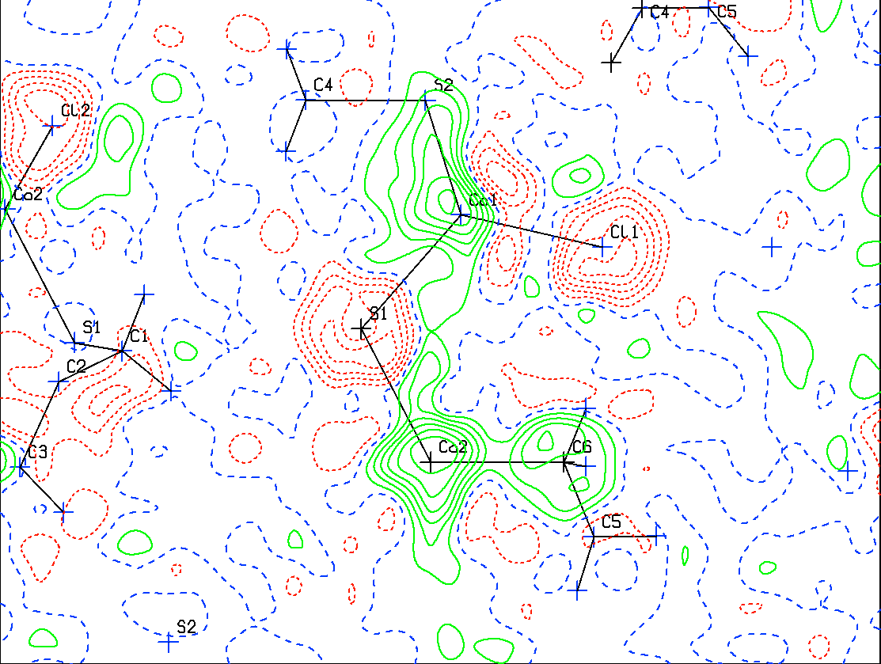
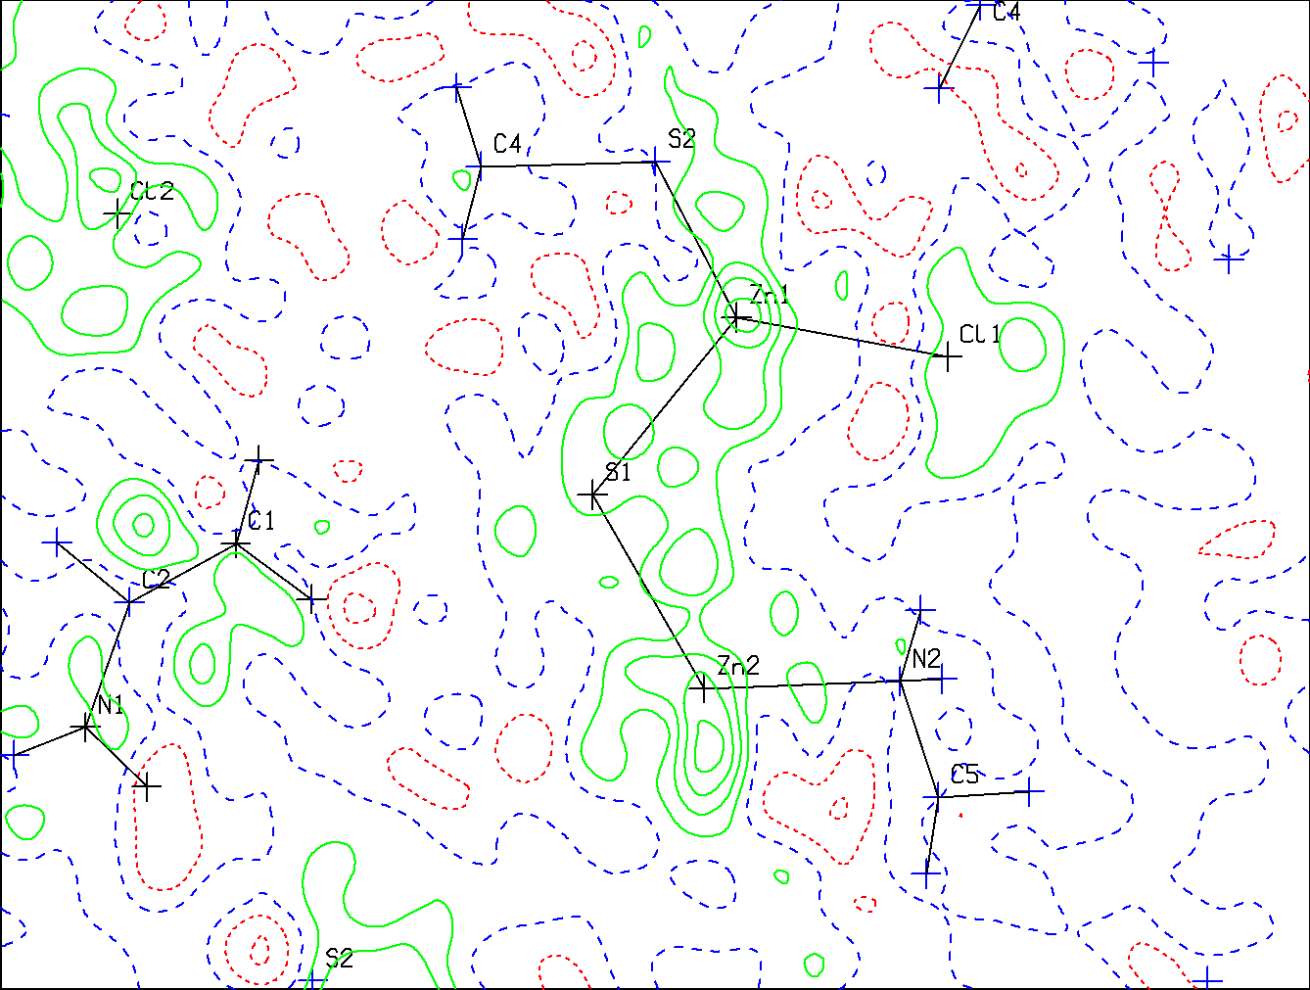
Wrong Atom Type Assignments
False Co-Complex ===➔ Zn-Complex
Contours at 0.1 e/Å³

Slide 15
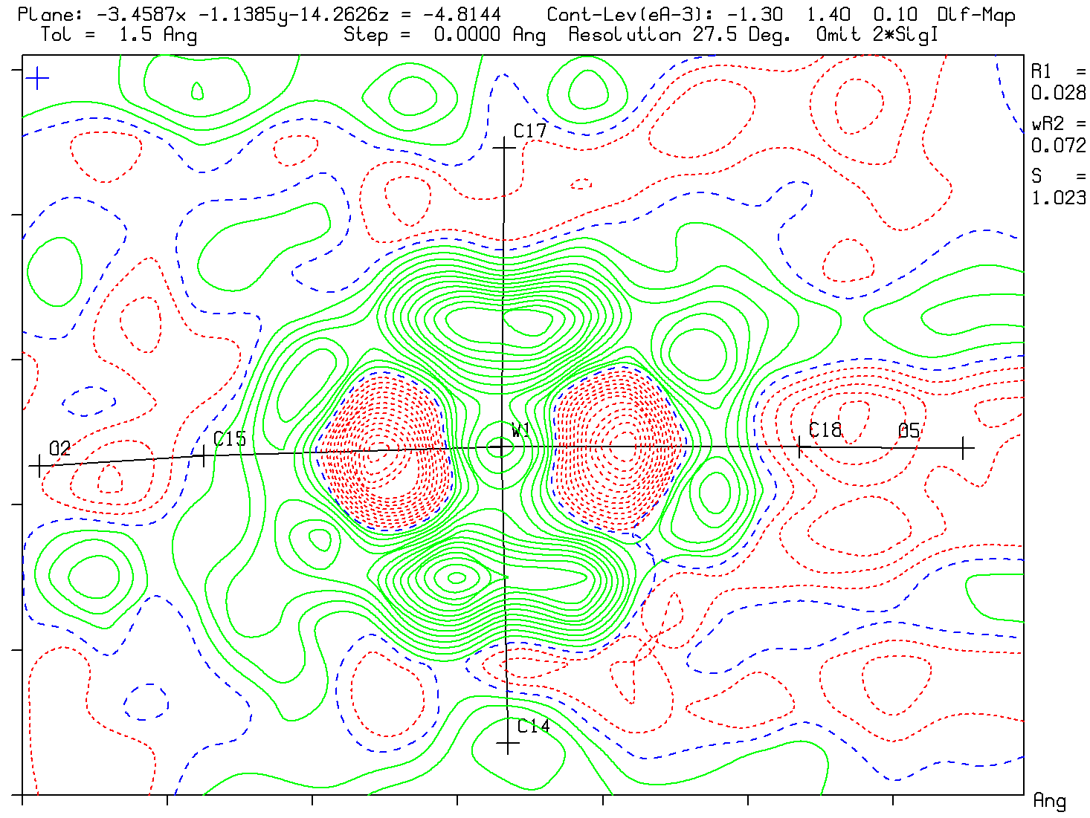
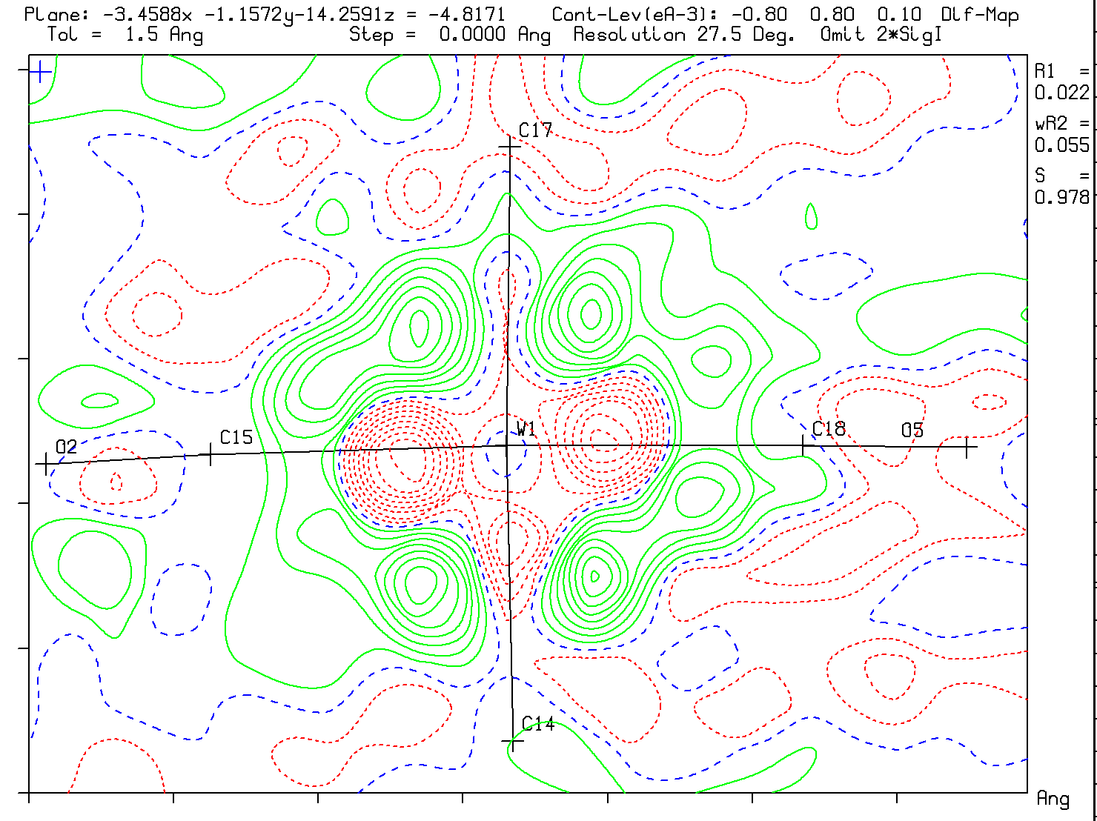
Absorption Artifacts (μ=6.45mm⁻¹)
file:///.file/id=6571367.25963400
Typical Difference map without
Absorption correction
Max density 1.40 eA⁻³
Slight improvement after multiscan
Absorption correction
Max density 0.80 eA⁻³

Slide 16
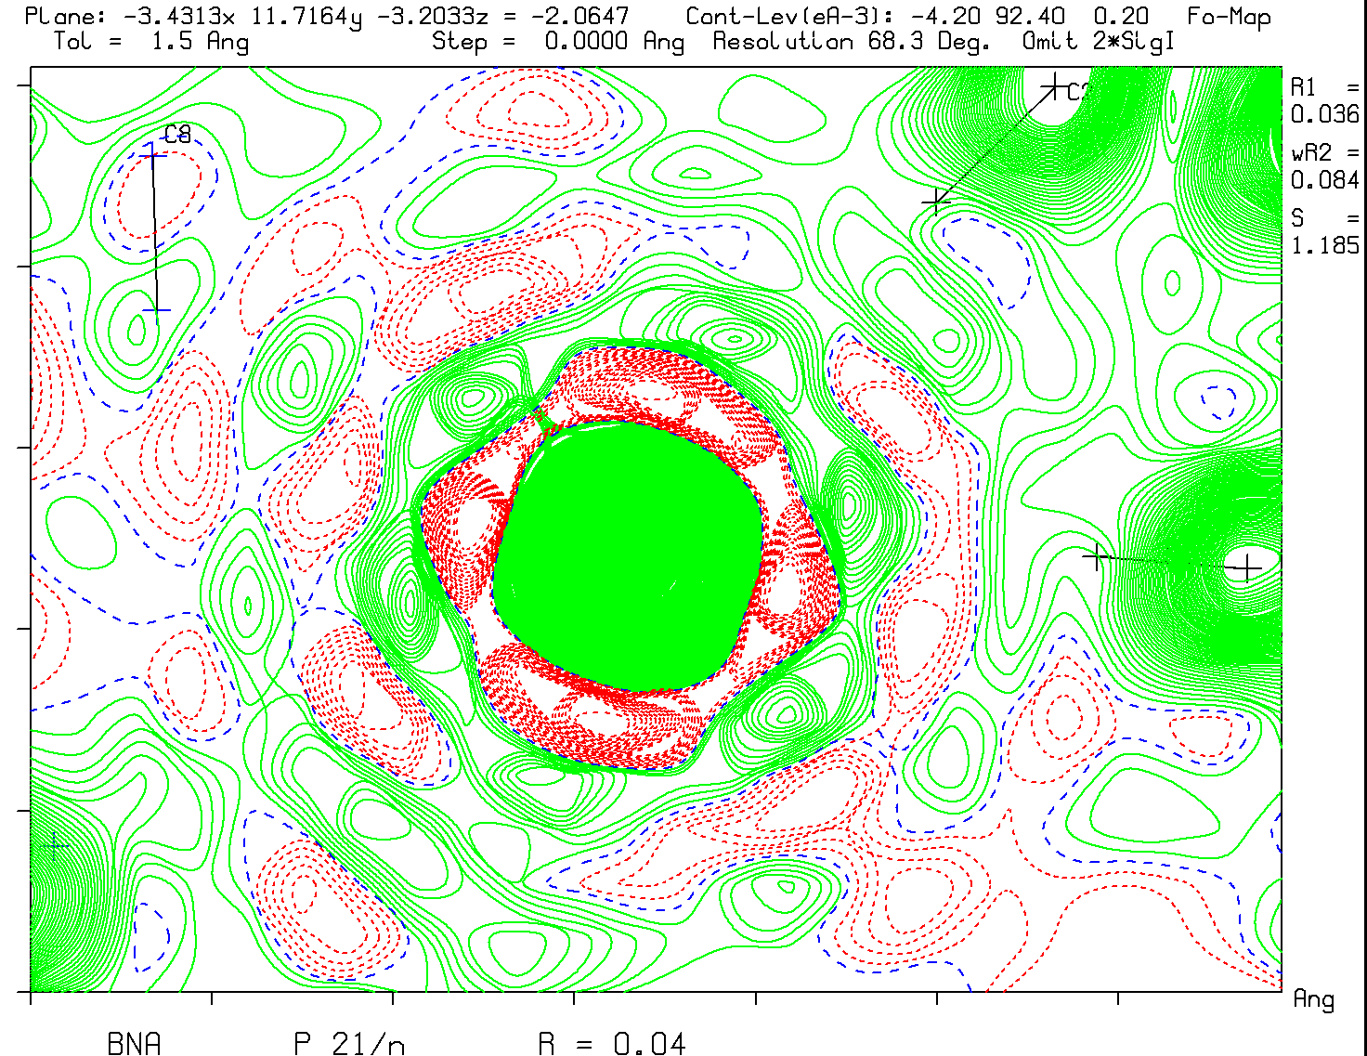
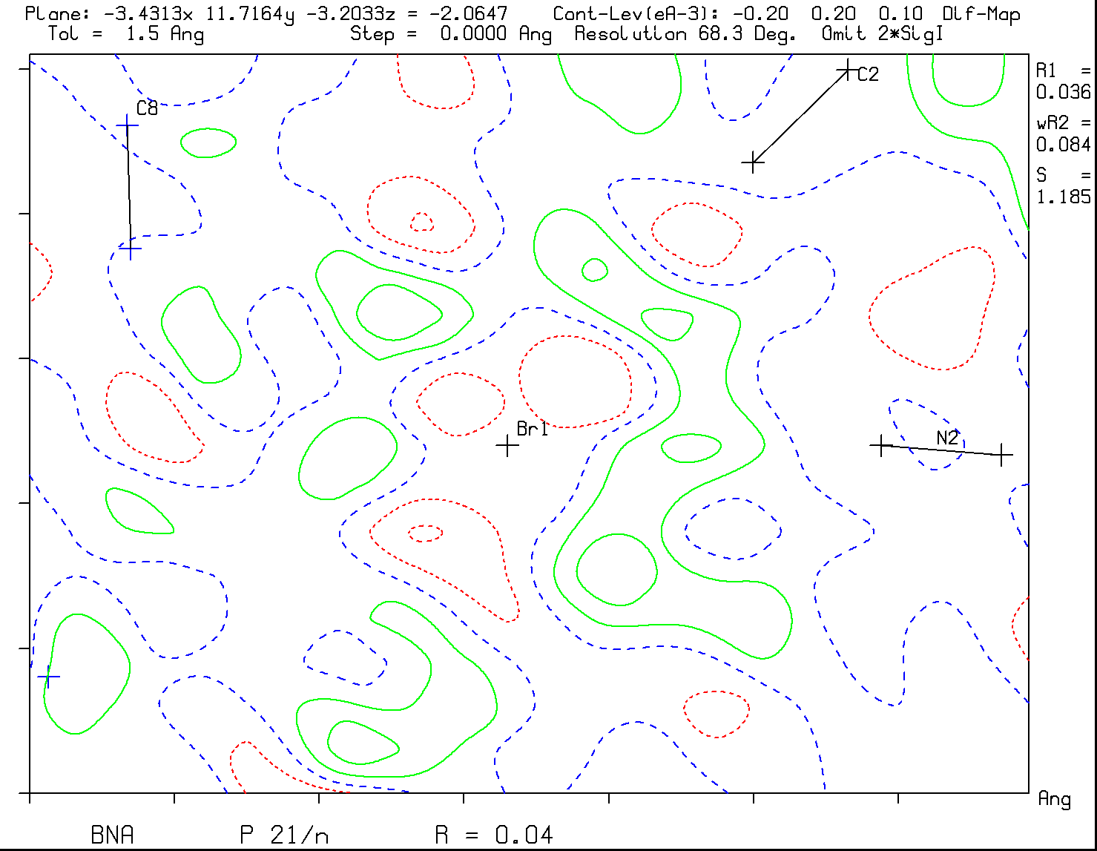
F(obs) and F(obs)-F(calc) Maps
Large peaks in a difference map are not due to truncation ripples
Br
Br
Note the truncation ripples in the F(obs) map and absence in the F(obs)-F(calc) map

Slide 17
Example: Validation of a Crystalline Sponge Method based Structure
Fujita et al. (2013) introduced a potentially interesting new approach to obtain structural information for difficult to crystallize compounds
A MOF with suitable channels is used to soak in a molecule of interest for structure determination
Chem. Asian J. (2017), 12, 208-211 provides a good example of a suitable MOF, [CuBr(benzene-1,3,5-triyl-triisonicotinate)]_{n}, soaked with 1-acetonaphthone as guest.

Slide 18
Replace CS₂ with Guest
Two independent infinite channels A & B (~700 Å³ each)

40%
Solvent
Channel


CS₂

Slide 19
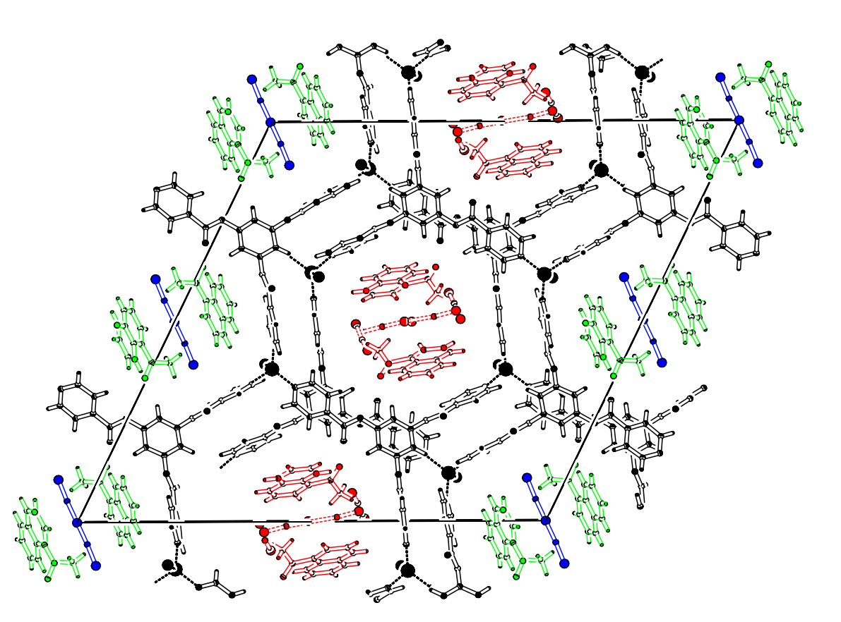
Host + Guests in MOF Framework
Guests are:
1-acetonaphthone
CS₂
93K
P2₁/c
R1 = 0.05
wR2 = 0.18
S = 1.066
Ρ_{min} = -1.26e/Å³
Ρ_{max} = 1.74e/Å³

Slide 20
Validation Report
There are only C & G Alerts that ask for attention
The largest residual density maxima, up to 1.71e/Å³, are near the CS₂ solvent molecules, suggesting residual unaccounted for solvent disorder.
High SHELXL optimized second weight parameter.
Unusually large number of 355 missing reflections
Various constraints and restraints are used on bonds and displacement parameters

Slide 21
Scientific Questions
What is the quality of the MOF framework
What is the saturation in the A & B channels with the target guest molecule (Reported as 80% and 100% respectively)
The amount of residual CS₂ solvent in the A & B Channels.
The quality of the geometry of the target guest molecules.

Slide 22
The VOID/SQUEEZE Test
PLATON/SQUEEZE/SHELXL201x unrestrained refinement based on the MOF structure with non-framework atoms removed.
Convergence reached at R₁ = 0.0226, wR₂ = 0.0644, S = 1.085, -0.35 < Δρ < 0.43 e/Å³. Reflection data of high quality. Framework model good.
The solvent channels A & B contain about the same amount of ‘electrons’ (221 & 223 e).
Conclusion: The published disorder model is incomplete with R₁ = 0.0529, wR₂ = 0.1818, S = 1.066, Ρ_{min} = -1.26e/Å³, Ρ_{max} = 1.74e/Å³

Slide 23
New test-model refinement
The populations of both main guest molecules are now refined, keeping the authors constraints and restraints.
Populations of the target molecules converged to 0.793(4) in the A channel and 0.769(5) in the B channel.
A slightly better convergence was reached at R₁ = 0.0509, wR₂ = 0.1705, S = 1.067, Ρ_{min} = -0.93e/Å³, Ρ_{max} = 1.76e/Å³

Slide 24
0.1 Å⁻³
A
B
93K
50%
0.793(4)
0.769(5)

Slide 25
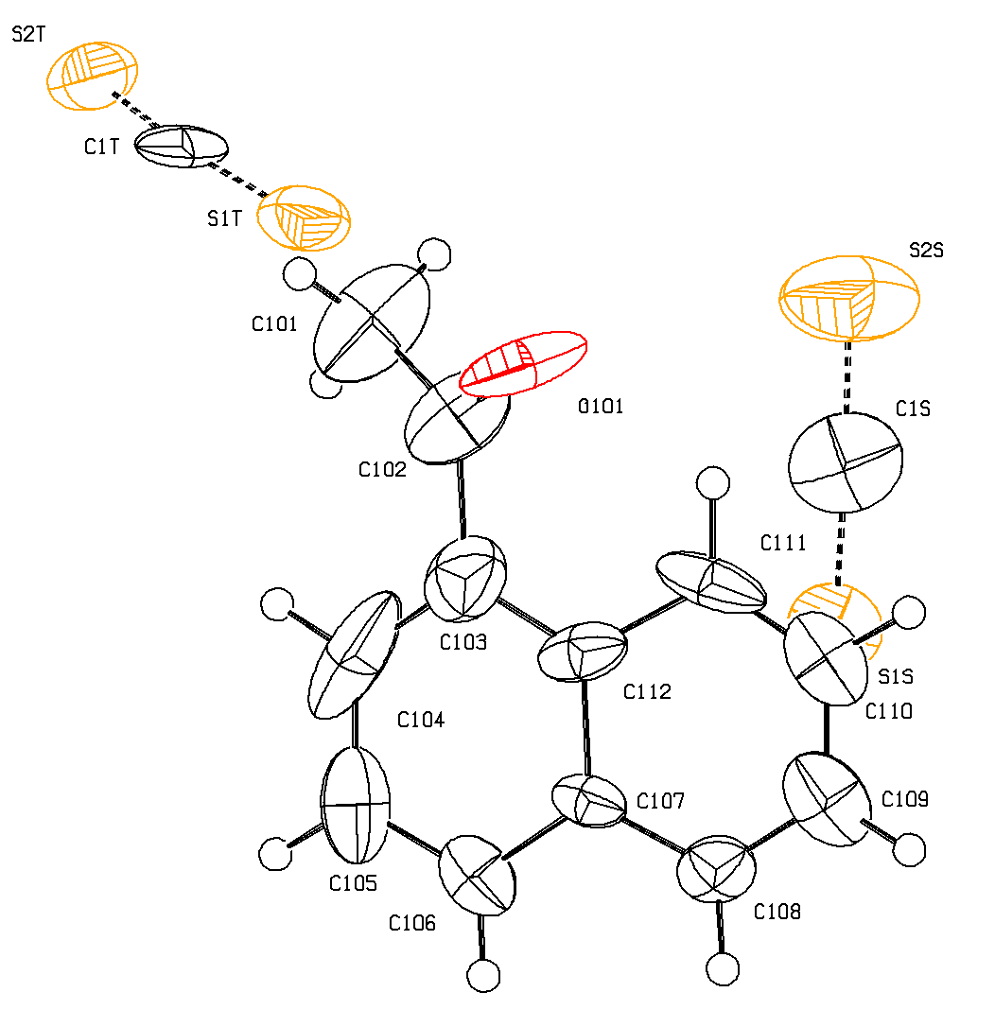
Residual Disordered Solvents in the A Channel
~0.2
~0.44
~0.8

Slide 26
Evaluation
Residual solvent coinciding with the target guest may seriously effect the quality of the geometry of the guest.
C-C bonds in the A channel guest deviate by -0.10 to 0.06 Å from expected values
It might be difficult to distinguish between N, C or O in a particular site without prior information as might be the case with natural products.

Slide 27
Valid versus Value
A structure report is ‘valid’ when the reported results include the experimental data, the authors interpretation of the data, the way that those results were obtained and all non-standard issues discussed.
The value of the report depends on what new information is obtained, relevant for the related research. The value of heavily constrained and restrained structures might be limited.

Slide 28
Future
Not all issues with a reported structure can be resolved with the availability of the set of unmerged reflection data.
Eventually, the diffraction images may be needed for proper analysis of an analysis issue. An IUCr committee works on archival options of images.
Would be nice when image processing software provided a summary report of the images to be appended to a CIF, in particular about features not included in the integrated reflection data (streaks, additional spots etc.)

Slide 29
Thank you!
Related Paper:
A.L.Spek, Inorg. Chim. Acta (2017), December
http://dx.doi.org/10.1016/j.ica.2017.04.036
PLATON Workshop, 28/29 Sept., Berlin, Germany
Details:
Dgk-home.de/aks/ak6

