Slide 1
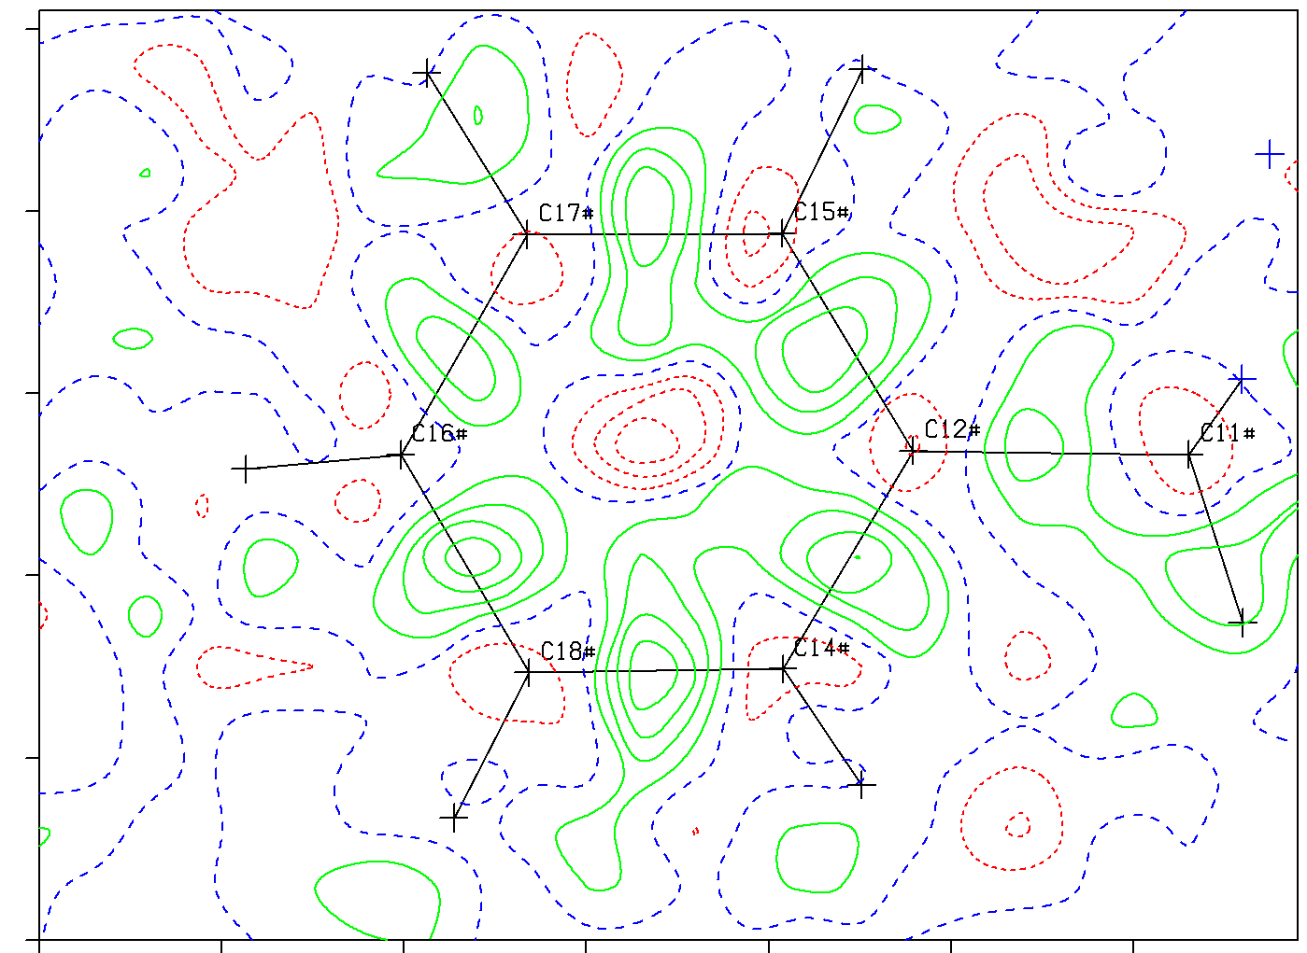
What is Needed for Proper Structure Validation and How to Act upon Validation ALERTS
Ton Spek
Utrecht University
The Netherlands
ACA-Denver, july 26, 2016
Notes:
Thanks to the organizers

Slide 2
CIF was Introduced in 1991
The main target of many X-ray studies is the 3D molecular structure in the form of coordinates, displacement parameters, bonds and angles etc.
The computer readable CIF file was introduced in the 1990’s as a replacement for the printed results.
CIF facilitates easy data transfer, archival (CSD), geometry calculations, graphics, publication (Acta Cryst.) and validation (checkCIF) of the results of a crystal structure.
A CIF, in its basic form, mainly reports the authors interpretation of the experimental diffraction data
determination

Slide 3
However ….
A CIF in its basic form is insufficient for proper validation of a structure report, in particular in case of unusual, reported or claimed, results.
What is needed is detailed information of the refinement model, including the Fobs², Fcalc² and sigma(Fobs²) listing file (FCF).
An FCF allows for statistical analysis of the fit of the authors structure model on the reflection data (missed twinning, absolute structure etc.).

Slide 4
Good Scientific Practice
In addition, it is good scientific practice to also supply and archive the unmerged set of observed data on which a study is based. The subject material might be unique or difficult to obtain !
This practice is now fully implemented in the SHELXL2014 refinement program with the embedding of the .res, .hkl (and .fab) files in an extended CIF format file. Other packages follow.
This allows for an alternative refinement with the archived data (e.g. A disorder model refinement versus a published SQUEEZE based refinement)

Slide 5
IUCr checkCIF validation
Structure validation based on a CIF was pioneered by the IUCr + Acta Cryst. C with the creation of a validation report, also starting in the early 1990’s
Most journals currently require validation reports created by the IUCr checkCIF server for structure reports.
Significant knowledge of the crystallographic procedures (and underlying chemistry) will still be needed for the proper interpretation of and acting upon ALERT messages that come in levels A, B, C & G
Unfortunately, not all authors, referees and chemical journals appear to have that knowledge available.

Slide 6
ALERTS A,B,C,G Level
All ALERTS should be inspected and possibly acted upon (in particular A-ALERTS with a suitable response)
The on-line documentation of an ALERT should be consulted.
Not all ALERTS are ERRORS but may point to interesting or unusual issues or just offer relevant information.
A combination of low level ALERTS (e.g. C or G) may point to serious problems as well.
checkCIF is a learning process and is still developing
Following is an interesting case study that illustrates the need for a continuous update of checkCIF

Slide 7
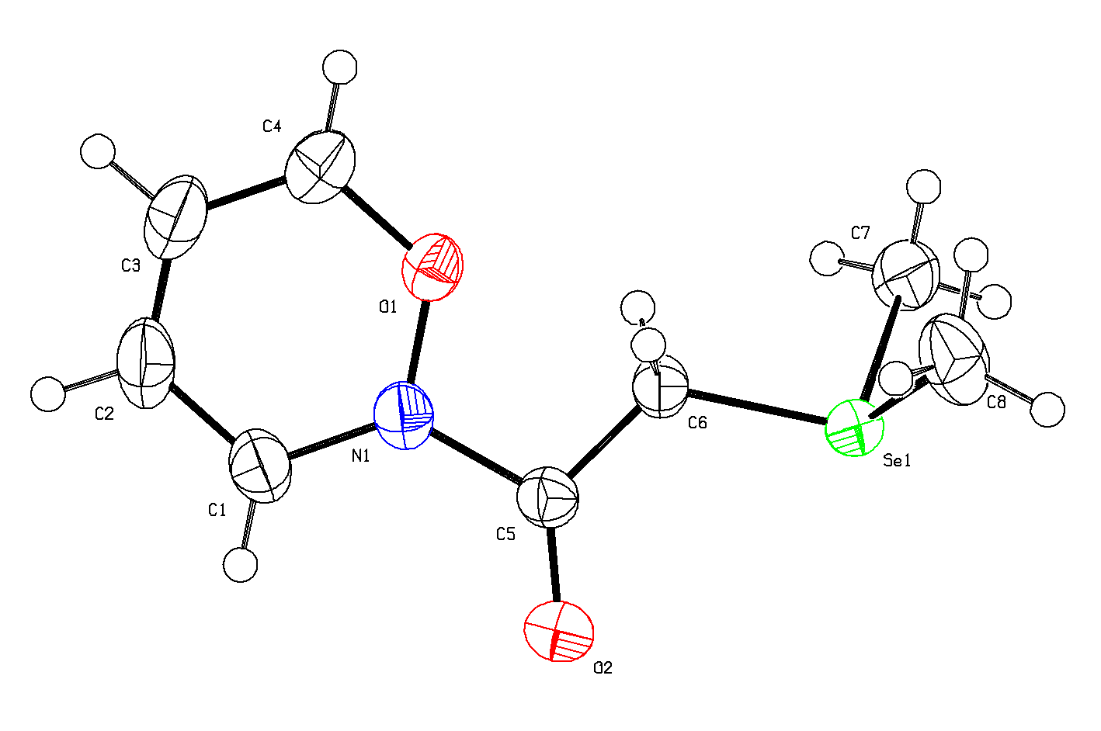
QUESTION: Is this Structure Correct ?
The Aug. 2015 IUCr/checkCIF reports no serious ALERTS
R1 = 0.0111
wR2 = 0.0339
S = 1.042
Rhomin -0.43
Rhomax 0.47
checkCIF:
No Voids
No Unusual Contacts
Slightly high Difference Density Range
What would a synthetic
chemist’s comment be ?

Slide 8
No, The Structure was Deliberately INVENTED
- This devious structure was
clevery created by Natalie
Johnson et al., Newcastle, UK,
aiming to beat checkCIF & FCF.
- Her point was that it is easy
to invent a fake data set that does
not raise checkCIF ALERTS.
- So does the deposition of an
FCF avoid frauded structures?
- She even created diffr. Images.
- Presented as an excellent
Poster during ECM-2015, Croatia.
But: Every crime leaves its traces …..
and we can learn from them.

Slide 9
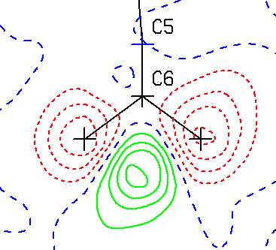
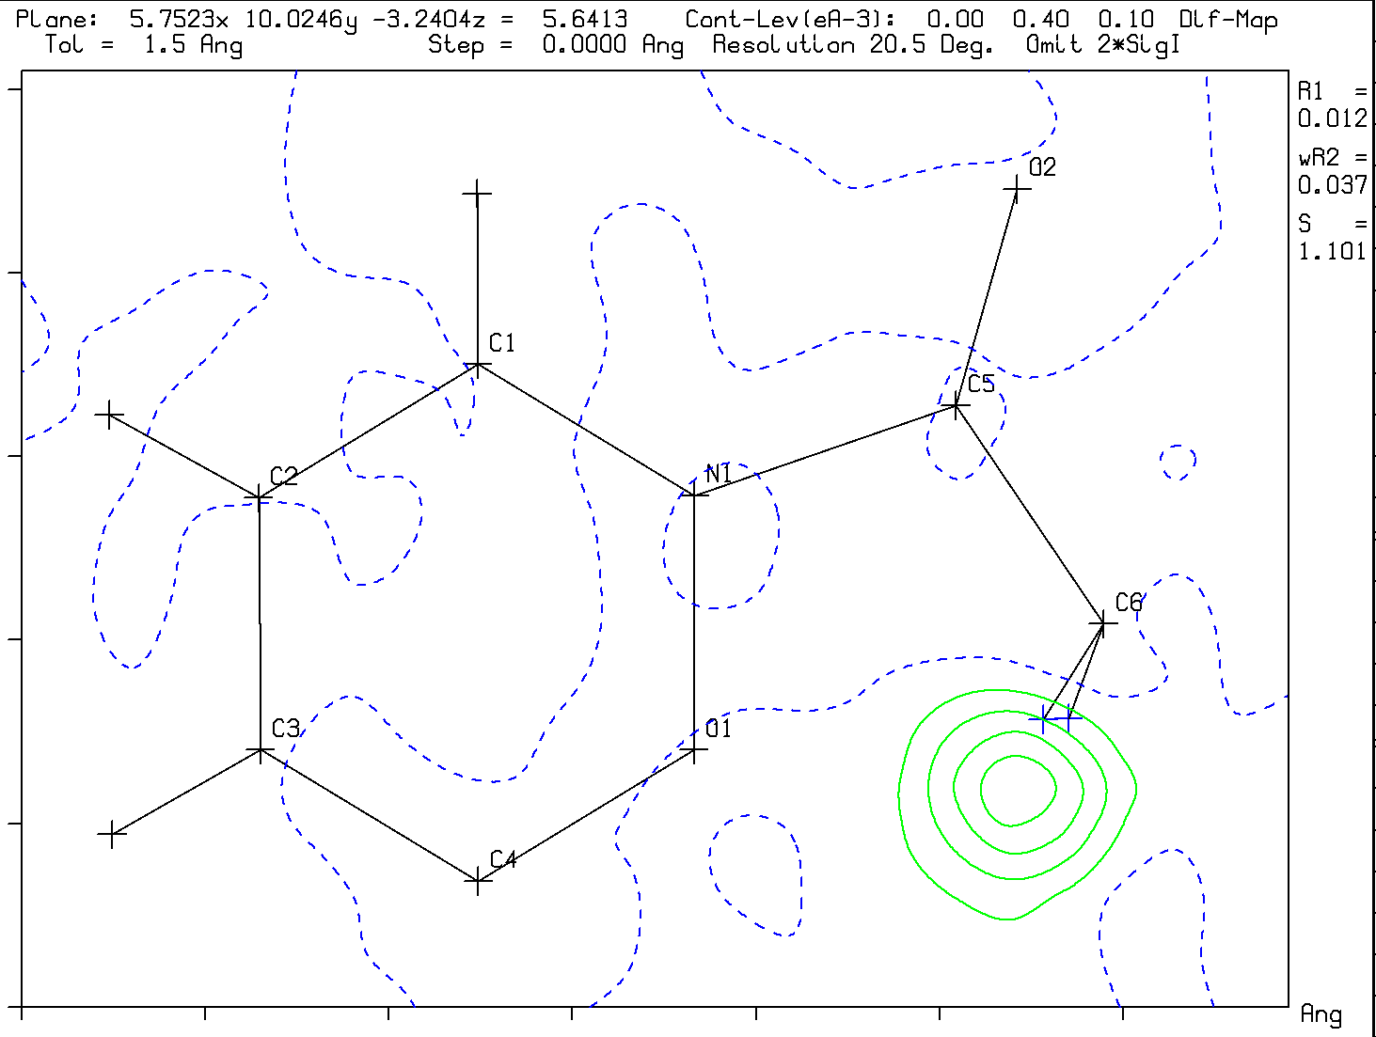
Clear traces of the ‘Crime’ are
in the Difference Density Map
Expected type of difference map
Difference map in the CH2 plane
The CH₂ Hydrogen atoms at calculated
positions are definitely not in F(obs)
Unusual Actual difference map Density

Slide 10
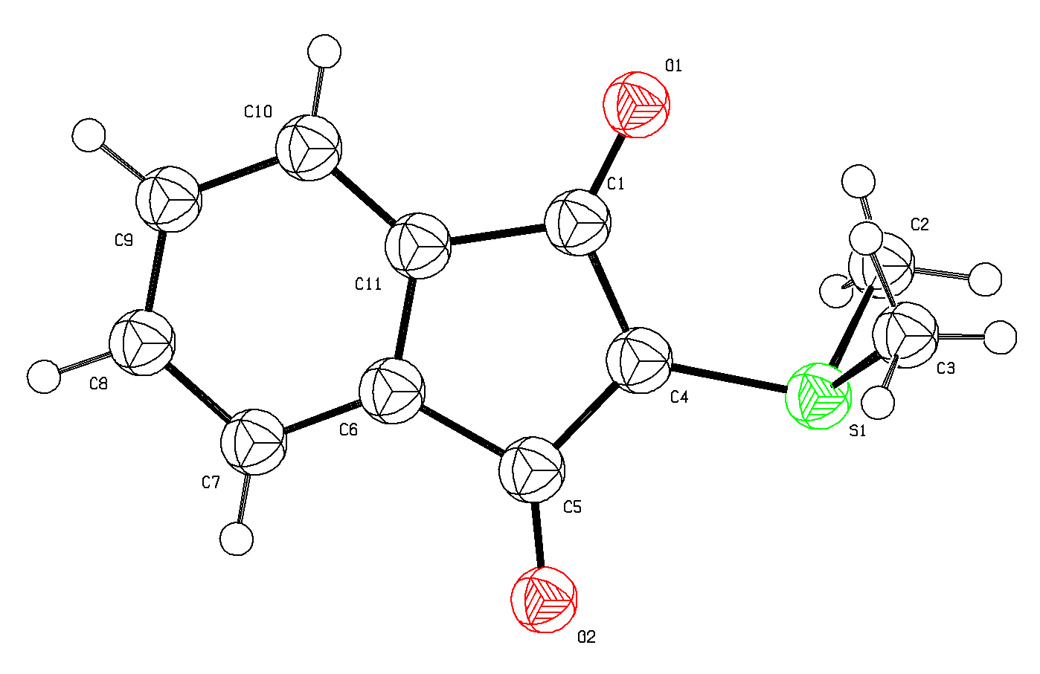
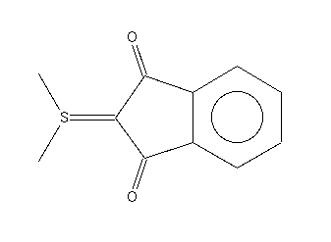
How was Structure ‘Natalie’ created ?
YLID
YLID
‘Starting Material’ (Bruker)
Chemical issue: Se⁺
No example in the CSD
for the 6-membered ring
System
Mogul : Se – C outlier
Se
NATALIE

Slide 11
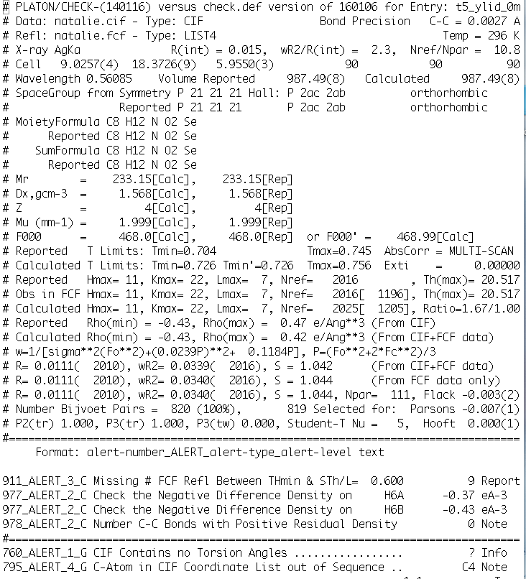
CURRENT
PLATON/CHECKCIF
VALIDATION
REPORT FOR
‘NATALIE’

No H-density

No Density on Bonds

Slide 12
On the Positive side
(Reported) attempts to beat checkCIF are extremely helpful (thanks Natalie!), not only to address fraud attempts (which have unfortunately happened in the past) but also as a source for additional tests for the detection of author errors.
The two added ALERTS are excellent examples for this.
The newly introduced ALERTS are helpful for the detection of accidently misplaced Hydrogen atoms.
Analyses of the FCF may give further clues as shown next.

Slide 13
Look in Detail at the Reflection Data
Partly, such information is in the .ckf file created by PLATON/checkCIF from the FCF data or use e.g. tools available in PLATON
The Normal
Probability PLOT is
not perfect for
the fake ‘Natalie’
structure with its low
R-factor values

Slide 14
Look at the sigma(I) versus sqrt(I) Plot
‘Nardelli’ (Bruker) versus non-fake Bruker data
Poisson Statistics

Slide 15
Look at log(Iobs) versus log(Icalc) Scatter Plot
Log(Iobs)
Fake Data
Log(iobs)
Real Data
Log(Icalc)
Log(Icalc)
Little speading at low I
Normal spreading at low I

Slide 16
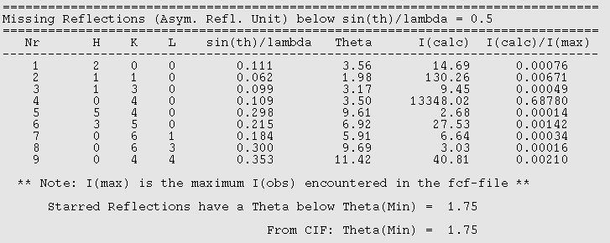
Inspect the List of Missing Reflections

Slide 17
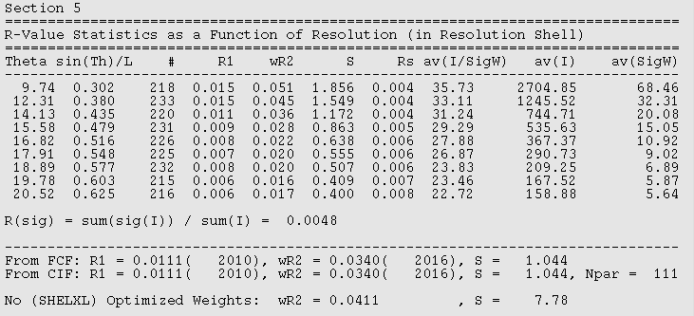
Inspect R-value as a function of sin(theta)/lambda
Note the very low wR₂ values at higher resolution

Slide 18
FCF-Validation (in .ckf) adds:
Analysis of the quality of the refinement
Analysis of the difference map (peaks)
Detection of void content (SQUEEZE)
Detection of missing reflections
Detection of outliers
Detection of missed twinning
Check of the reported absolute structure

Slide 19
Common checkCIF Issues The ADDSYM ALERTS
ADDSYM is designed to warn for possible higher symmetry within the supplied coordinate set with a suggestion for a revised space group. The tolerances used are relatively high in order to catch most known mis-assignments. An ADDSYM ALERT not necessarily means an error, but just something to be investigated and reported on.
Many structures show pseudo-symmetry, in particular inorganic compounds and (chiral) Z’ = 2 structures
The suggested higher symmetry should be tested with the reflection data (merging index) and refinement.

Slide 20
Common checkCIF Issues
With multiple components in the unit cell or with polymers it is not always clear what the best choise of the formula unit is. CheckCIF might make a different choise than an author on the basis of chemical insight. The main issue is that the reported Z and related quantities are consistent with the reported formula unit.
CheckCIF uses its own f’ and f’’ anomalous dispersion parameter values for a synchrotron based wavelength as a check against those supplied. The correct lambda should be supplied (not e.g. MoKa)

Slide 21
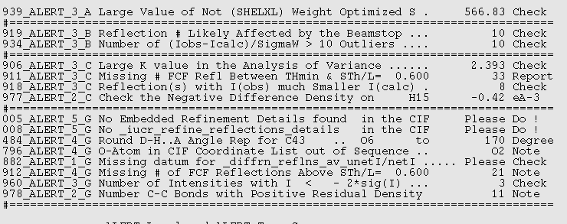
Outliers reported in checkCIF listing

Details on missing reflection and outlier ALERTS can be found in
the FCF validation report (in the .ckf file

Slide 22
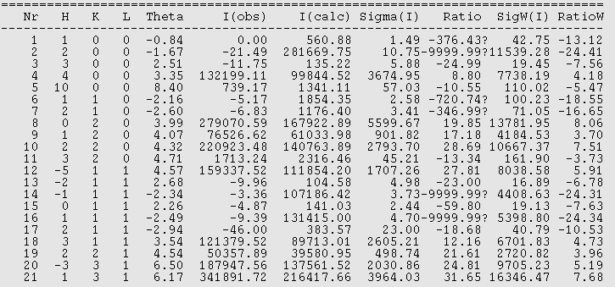
Inspect the list of Outliers in the .ckf listing

Slide 23
Common Validation Issues
A BASF/TWIN refinement needed when the Flack x deviates significantly from zero. Inversion twinning is not automatically included in the refinement model (structure factor calculation)
Do not cut data as an R-factor beautifier to resolution 0.6 Ang-1. Keep all measured data.
Look carefully at difference maps, in particular at H-atom sites.

Slide 24
Oher Common ALERTS
Make sure that at least the main molecule has its CG within the bounds of the unit cell and other species at contact distances
The FCF file should have the ‘LIST 4’ style and not ‘LIST 6’.
Short contacts: Might indicate missing bridging H or C-H being N or incorrect structure model.
Hirshfeld ALERTS: check correct atom type
C-C bond density (sign of good data)

Slide 25
Concluding Remarks
CheckCIF is intended to be helpful and to protect against oversights rather than being annoying
Many ALERTS have their origin in previous ‘incidents’
Some ALERTS can point to interesting features in a structure and might be relevant to be discussed
Some ALERTS may be less important in a given context where the main interest is the chemistry.
Sometimes, a combination of minor ALERTS can point to a problem that needs to be resolved
The set of ALERTS is still fine tuned and extended

Slide 26
Thank you !
Please send suggestions and examples (with data) of
(annoying) issues (or ‘frauded’ structures that fail
detection by checkCIF) to:
a.l.spek@uu.nl
More info:www.platonsoft.nl
(including this powerpoint presentation)

