Slide 1
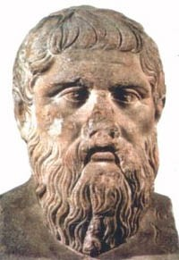
PLATON, an OVERVIEW
Ton Spek
Utrecht University, NL
DSK/AK6 PLATON Workshop
Berlin, 28-29 Sept 2017

Slide 2
What is PLATON About
PLATON is a collection of tools for single crystal structure analysis, bundled within a single SHELX style RES/HKL or CIF/FCF compatible program.
The tools are either unique to the program (e.g. checkCIF) or adapted and extended versions of existing tools such as ‘ORTEP’ and PLUTO.
The program was developed over of period of over 37 years in the context of the needs of our National Single Crystal Service Facility in the Netherlands and the IUCr checkCIF project

Slide 3
Application Area
PLATON addresses mainly the areas of small molecule organic, metalorganic and inorganic crystal structures (thus no macromolecules)
PLATON attempts to be compatible with major software in that area: SHELX, WINGX, OLEX2, CRYSTALS and JANA
IUCr Structure validation (checkCIF)

Slide 4
DESIGN HISTORY
PLATON development started out in 1980 as a program for the automatic generation of an extensive molecular geometry analysis report to be given for perusal to the clients of our National Single Crystal Structure Service that I ran from 1971 to 2009. (The CALC ALL mode)
Soon molecular graphics functionality was added (e.g. PLUTON, ORTEP)
Over time many other tools were included, many of which also require the reflection data (e.g. SQUEEZE, SYSTEM-S).

Slide 5
The CALC ALL MODE LISTING
A (large) file (ASCII, PostScript or PDF Format) for printing on a line- or laserprinter or for inspection with a terminal utility (e.g. editor)
The extensive listing details/analyses the
  Intra-molecular Geometry
  Inter-molecular Geometry
  Coordination Geometry
  The (an)isotropic displacement parameters
  A validation report etc.

Slide 6
Intra-molecular Geometry includes
Bond distances
Bond angles
Torsion Angles
Least-squares planes
Ring search and Cremer & Pople puckering analysis
Detection of missed or pseudo-symmetry

Slide 7
Inter-molecular Geometry Includes
Hydrogen bonds and network analysis
Detection of short inter-molecular contacts
Ring-ring and pi-pi interaction search
C-H..pi interaction search
Search for solvent accessible voids

Slide 8
Coordination Geometry Includes
Geometry around metals
Descriptors for 4, 5 & 6 coordination
BondValence (estimated valency of metals)

Slide 9
Tools Include
ADDSYM
BIJVOET
TwinRotMat
SPGR Determination

Slide 10
DESIGN FEATURES
As hardware independent as possible
Limited dependence on external libraries
Single routine/interface for all graphics calls
Single routine for all symmetry handling
Sharing of the numerical routines by the various tools
Single Fortran source, simple compilation
Small C routine for interface to (X11) graphics
Hardcopy standards: Lp,PostScript (and HPGL)

Slide 11
Three PLATON Versions
The full PLATON version with X-Windows graphics as currently developed on the UNIX (Linux or MAC-OSX) platform.
A MS-Windows version (Louis Farrugia) with alternative graphics (& GUI) but missing some UNIX style functionality (e.g. SYSTEM S)
A non-graphics version with interactive terminal input and command line options for calling functionality from other software.

Slide 12
PLATON USAGE
Today, the PLATON functionality is most widely used in its validation incarnation as part of the IUCr checkCIF facility.
Tools are available in PLATON to analyze and address/solve many of the validation issues that are reported in need to be addressed.
The most popular PLATON tools are checkCIF, SQUEEZE, ADDSYM, TwinRotMat & Bijvoet

Slide 13
UPDATES
PLATON is frequently updated with feature extensions and bug fixes.
At the top of the PLATON opening window there is a display of the program version and the latest available version on the WEB.
Currently, an update is needed to accommodate new SHELXL2017/1 style labels such as C100^b_2

Slide 14
Suggestions and Bug Reports
Suggestions for updates/extensions/clarification are welcome
It is very helpful to submit bug-reports along with the offending data (generally CIF + FCF)
a.l.spek@uu.nl or spea@xs4all.nl
Note: our university server will delete files ending on .ins (even in zip-files).( .res is o.k)

Slide 15
Current Platforms
Development under UNIX/FORTRAN
Implementations:
  LINUX
  MAC-OSX
  MS-Windows (Maintained by Louis Farrugia, U.K.)
  Sygwin/MS-Windows/UNIX box
  Raspberry-Pi/UNIX

Slide 16
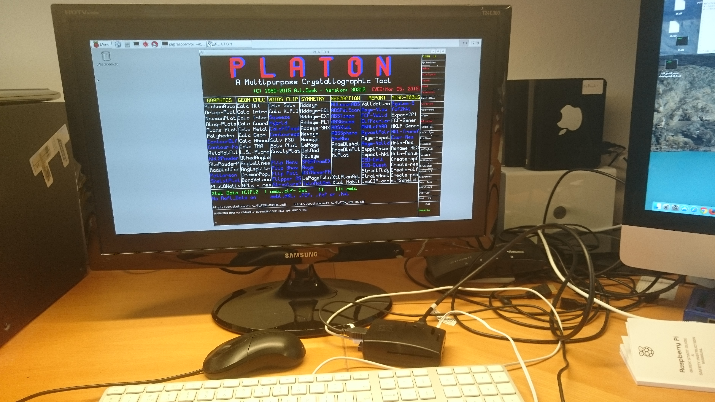
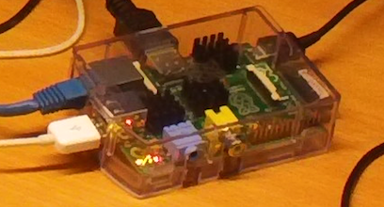
PLATON implementation on a ~50 US$ creditcard size Raspberry-Pi running LINUX

Slide 17
PLATON Organization
The program is invoked from a terminal window with the file(s) to work with (UNIX: platon name.cif)
The tools available in PLATON are listed as clickable objects on the opening menu
Main menu and tool options are clickable in submenu’s.
Input can be either in the keyboard entry area or by clicking on items/in boxes
Frequently used tools can also be invoked with command line options (e.g. platon –U name.cif) for a validation report.

Slide 18
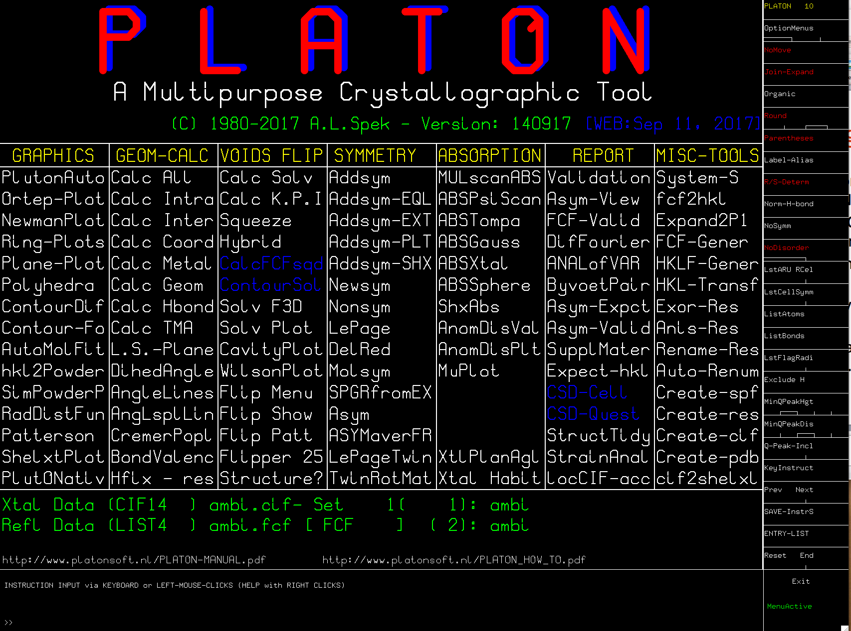

Slide 19
Examples
PLATON/NON-GUI ‘CALC ALL’ demo
sk3605.cif + sk3605.fcf
platon –c sk3605.cif
Inspect: sk3606.lis with e.g. Editor
or: print (laser) sk3606.lps
or: convert .lps to .pdf (PS2PDF converter)
PLATON/GUI example demos

