Slide 1
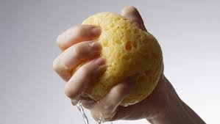
PLATON/SQUEEZE and the
Disordered Solvent Problem
Ton Spek
Utrecht University

Slide 2
The Disordered Solvent Problem
SHELXL offers an extensive set of options to model and refine disordered solvents. This is the preferred approach in most known solvent disorder cases.
In cases of multiple unknown solvent mixtures and smeared density, an elaborate disorder model might not work satisfactorily.
In such cases the SQUEEZE approach with an externally determined solvent contribution might result in a satisfactory main molecule refinement

Slide 3
PLATON/SQUEEZE
The current implementation of the SQUEEZE tool to handle disordered solvents is the third generation of a ‘proof of concept’ method published by us more than 27 years ago.
Interfacing with SHELXL201n refinement solves many earlier issues with SHELX76 & SHELXL97 using .res & .hkl data. [e.g. Modification of the observed data]
Documentation of the recommended procedure: A.L.Spek (2015) Acta Cryst. C71, 9-18
http://www.platonsoft.nl/PLATON_HOW_TO.pdf

Slide 4
The SHELXL201n ABIN Instruction
The total electron density in the unit cell can be split up into two parts, rho1 & rho2, with associated contributions to F_{h}(calc): F_{h} (calc) = F_{h}1 + F_{h}2.
F_{h}1 might be associated with the main molecule of interest and F_{h}2 with a disordered solvent region.
Generally, a disorder model takes care of F_{h}2.
Optionally, the F_{h}2 part can be calculated using an external program and read by SHELXL from a .fab file
The ABIN instruction informs SHELXL201n to search for and read the external .fab file with H,K,L,A_{h}2,B_{h}2.

Slide 5
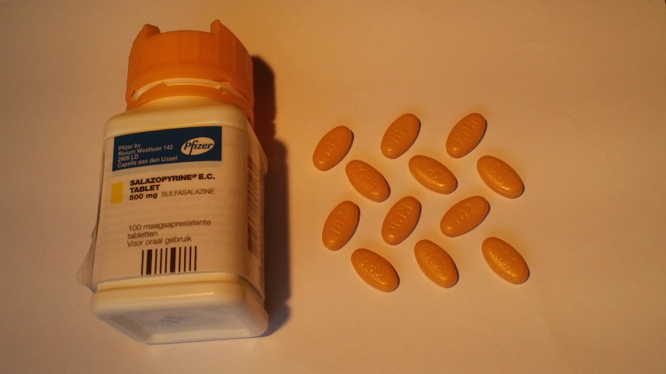
Development History
SQUEEZE has its origin in my interest in the determination of
the crystal structure of the pharmaceutical in the pills above.

Slide 6
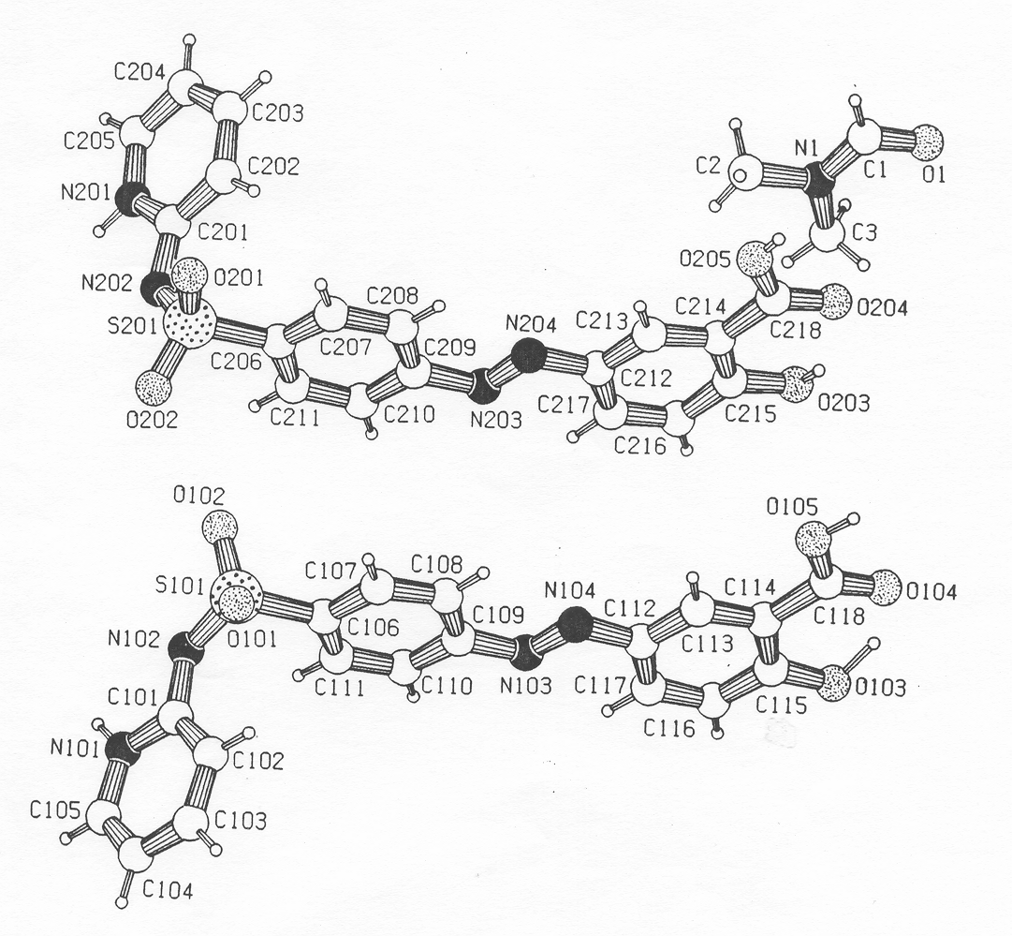
Crystals were eventually obtained from the pills by Paul van der Sluis after many
unsuccessful crystallization attempts from different solvents
P-1
Salazopyrin from DMF – Stuck at R = 0.096
Status around 1988: Poor R-value / SHELXL76, WHY?, What to Do?
Notes:
6

Slide 7
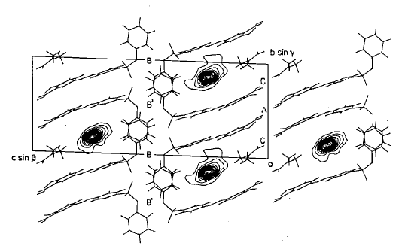
Always Inspect a Difference Density Map, even when there are no Significant Peaks
Rotate by 90 degrees about x-axis => next slide

Slide 8
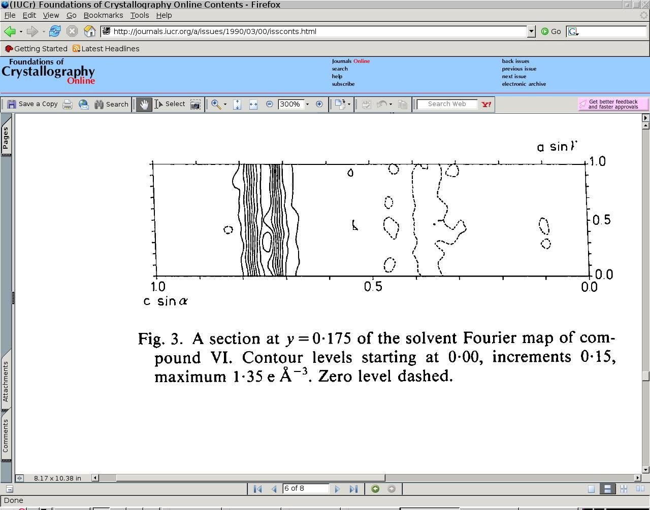
Structure Modelling and Refinement Problem for the Salazopyrin Structure
Infinite density channel, incommensurately filled with solvent
Notes:
8

Slide 9
Advise
Always check for solvent accessible voids in a structure
Peak search algorithms (such as implemented in SHELXL) will not always tell about the residual density since they attempt to model an atom as a 3D ellipsoidal density distribution

Slide 10
The Prototype Refinement Solution based on SHELX-76
Identify the disordered solvent volume
Calculate by difference map iteration the contribution of the electron density found in the voids to the calculated structure factors.
Subtract the solvent contribution from the observed data and continue SHELX refinement.
The R-value improved from 9.6 to 4.5 %
P. van der Sluis & A.L.Spek (1990). Acta Cryst. C46, 883-886 and A46, 194-201 (BYPASS)

Slide 11
Solvent Accessible Voids
A typical crystal structure has only in the order of 65% of the available space filled.
The remainder volume is in voids (cusps) in-between atoms (too small to accommodate an H-atom)
Solvent accessible voids can be defined as regions in the structure that can accommodate at least a sphere with radius 1.2 Angstrom without intersecting with any of the van der Waals spheres assigned to each atom in the structure.
Next Slide: Void Algorithm: Cartoon Style ➔

Slide 12
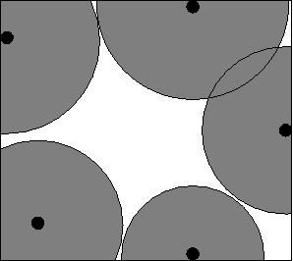
DEFINE SOLVENT ACCESSIBLE VOID
STEP #1 – EXCLUDE VOLUME INSIDE THE
VAN DER WAALS SPHERE

Slide 13
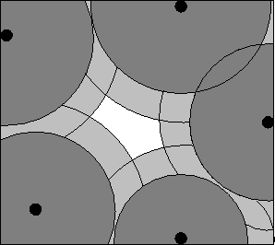
DEFINE SOLVENT ACCESSIBLE VOID
STEP # 2 – EXCLUDE AN ACCESS RADIAL VOLUME
TO FIND THE LOCATION OF ATOMS WITH THEIR
CENTRE AT LEAST 1.2 ANGSTROM AWAY

Slide 14
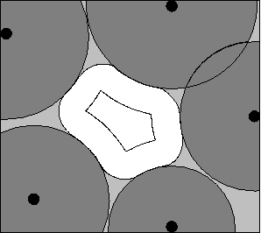
DEFINE SOLVENT ACCESSIBLE VOID
STEP # 3 – EXTEND INNER VOLUME WITH POINTS WITHIN
1.2 ANGSTROM FROM ITS OUTER BOUNDS

Slide 15
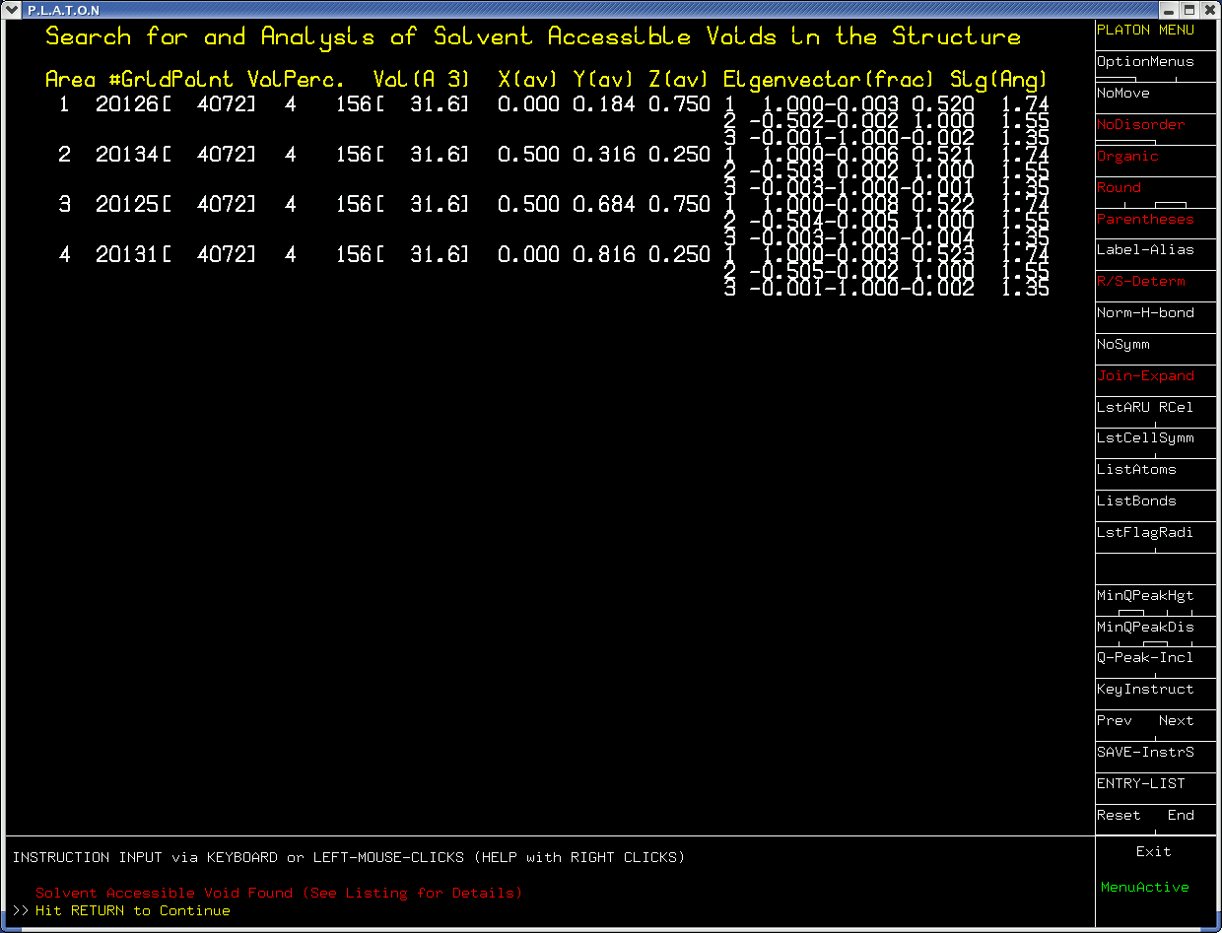
Listing of all voids in the triclinic unit cell
Cg

Slide 16
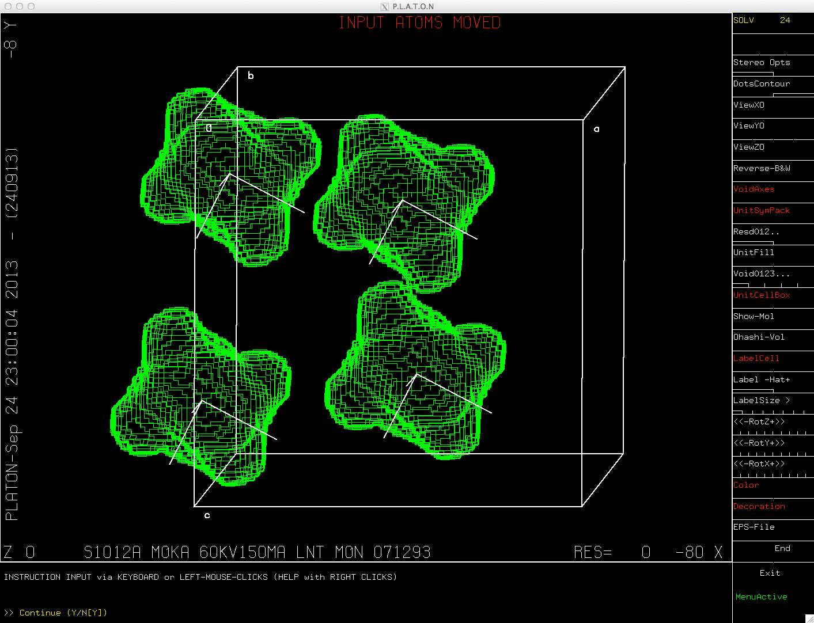
Example of solvent accessible voids

Slide 17
BYPASS/SQUEEZE
In the Complex Plane
Trick needed to refine with SHELX
Fc(solvent)
Fc(total)
Assign Phase
Fc to Fobs
Fc(model)
Fobs
Solvent Free Fobs
Black: Split Fc(total) into a discrete atom and solvent contribution
Red: For SHELX refinement, temporarily substract the recovered solvent contribution from Fobs. (To be reinstated after convergence)
Notes:
17

Slide 18
The SQUEEZE Algorithm
Calculate the VOID-map
Calculate a difference density Fourier map (FFT)
Use the VOID-map as a mask on the FFT-map to set all density outside the VOID’s to zero.
FFT⁻¹ this masked Difference map -> contribution of the disordered solvent to the structure factors (A(cal) & B(cal)
Calculate an improved difference map with F(obs) phases based on the vectorial sum of F(calc) + F(solv) and F(calc) without the solvent contribution.
Recycle to 2 until convergence.

Slide 19
New Procedure with SHELXL101n
With SHELXL76 & SHELXL97, SQUEEZE had to be based on a ins & hkl set of files as input. The output was a set of ins and hkl files for final refinement with the solvent contribution removed from the observed intensity data..
With SHELXL201n that has changed to SHELXL201n created cif & fcf files as input and ins, hkl & fab files as output for final refinement. Information on the solvent contribution and SQUEEZE details are stored in fab.

Slide 20
SQUEEZE TEST EXAMPLE
Comparison of a the results of a ‘classical’ refinement of a disordered solvent molecule with the results of a SHELXL201n/SQUEEZE based refinement.
The starting point of the ‘SQUEEZE path’ are the cif and fcf files obtained after a SHELXL201n refinement with the solvent molecule removed.

Slide 21
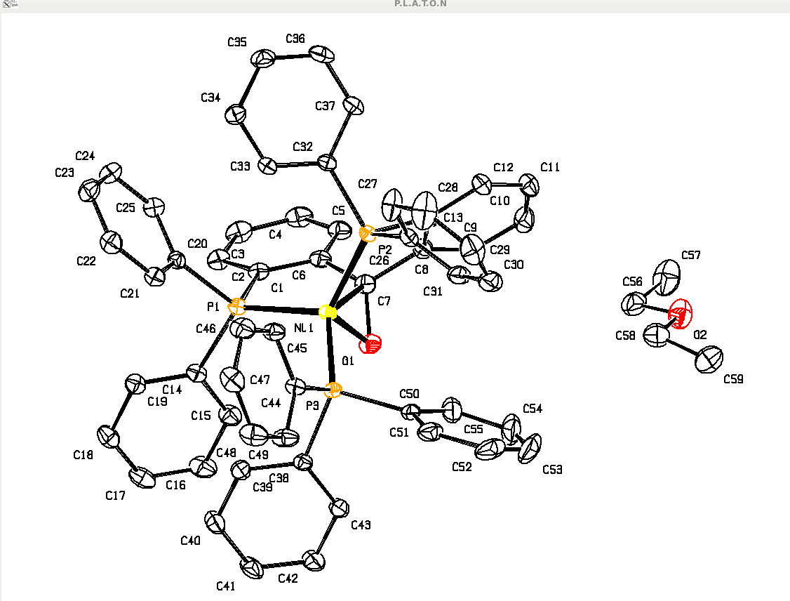
Example
P21/c, 150K
R = 0.0386
wR2 = 0.0966
S =1.037
Diethyl Ether
Disordered over
Inversion centre
PART -1
Organometallics (2015), 34,2710-13

Slide 22
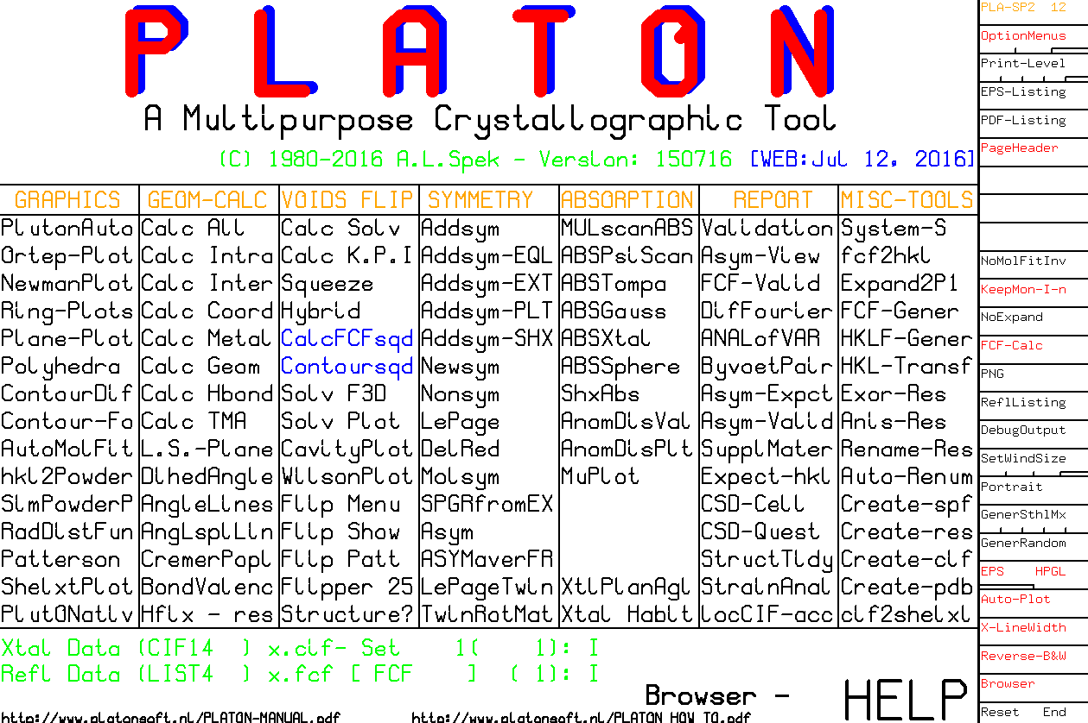
⬅

Slide 23
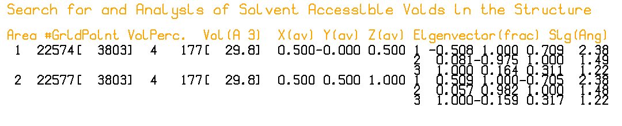
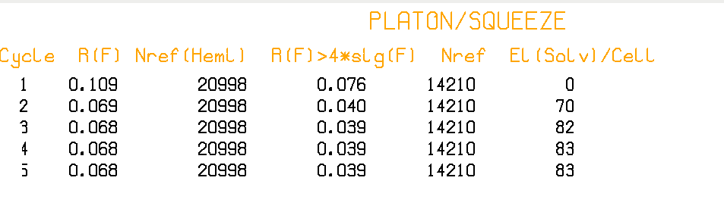
Definition of VOIDS (white area): roll sphere with radius 1.2 A
In this case there are two solvent accessible voids with
Volume 177 A**3 in the unit cell
SQUEEZE uses this area as a mask to recover the density
In the white area from the difference density map by
Iterative back-Fourier transformation into F_{h}2 (.fab)

Slide 24
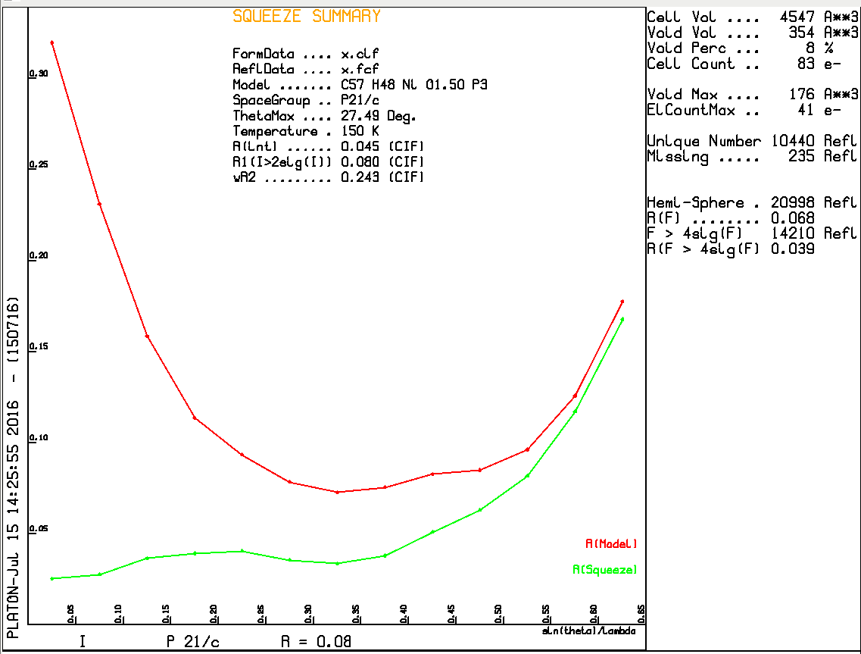
Without Solvent Contribution
With Solvent Contribution

Slide 25
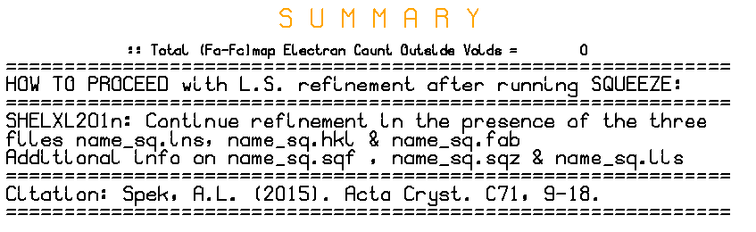
- The _sq.ins file is the original .res (from .cif) + ABIN Instruction
- The _sq.hkl file is the original .hkl (from .cif)
- The _sq.fab file (created by SQUEEZE) includes after the last
reflection info about the SQUEEZE job i.e._sq.sqf & _sq.sqz
Note: PLATON/SQUEEZE does NOT refine the Model Parameters

Slide 26
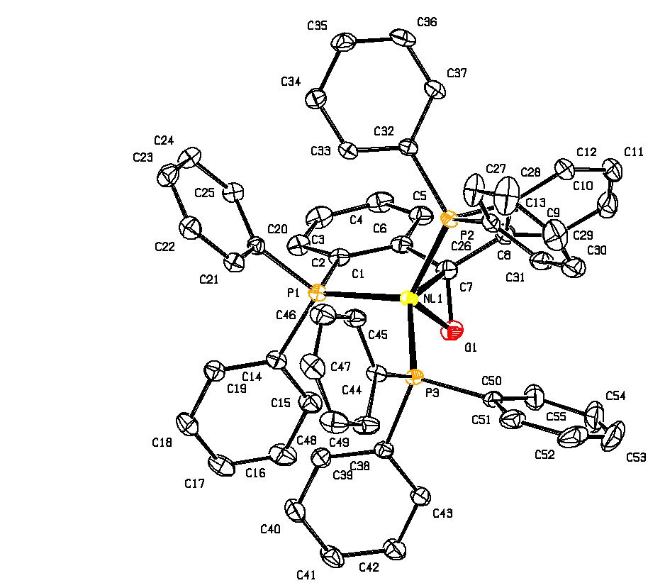
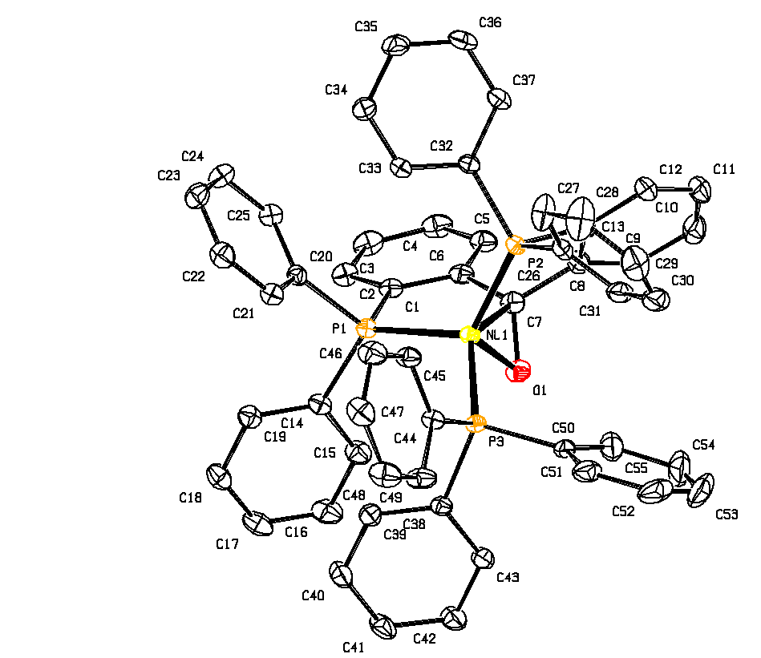
Comparison
R₁ = 0.0386, wR₂ = 0.0966
S = 1.037, 42 electrons
C-C BP = 0.0036 Angstrom
R₁ = 0.0383, wR₂ = 0.0960
S = 1.044, 41 electrons
C-C BP = 0.0035 Angstrom
Disorder Model Diethyl Ether
Squeeze Model DiethylEther

Slide 27
The Proper use of the SQUEEZE Tool
It is important that the final CIF archives both the details of the SQUEEZE calculation and the unmerged reflection data.
The SQUEEZE details are appended to the .fab file
SHELXL201n offers, by embedding the .res, .hkl & .fab data, all what is needed for that.
In that way, the calculations can be reconstructed and/or alternative refinement models attempted.

Slide 28
Summary of SQUEEZE + SHELXL201n
Refine a non-solvent model with name.ins & name.hkl (Include ACTA record, NO LIST 6) .
Run PLATON/SQUEEZE, based on name.cif & name.fcf from 1 as ‘platon –q name.cif’.
Continue SHELXL refinement with the files name_sq.ins, name_sq.hkl & name_sq.fab from 2 as ‘(shel)xl name_sq’
Inspect the .lis & .lst files and Validate

Slide 29
SQUEEZE Disordered Solvent + Twinning
Step 1: SHELXL2014 refinement based a name.ins (that should include ‘ACTA’, ‘LIST 8’, ‘BASF’ and ‘HKLF 5’ [or ‘TWIN’] records) and a name.hkl file
Step 2: Run SQUEEZE with the name.cif and name.fcf files produced in Step 1 (i.e. run: platon –q name.cif)
Step 3: Continue SHELXL refinement with the files name_sq.ins, name_sq.hkl and name_sq.fab produced by PLATON in step 2 ➔ name_sq.cif & name_sq.fcf

Slide 30
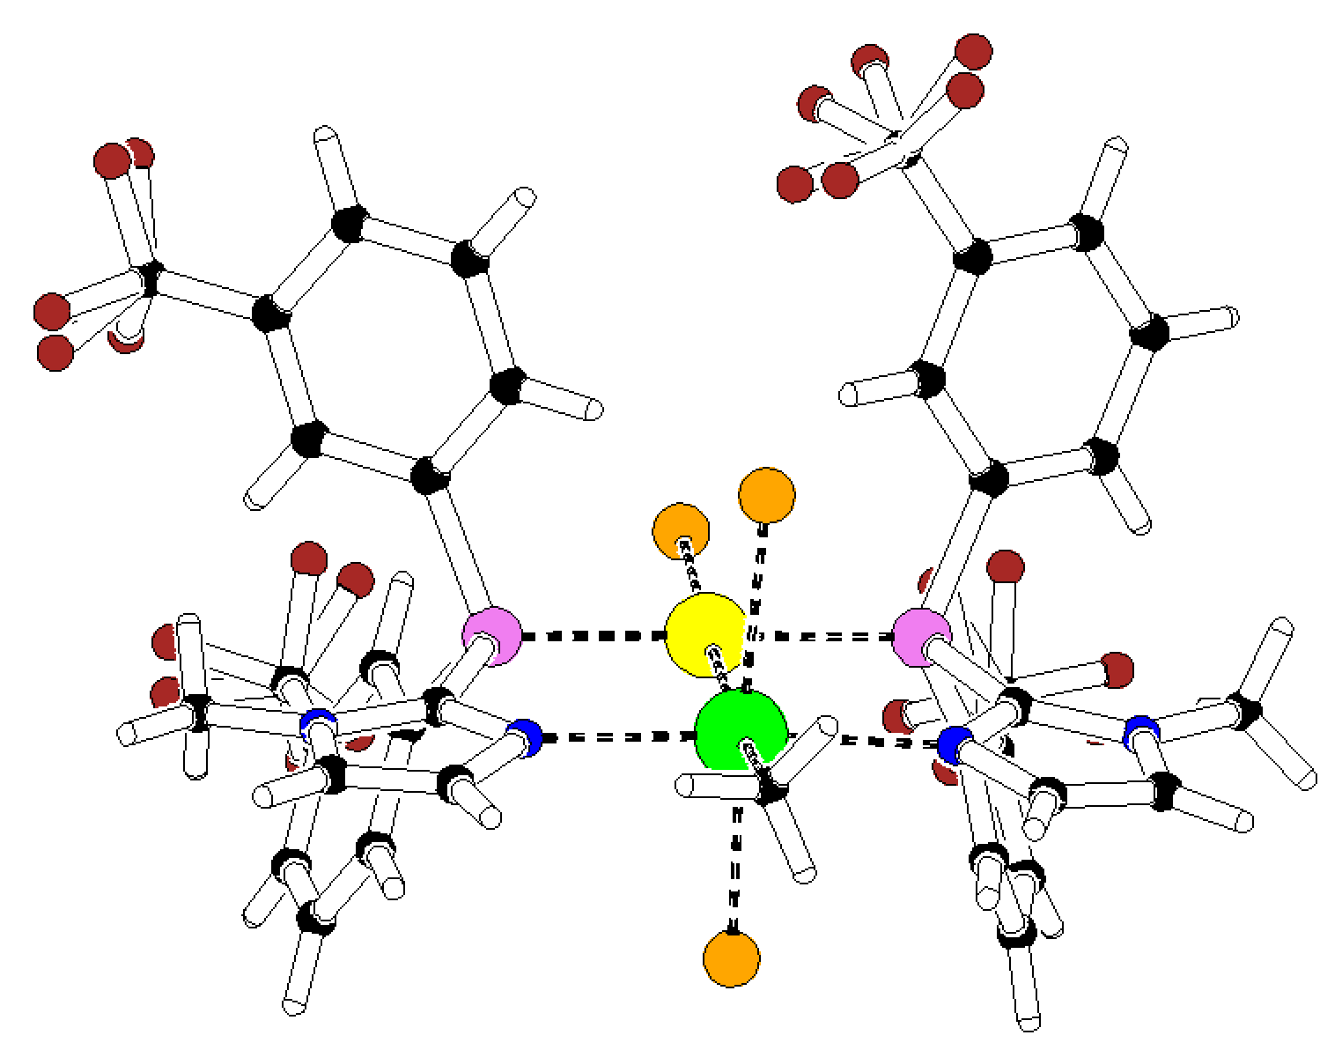
SQUEEZE-2016 EXAMPLE [Chem.Eur.J. (2015) 21, 1765]
Acetonitril Model: R = 0.0323, wR2 = 0.0889, rho(max) = 1.34 e/A-3
Space Group P2₁
Z = 4, Z’ = 2
60:40 Twin
Twin axis: (0 0 1)
150 K
TWINABS hklf5 data
Acetonitril solvate
Step 1 (SHELXL2014) ➔ R1 = 0.047, wR2 = 0.1445
Step 2 (SQUEEZE) ➔ 177 electrons found in unit cell
Step 3 (SHELXL2014) ➔ R1 = 0.0275, wR2 = 0.0679, S = 1.064

Slide 31
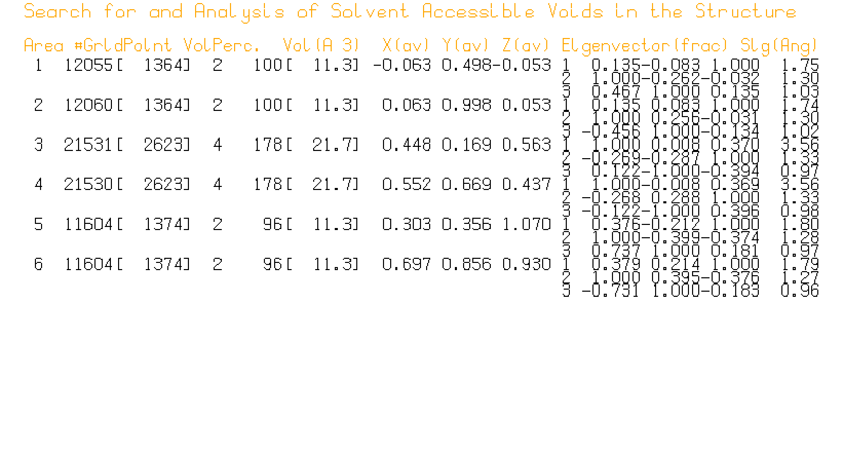
In total 6 solvent accessible voids are detected (of three types)

Slide 32
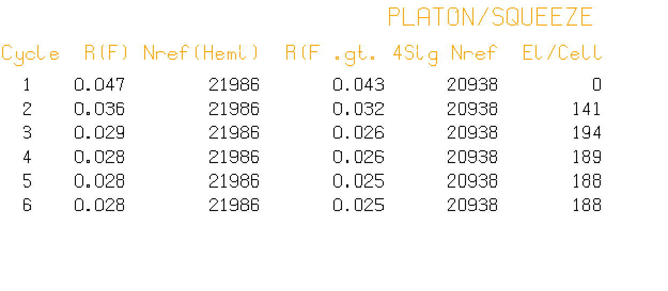
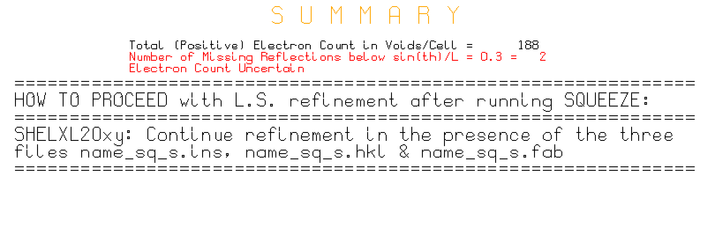
Difference map iteration

Slide 33
Effect of on R(F) before and after SQUEEZE as a function of sin(theta)/lambda

Slide 34
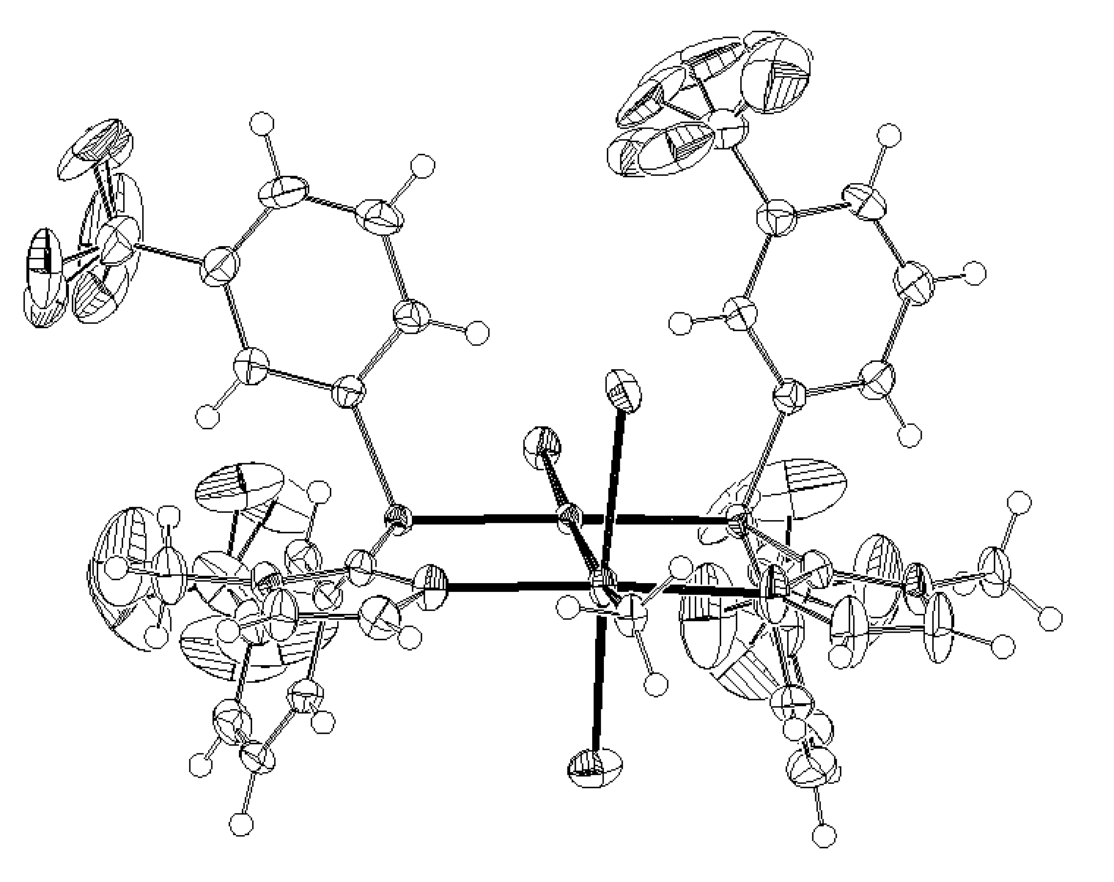
Final ORTEP (R = 0.0275)
← F-Disorder
SQUEEZE RESULT

Slide 35
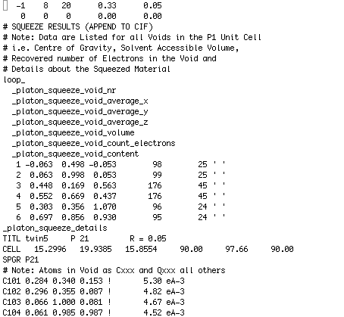
Embedded SQUEEZE info at the end of the .fab file
⬅ h k l A(solv) B(solv)
Void volume + electron count
⬅ Optimized peak list

Slide 36
The ‘NEXTRA’ Issue
One of the issues that needs to be addressed is the number of additional parameters to be added in the calculation associated with SQUEEZE on the L.S. Command. The default value is set to: (E x n) / (Z x m) where
E = the number of recovered electrons in the unit cell
Z = the number of asymmetric units
m = the number of electrons in a CH2 fragment (=8)
n = the number of parameters usually refined for a CH2 fragment (=9)
This formula has the nice property that it vanishes when there is no residual density in the void

Slide 37
SQUEEZE EXAMPLES
In case of unclear solvent disorder, both a disorder model with constraints/restraints and a SQUEEZE calculation should be attempted and their results compared
Following are SQUEEZE examples without and with additional twinning complications
Both examples are based on good data
Note: Electron counting requires good data

Slide 38
SQUEEZE EXAMPLES
In case of unclear solvent disorder, both a disorder model with constraints/restraints and a SQUEEZE calculation should be attempted and their results compared
Following are SQUEEZE examples without and with additional twinning complications
Both examples are based on good data
Note: Electron counting requires good data

Slide 39
The MAIN Cycle
The original BYPASS paper described a procedure involving an inner and an outer loop. In general only the inner loop (SQUEEZE) is done.
Under certain conditions (large disorder contribution to the SF or twinning) the full BYPASS procedure including the outer loop (i.e. L.S./SQUEEZE/L.S./SQUEEZE/. ..) can be attempted. [INVOKED as BYPASS with name.cif and name.fcf]. This routine assumes SHELXL2013.

Slide 40
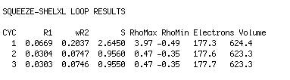
SQUEEZE optimizes the Difference map by Fourier Recycling.
Refinement is done with SHELXL
SQUEEZE + L.S. Recycling is rarely needed but can be done as:
platon –q3 name.cif (by calling SHELXL from within PLATON)

Slide 41
Requirements
There should be no residual unresolved density in the discrete model region of the structure because of its impact on the difference map in the solvent region.
The data set should be reasonably complete and with sufficient resolution [i.e. sin(theta)/lambda >0.6].
Low temperature data help a lot.
There should be no unresolved charge balance issues that might effect the chemistry involved (e.g. The valency of a metal in the ordered part of the structure)

Slide 42
Limitations
The reported electron count in the solvent region is meaningful only with the supply of a complete and reliable reflection data set
The SQUEEZE technique can not handle properly cases of coupled disorder effecting both the model and the solvent region.
The solvent region is assumed not to contain significant anomalous scatterers (Friedels averaged)
Designed for ‘small molecule structures’
Using SQUEEZE as part of the MOF soaking method where the interest lies in the solvent region can be very tricky and should be done with extreme care

Slide 43
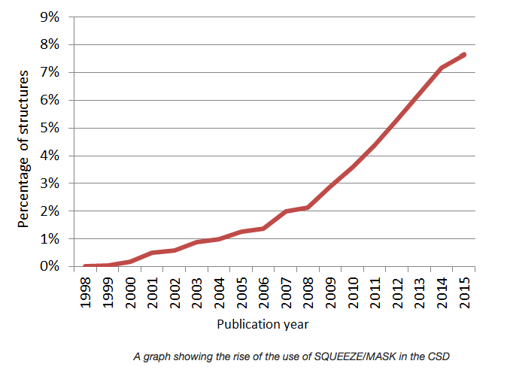
Reported SQUEEZE
Usage Statistics as
Prepared by the CCDC
The 2017 CSD release reports over 26000 SQUEEZEd structures

Slide 44
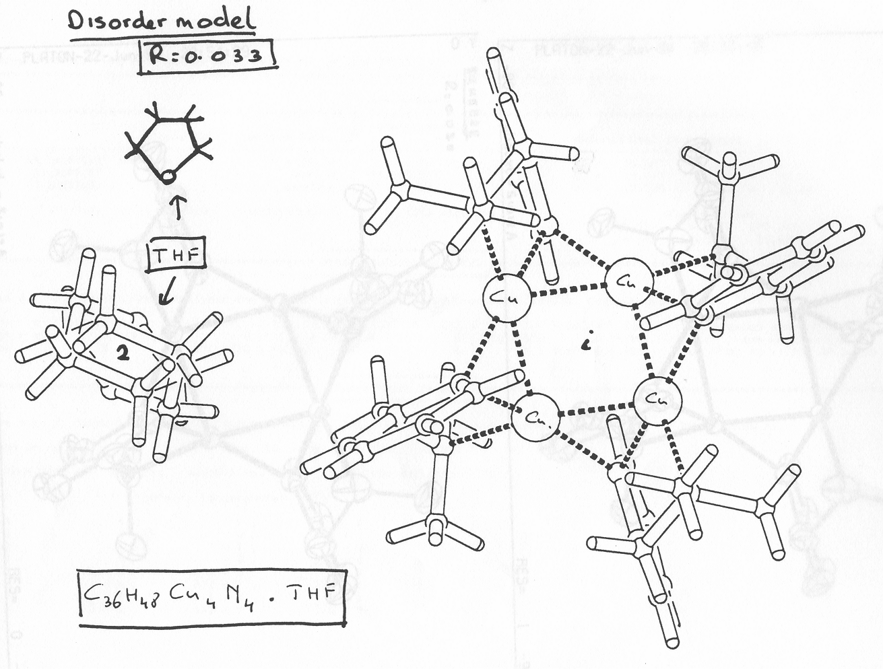
Disorder Model Refinement
Final R = 0.033
DEMO EXAMPLE

Slide 45
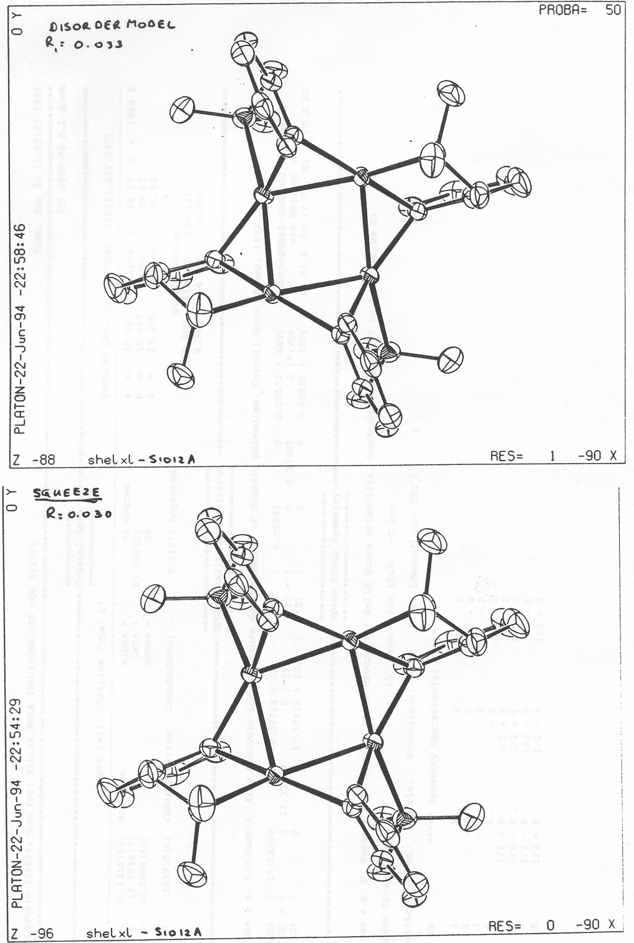
Comparison of the Results of
the two Modeling Procedures
Disorder Model
R = 0.033
SQUEEZE Model
R = 0.030

