Slide 1
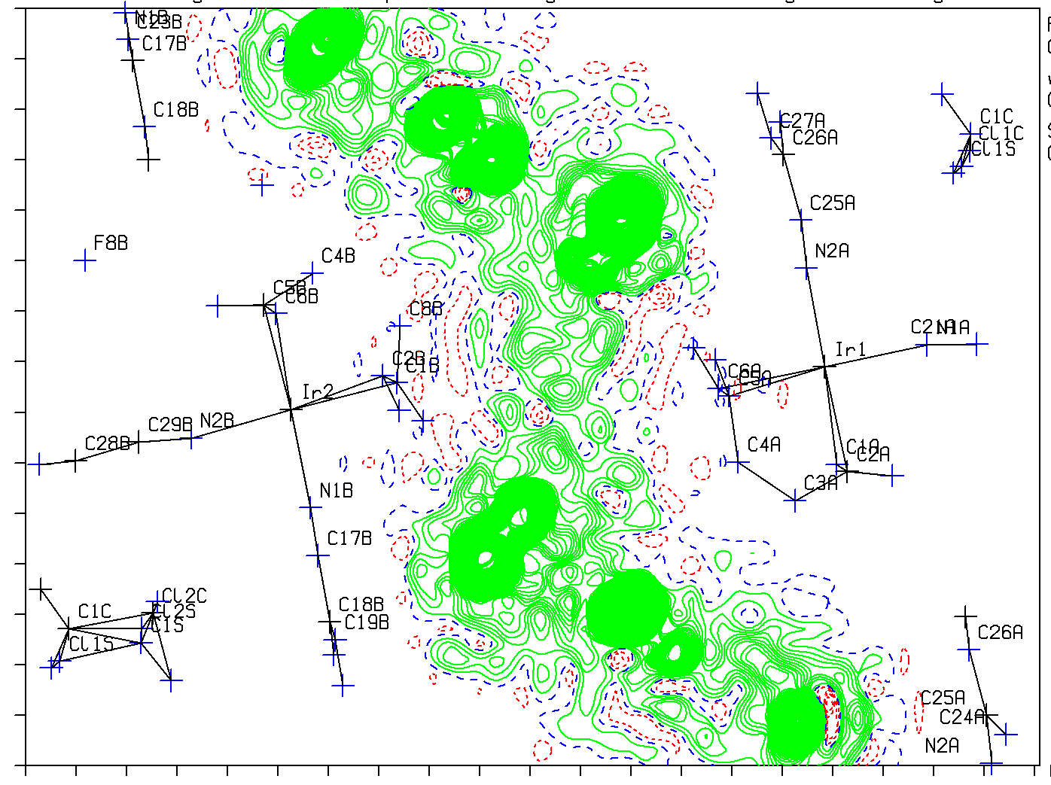
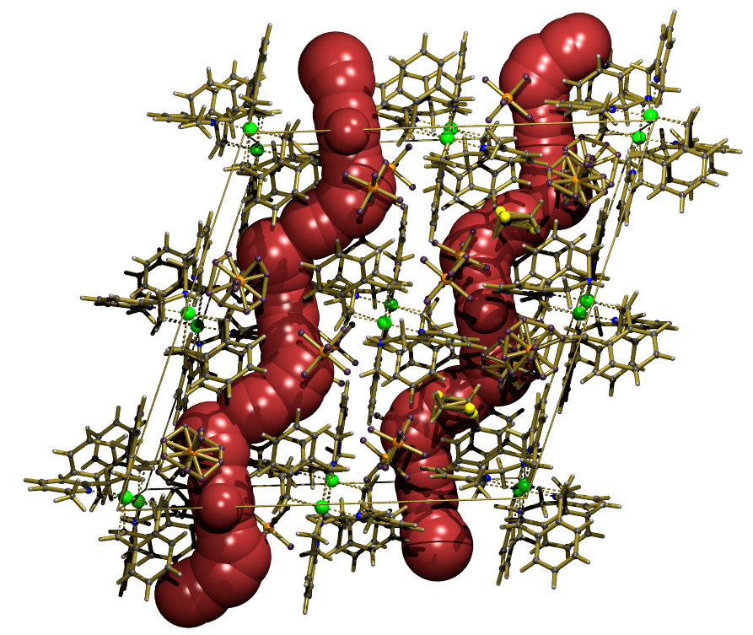
The Difference Electron Density Map as a Crystal Structure Validation Tool
Ton Spek
Utrecht University
The Netherlands
Vienna-2019-GIG-21-8-2019

Slide 2
Structure Determination Today
Structure determination programs such as SHELXT, OLEX2 etc. have made structure determination and refinement trivial in many cases.
Problems with a structure may turn up only at the validation stage as IUCr checkCIF ALERTS
Some ALERT messages will need detailed inspection of the difference density map rather than inspection of the residual density peak list.

Slide 3
Difference Density Map (F_{o}-F_{c})
A good structure model should show no significant residual density excursions > 0.5 eÅ⁻³
In a good structure model, the value of |ρ_{min}| should be about that of ρ_{max}
Examples follow:

Slide 4
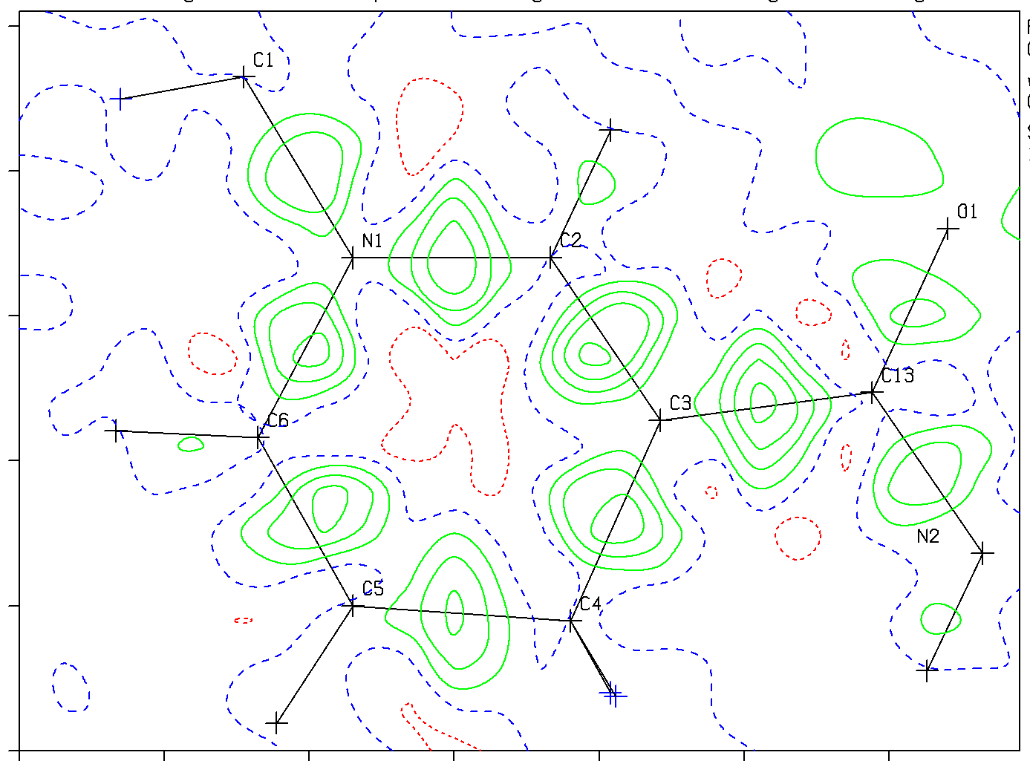
(Fo-Fc)map for a Healthy Structure
Density on Bonds for a Quality Structure
Reported as a G-ALERT (Info)

Slide 5
Special Cases
Absence of nice residual density blobs on bonds may indicate:
1 – Poor data associated with high R-value
2 – The use of non-spherical scattering factors E.g. with IDEAL type refinement packages to handle bonding effects
3 – Fraud with calculated ‘ observed’ data. Several cases have now been identified.

Slide 6
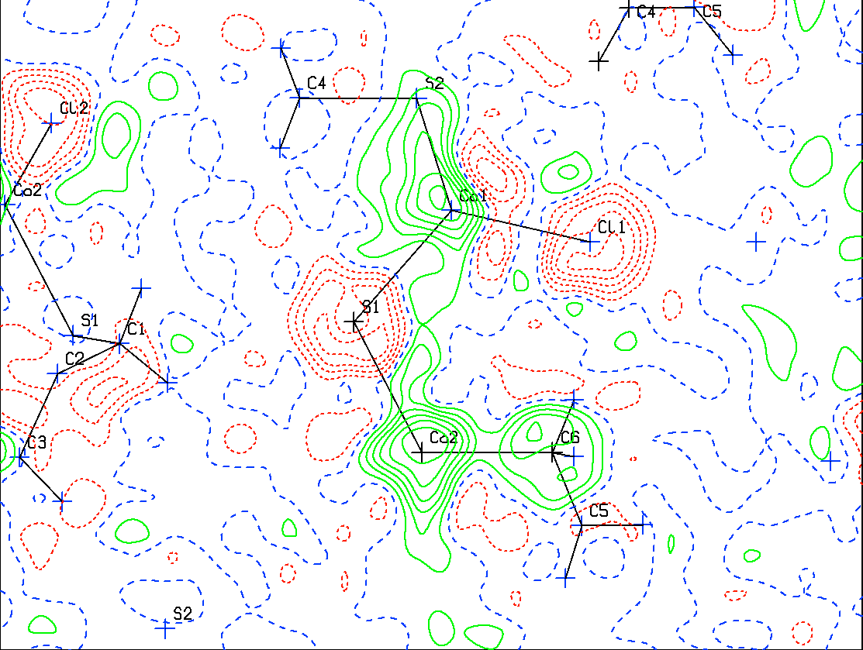
(Fo-Fc) map of an Unhealthy / Wrong Structure
Wrongly Assigned Atom types ?
Red: To much density in model; Green: To little density in model

Slide 7
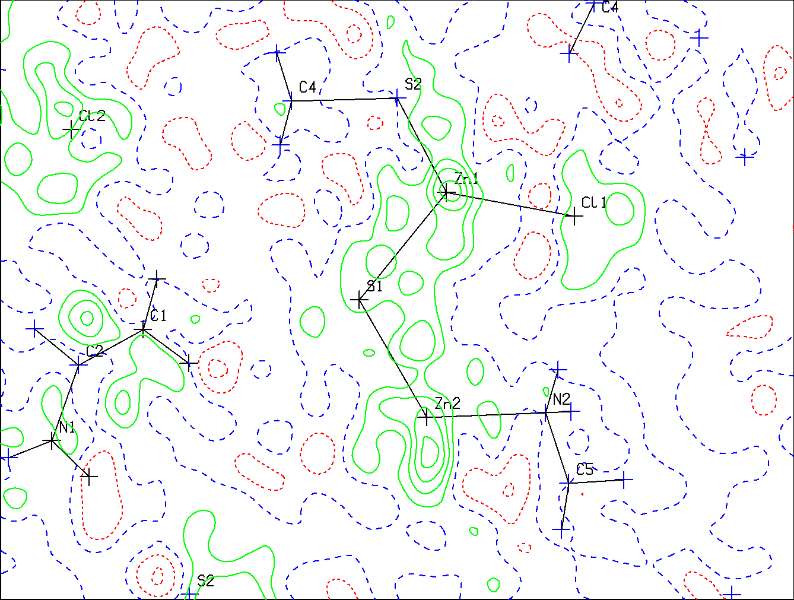
False Co-Complex ===➔ Zn-Complex
Fraud or Mis-Interpretation
Contours at 0.1 e/Å³

Slide 8
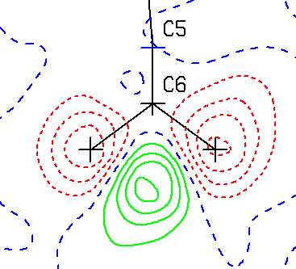
Wrong Hydrogen Atom Positions
Red:
Too much
density
In model
Green:
Too little
density
In model
Could be caused by wrong AFIX constraint type

Slide 9
Residual Density Peaks may also point to
Unaccounted for disorder in the molecule(s)
Unaccounted for Twinning (ghost structure peaks)
Absorption artefacts (insufficient correction)
Difficult to model disordered solvents.
Sites occupied by a mixture of solvents

Slide 10
Warning
Some software will not list residual density peaks on atom sites
Peak search algorithms assume 3D Gaussian type density maxima. Ridges of density might be missed
It is good to inspect the density in solvent accessible voids in a structure.

Slide 11
Uninterpretable Solvent Channel

Slide 12
Radius ~ 2

Slide 13
Heavy Atoms
A peak list often includes density peaks near heavy atoms
Their reason should be investigated
They are often falsely designated as diffraction ripple effects

Slide 14
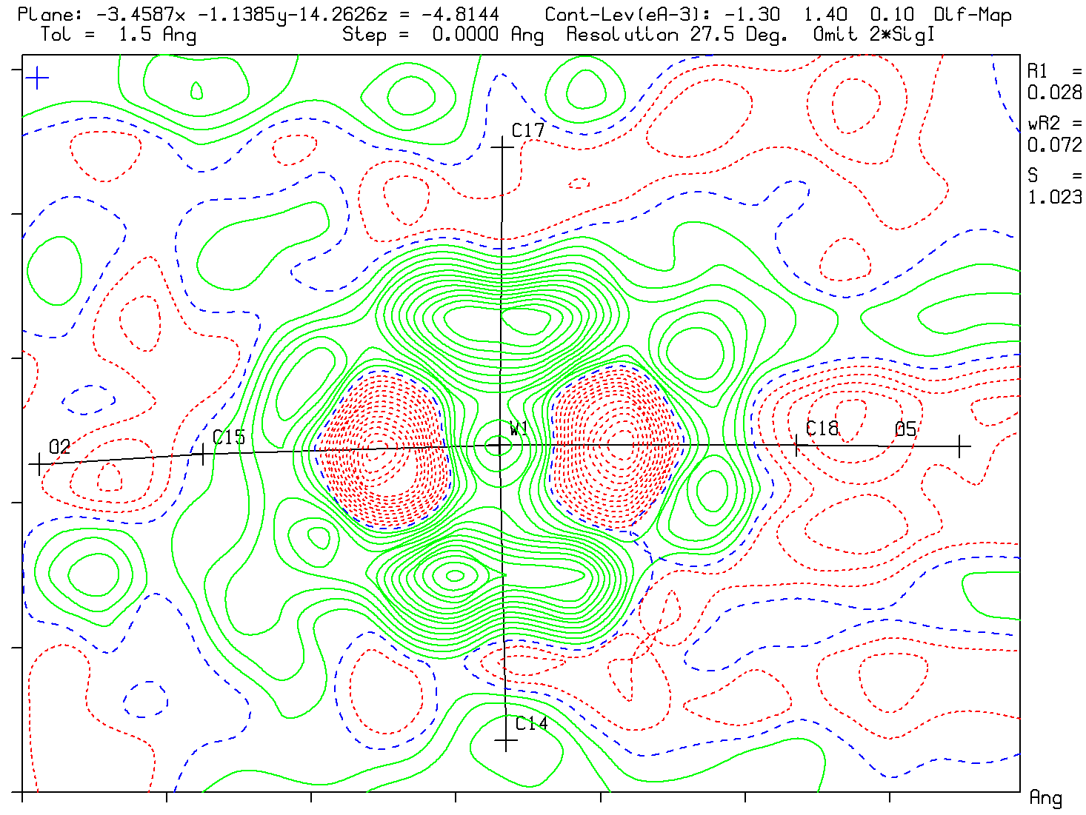
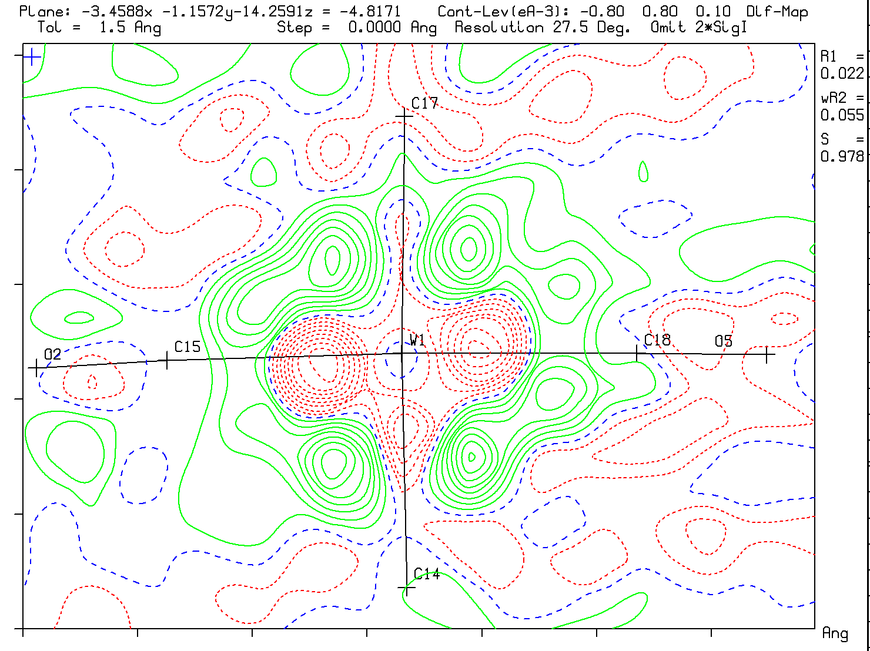
Absorption Artefacts (μ=6.45mm⁻¹)
file:///.file/id=6571367.25963400
Typical Difference map without
Absorption correction
Max density 1.40 eA⁻³
Slight improvement after multiscan
Absorption correction
Max density 0.80 eA⁻³

Slide 15
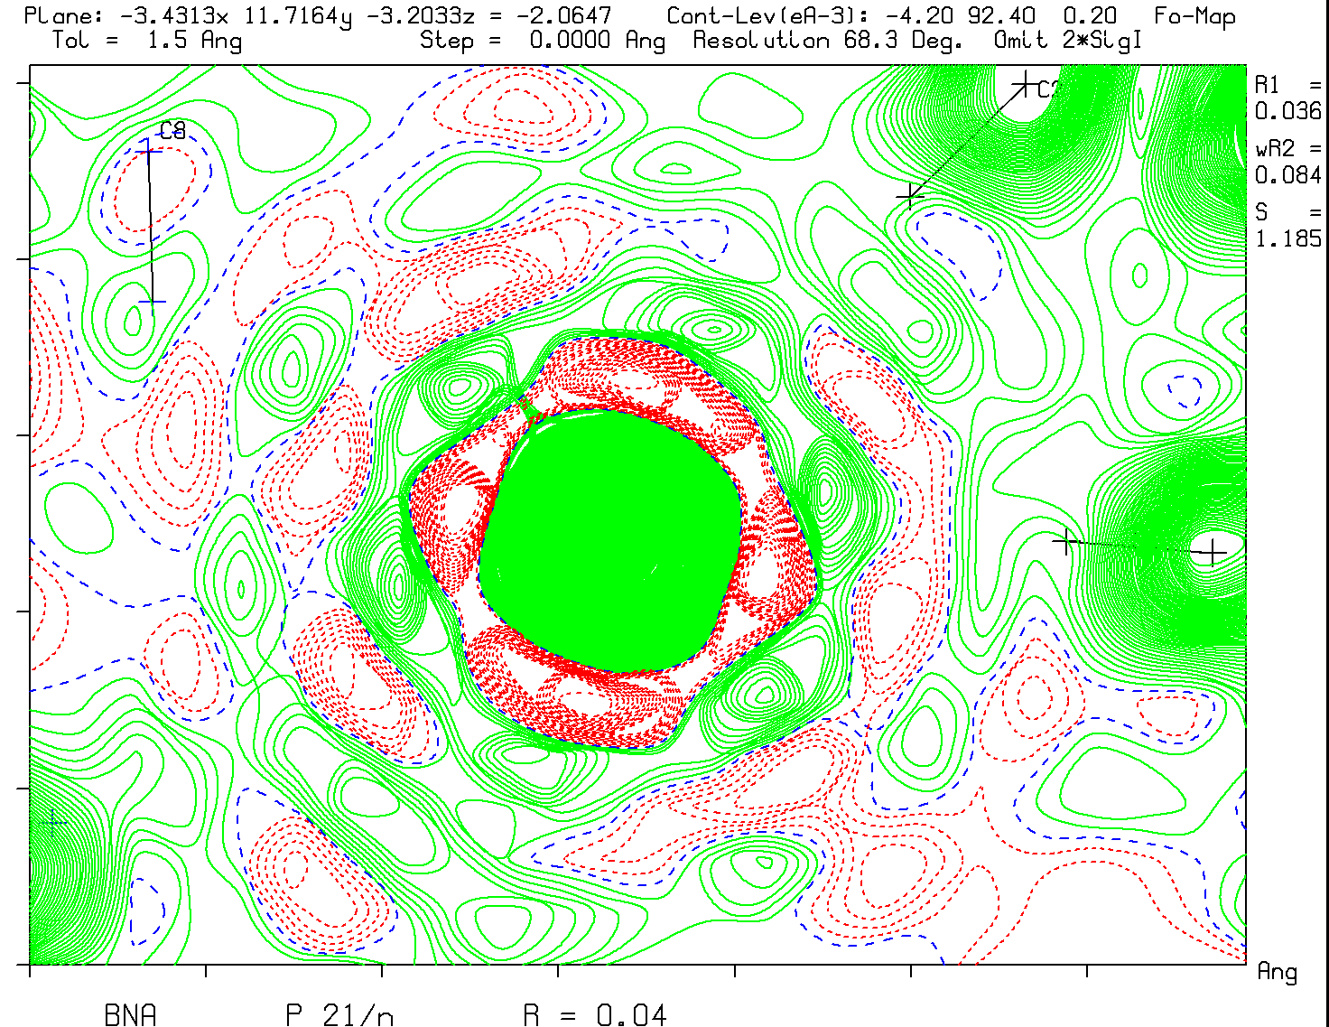
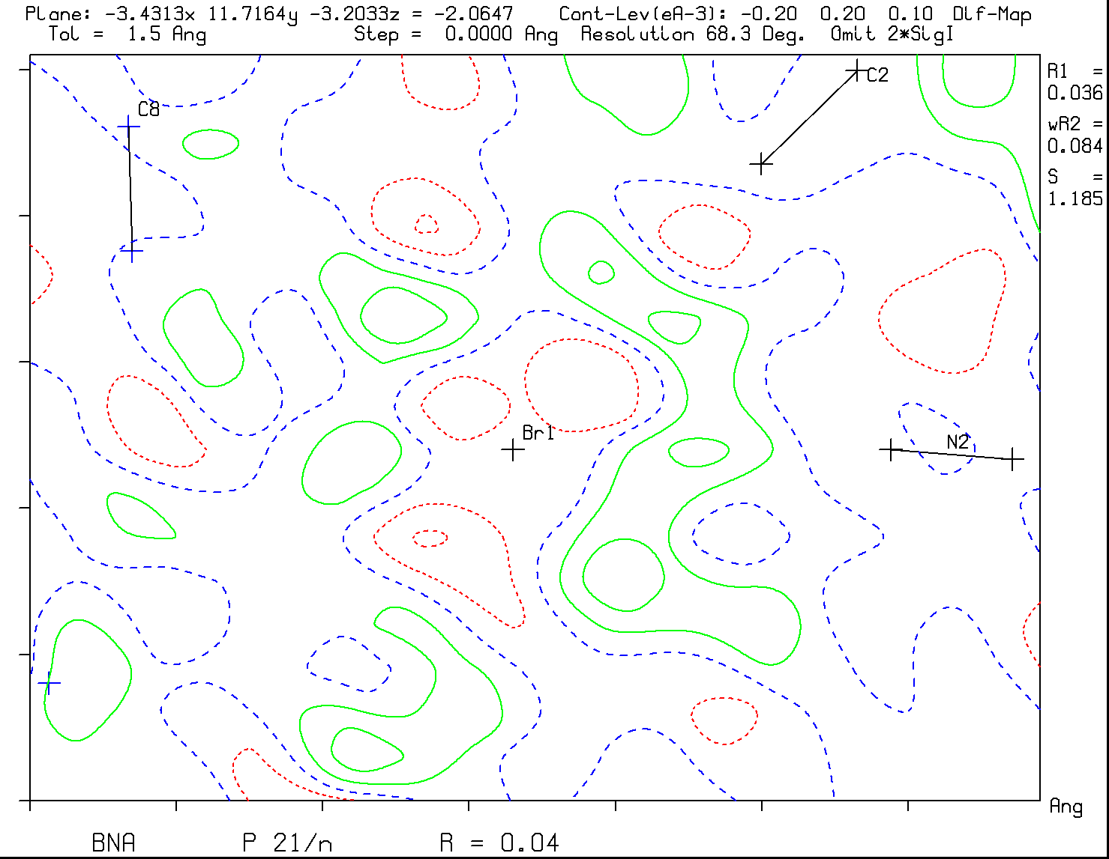
F(obs) and F(obs)-F(calc) Maps
Large peaks in a difference map are not due to truncation ripples
Br
Br
F_{obs} Map
F_{obs} – F_{calc} Map
Note the truncation ripples in the F(obs) map and absence in the F(obs)-F(calc) map

Slide 16
Example: Validation of a Crystalline Sponge Method based Structure
Fujita et al. (2013) introduced a potentially interesting new approach to obtain structural information for difficult to crystallize compounds
A MOF with suitable channels is used to soak in a molecule of interest for structure determination
Chem. Asian J. (2017), 12, 208-211 provides a good example of a suitable MOF, [CuBr(benzene-1,3,5-triyl-triisonicotinate)]_{n}, soaked with 1-acetonaphthone as guest.

Slide 17
Replace CS₂ with Guest
Two independent infinite channels A & B (~700 Å³ each)

40%
Solvent
Channel


CS₂

Slide 18
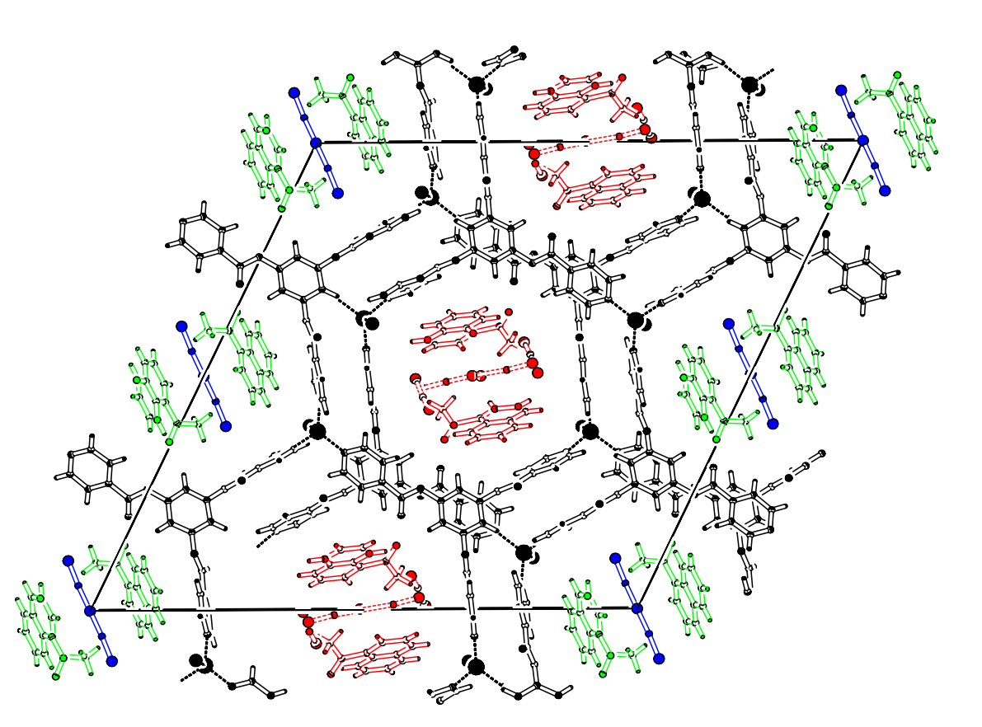
Host + Guests in MOF Framework
Guests are:
1-acetonaphthone
CS₂
93K
P2₁/c
R1 = 0.05
wR2 = 0.18
S = 1.066
Ρ_{min} = -1.26e/Å³
Ρ_{max} = 1.74e/Å³

Slide 19
Refinement
A model with guest molecules and residual CS2 solvent molecules was refined.
Restraints were needed on the geometry
A difference map reveals the reason for the need of those restraints

Slide 20
0.1 Å⁻³
A
B
93K
50%Prob.
Constraints & Restraints
needed to keep the geometry healthy
0.793(4)
0.769(5)

Slide 21
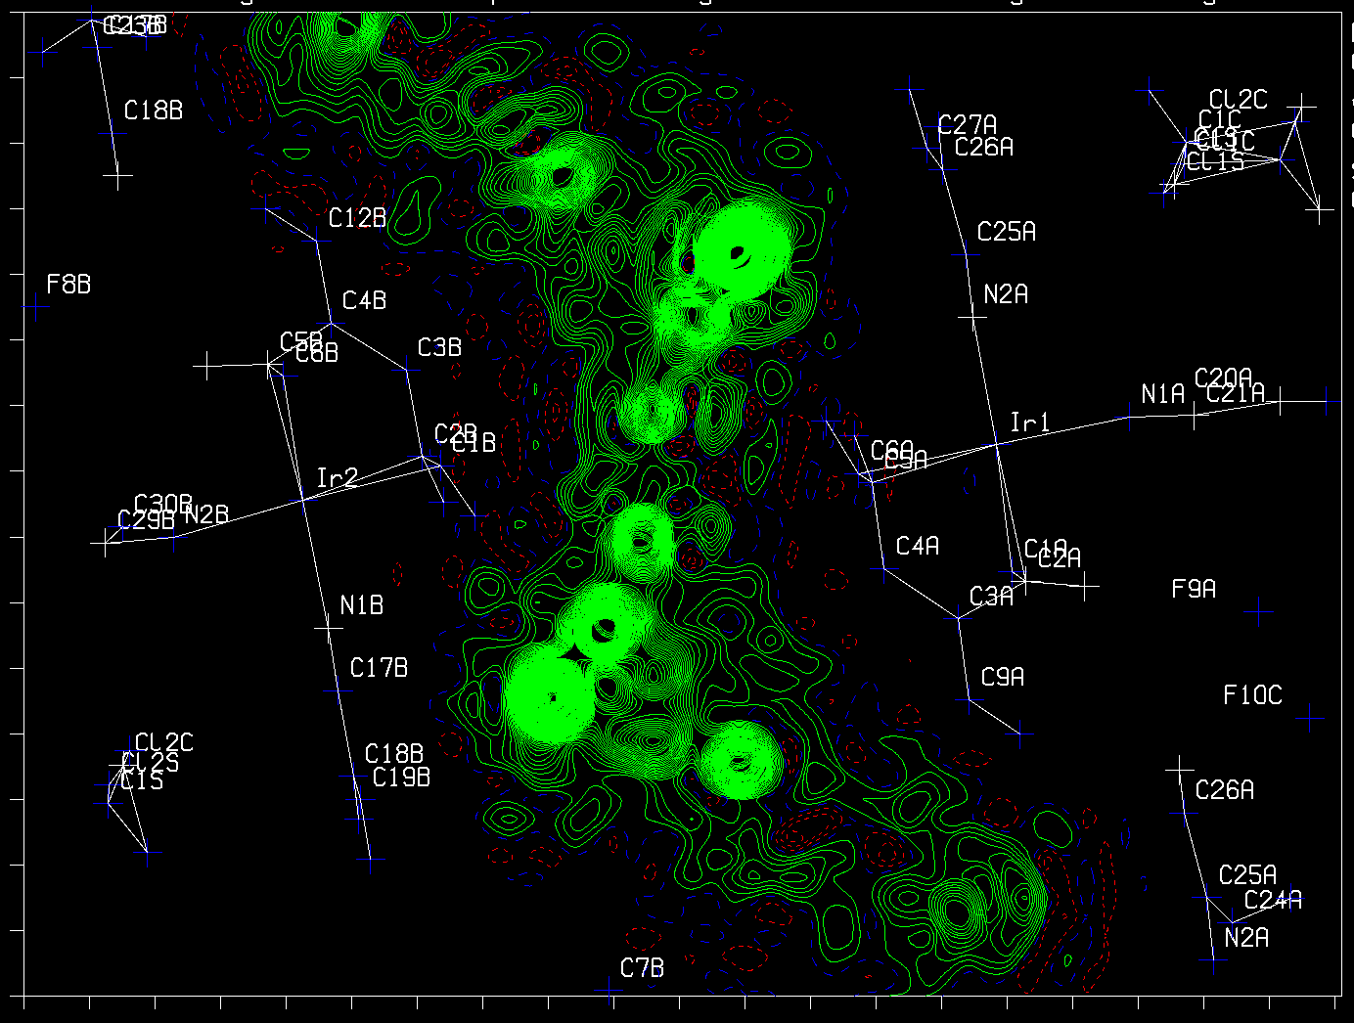
Thanks !

