Slide 1
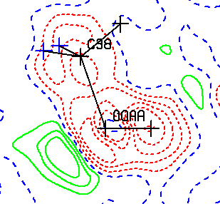
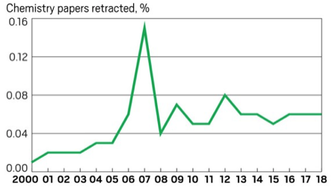
PLATON Tools to Help with Resolving Cryptic checkCIF ALERTS
Ton Spek, Utrecht University, NL
Leeds, BCA, 14 April 2022

Slide 2
The checkCIF Report
Today, an IUCr/checkCIF report is required as part of the refereeing process of any paper that includes a crystal structure. A PLATON/checkCIf report is integrated in that
Such a report for compound name consists of two parts:
  The <name>.chk file with ALERT messages about the structure analysis, mainly based on the structure model parameters as supplied in the <name>.cif file, being
  the authors interpretation of the experimental data
  The <name>.cfk file with details on the quality of the refinement and experimental reflection data, as supplied with the <name>.fcf file, on which the model is based.

Slide 3
STRUCTURE VALIDATION AIMS AT PROVIDING INFORMATION ON ..
The quality of the data on which the study is based (i.e. based on the best attainable data quality or sufficient for the purpose of the study)
The quality of the refined model (i.e. all issues such as disorder resolved or sufficient to prove the structural features of interest)
Details on the experimental and data reduction and handling procedures used.
Messages about interesting, unusual, erroneous structural features

Slide 4
ALERTS
A checkCIF reports consist of a list of compact ALERT messages with details on the WEB
ALERTS originally had levels A,B & C on issues to be corrected or commented upon
G ALERTS were added later on with info/issues to be noted but not necessarily being an error
ALERTS starting with PLATxyz in the IUCr checkCIF report are created by PLATON and included in the original IUCr based ALERT set.

Slide 5
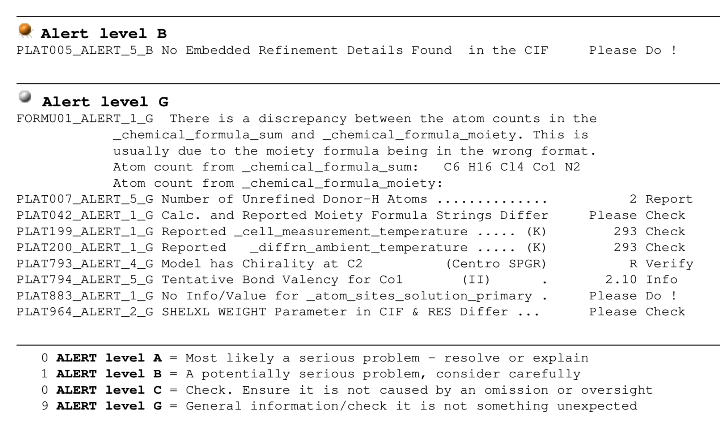
Example of an IUCr checkCIF Report

Slide 6
IUCr/checkCIF
IUCr/checkCIF is now around for > 25 years
It was pioneered by Acta Cryst. C. (Syd Hall)
It depends on the CIF-standard for the archival and exchange of crystallographic data (Hall et al.)
CIF was early adopted by Sheldrick in SHELXL
CheckCIF aims at the standardization of the review process and data archival of crystal structure reports
An IUCr checkCIF/report is now required by most journals for papers reporting a crystal structure or automatically invoked for Acta Cryst papers.

Slide 7
PLATON
PLATON is as single program with multiple tools that were found useful for our National Single Crystal Service Facility (> 40 years development)
A subset of those tools is used as part of the IUCr checkCIF facility for creating the review report
Additional PLATON tools can be used to investigate ALERTS as reported by IUCr/checkCIF
PLATON also includes its own checkCIF tool to be used locally during a structure determination to detect issues at an early stage of the analysis.

Slide 8
SELECTED PLATON TOOLS
ORTEP - Shows unusual ADP’s
PLUTON - Display intermolecular contacts
VOID/SQUEEZE - Inspect/report on void content
TwinRotMat - Report on missed twinning
ADDSYM - Investigate Missed or Pseudo Symmetry
SPGRfromEX – Analysis of systematic absences
FCFVALID/ANALofVAR - Inspection of the refinement details and unmerged .hkl and .fcf reflection data
ContourDIF - Inspection of the residual density map
BijvoetPair - Absolute Structure Parameters
ASYM-VIEW – Inspection reflection data set

Slide 9
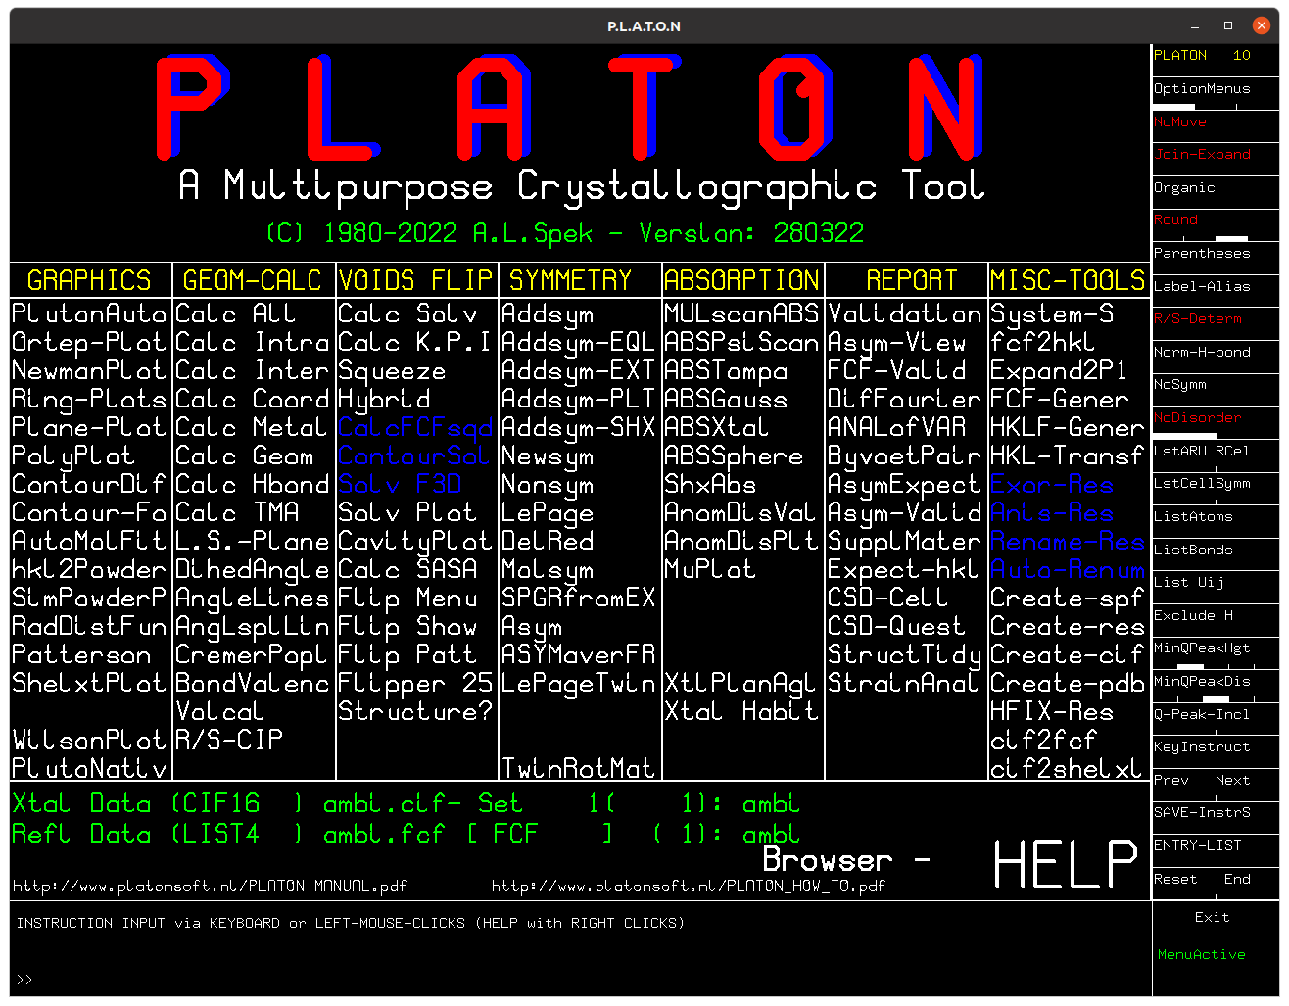

Slide 10
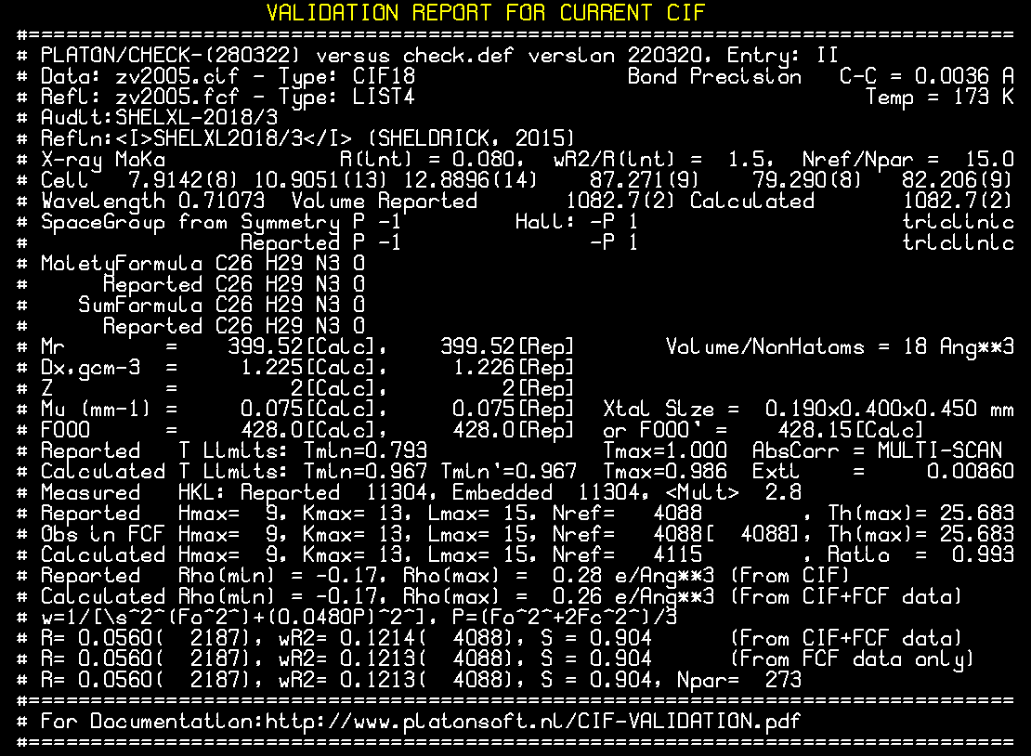

Slide 11
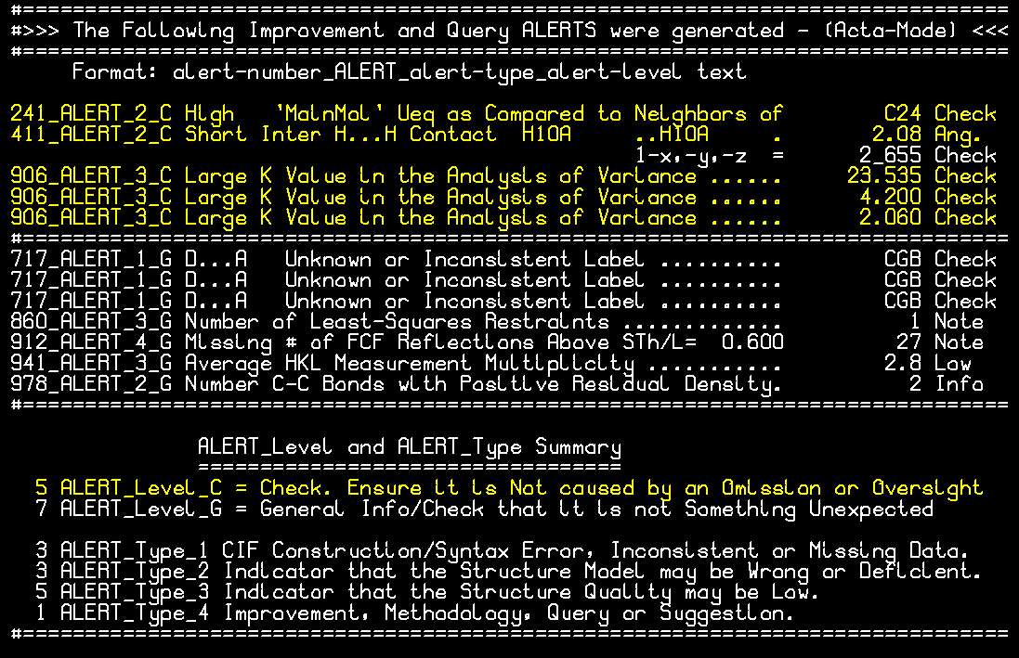

Slide 12
Reflection Dataset Completeness
Two types of information are expected to given
The completeness of the dataset at theta_max
The theta value (theta_full) at which the dataset is essentially complete
Data are expected to be complete to at least 25°(Mo)
SHELXL reports by default the completeness at 25.2° (Mo)
A completeness ALERT will we issued for a completeness lower than 95%
Proper theta_full values can be gleaned from the .ckf listing associated with the checkCIF report (Section 4)

Slide 13
Section 4 of .ckf listing
Resolution & Completeness Statistics (Friedel Pairs Averaged)
==============================================================
Theta sin(th)/Lambda Complete Expected Measured Total Missing
-------------------------------------------------------------------------------
20.82 0.500 0.999 1402 1400 2
23.01 0.550 0.999 1841 1839 2
25.24 0.600 0.999 2361 2359 2
------------------------------------------------------------ ACTA Min. Res. ---
27.51 0.650 0.997 2961 2951 10
29.84 0.700 0.955 3661 3497 164
31.24 0.730 0.899 4102 3686 416
A lower than 25° theta_full value needs a valid justification

Slide 14
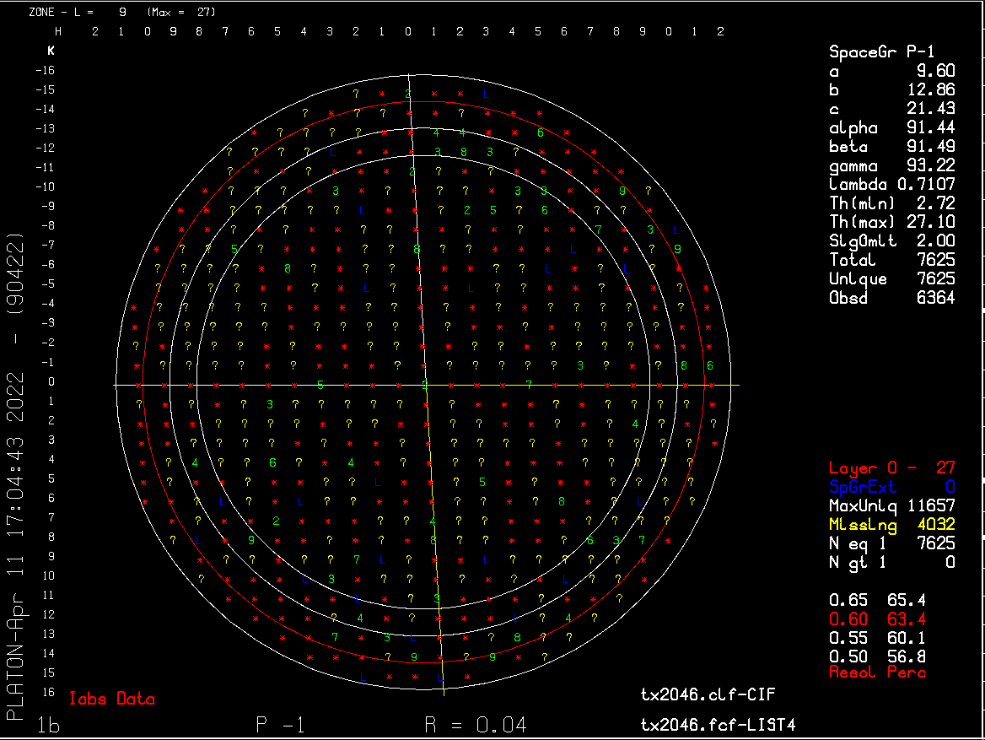

Slide 15
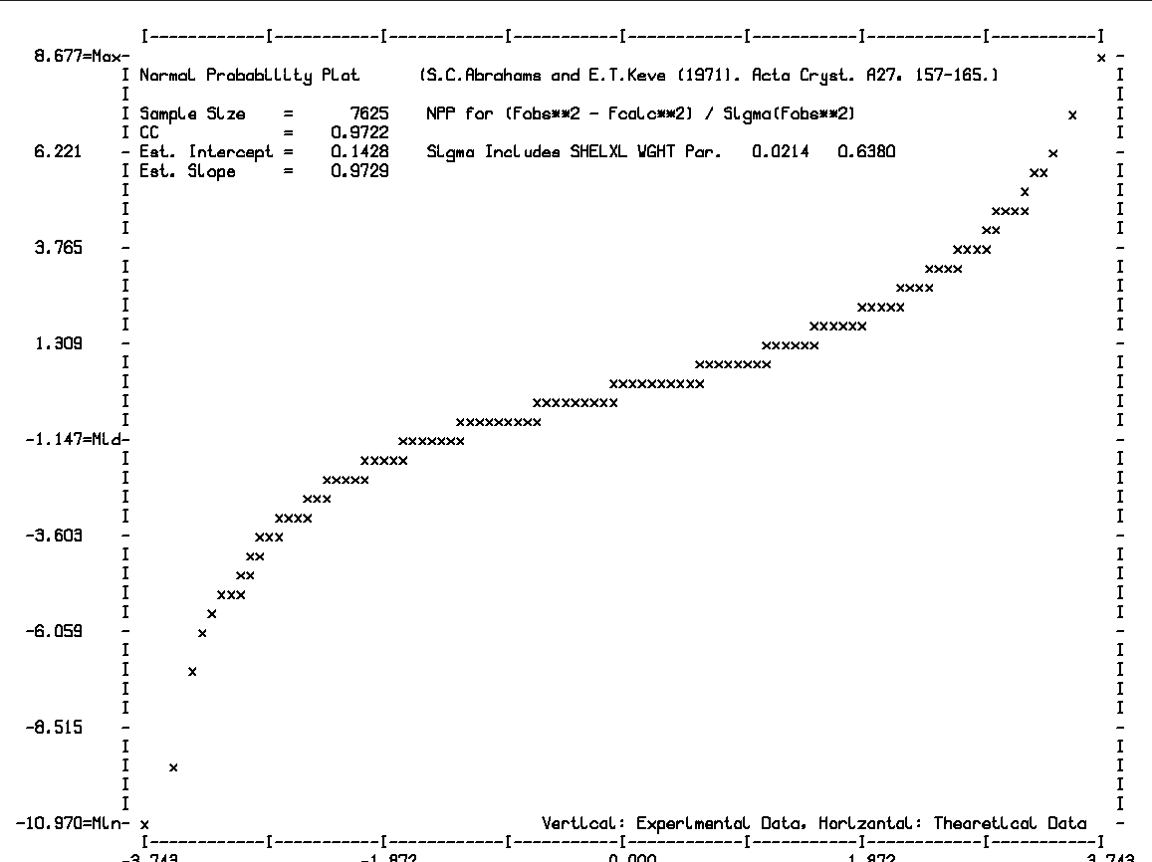

Slide 16
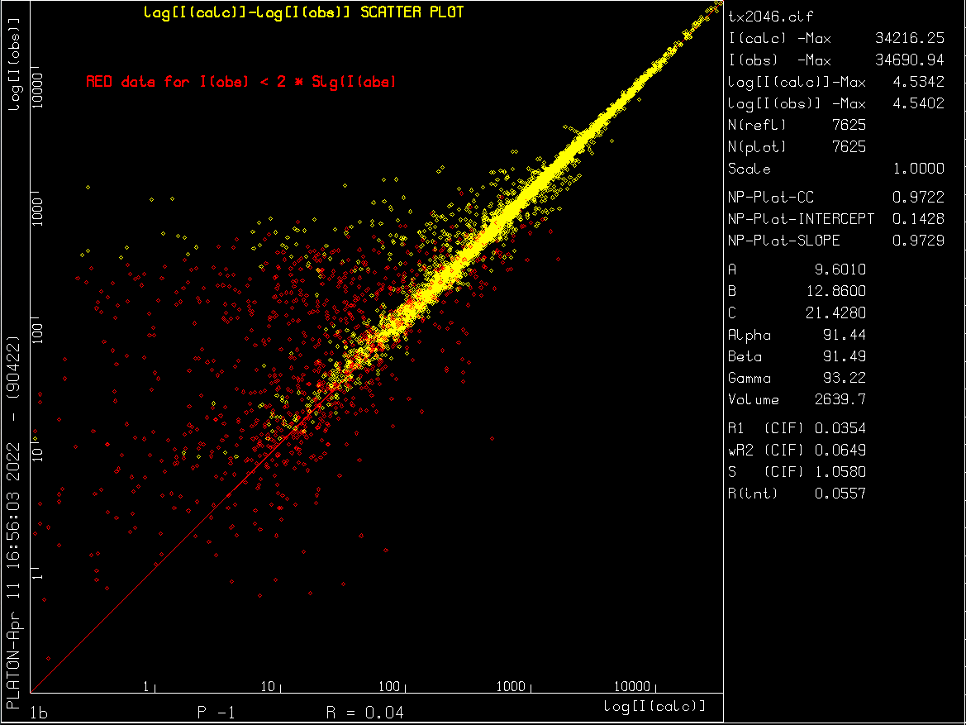

Slide 17
Example of a Cryptic ALERT Message
PLAT018_ALERT_1_C _diffrn_measured_fraction_theta_max .NE. *_full ! Check
A more explicit version of this ALERT reads:
================================================================
ALERT_018 Type_1 CIF Construction/Syntax Error, Inconsistent or Missing Data
================================================================
The values of _diffrn_reflns_theta_max and _diffrn_reflns_theta_full
are reported as equal. However, the associated reported values of
_diffrn_measured_fraction_theta_max and
_diffrn_measured_fraction_theta_full are not equal. This is inconsistent
This type of info can be obtained from the IUCr WEB-site along with associated CIF dataname definitions or as appended to the PLATON checkCIF report

Slide 18
CIF Dataname Definitions
_diffrn_measured_fraction_theta_max:
Fraction of unique (symmetry-independent) reflections measured out to
_diffrn_reflns_theta_max.
_diffrn_measured_fraction_theta_full:
Fraction of unique (symmetry-independent) reflections measured out to
_diffrn_reflns_theta_full.
_diffrn_reflns_theta_max:
Maximum theta angle in degrees for the measured intensities. The fraction
of unique reflections measured out to this angle is given by
_diffrn_measured_fraction_theta_max.
-diffrn_reflns_theta_full:
The theta angle (in degrees) at which the measured reflection count is
close to complete. The fraction of unique reflections measured out to
this angle is given by _diffrn_measured_fraction_theta_full.

Slide 19
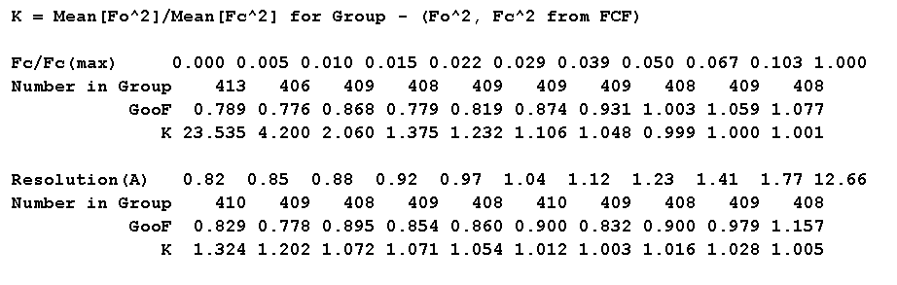
ALERT ‘Large/Negative K value in the Analysis of Variance’
K values are expected to be close to 1.0. See CFK listing
Large deviation should be investigated for model or data problems (twinning, unresolved solvent content)
Negative values may be due to numerous weak reflections with negative intensity due to poor integration

Slide 20
Do Authors and Referees take Notice of Validation ALERTS?
There was a wake-up call in 2010 with multiple cases where serious ALERTS related to faked structures were obviously not followed up during the refereeing process.
As a result, there were 100++ retractions with its effect shown in the next slide, making journals and referees more aware of the validation issue.
The situation has much improved but …. some avoidable errors still slip through.(example later)

Slide 21
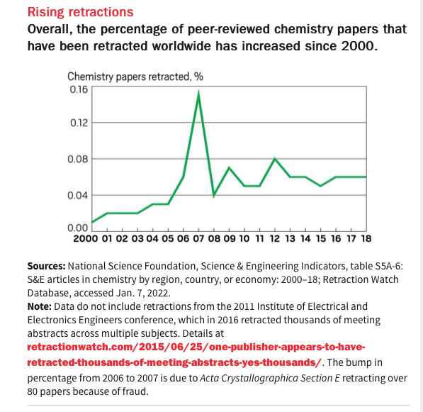

Slide 22
Recently Published 2022 Example
Authors & Referees did not follow-up on a series of level B & C ALERT messages in the following example (no fraud)
Fortunately there is no serious impact on the reported chemistry of the main molecule but the problem should have been easy to correct.
This example Illustrates the use of contoured difference electron density maps for a detailed inspection of residual unaccounted for density.

Slide 23
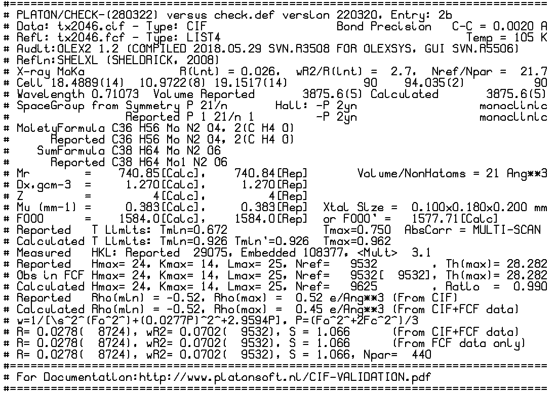

Slide 24
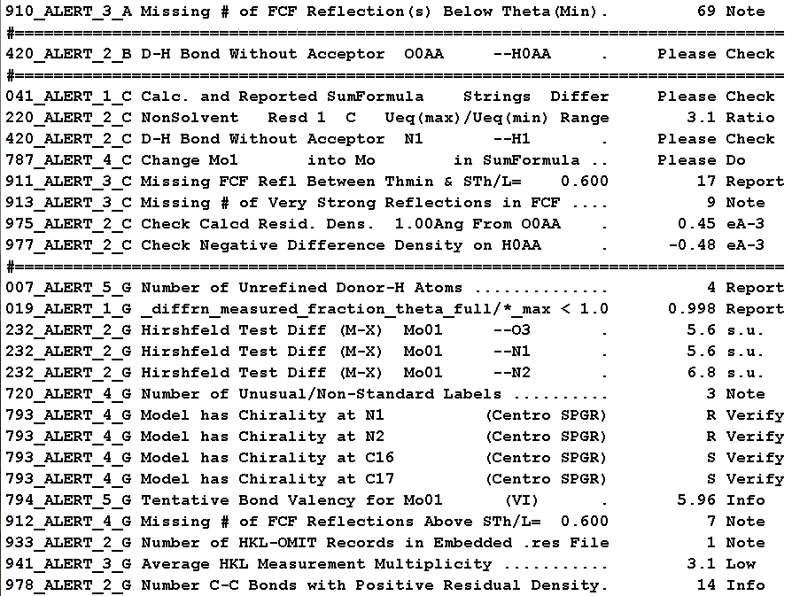

Slide 25
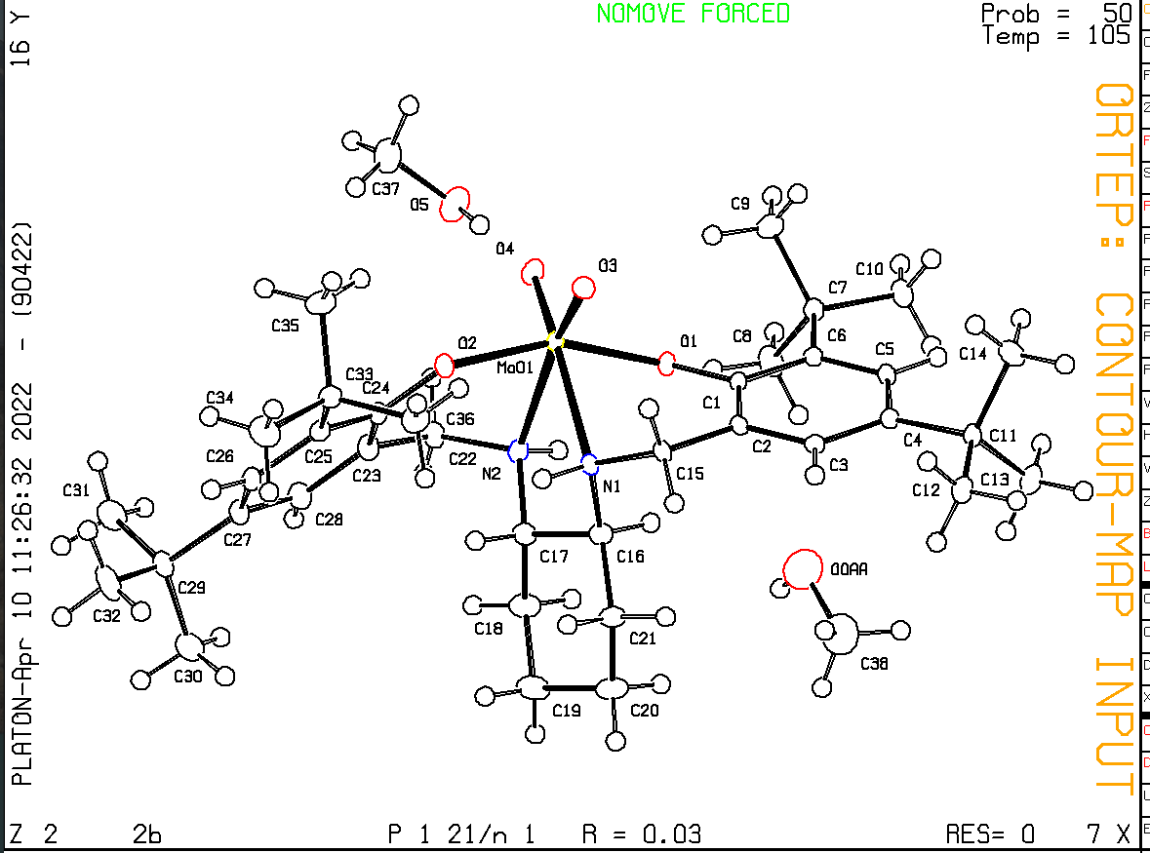

Slide 26
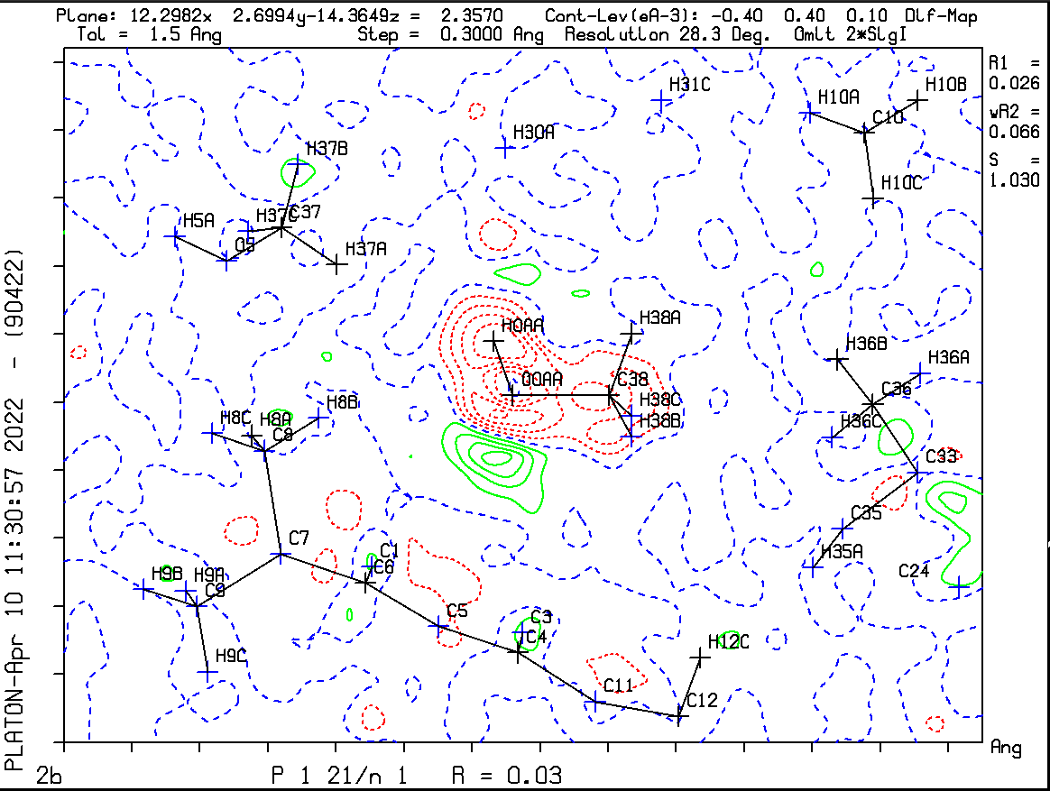

Slide 27
How to Proceed
Remove the H atom on O of methanol
Introduce a population parameter for the troublesome methanol
Refine
Prepare contoured difference map
Refine with H in proposed now staggered position 180 away from the erroneous position
Optionally, check with a difference map again while leaving out H from Fcalc

Slide 28
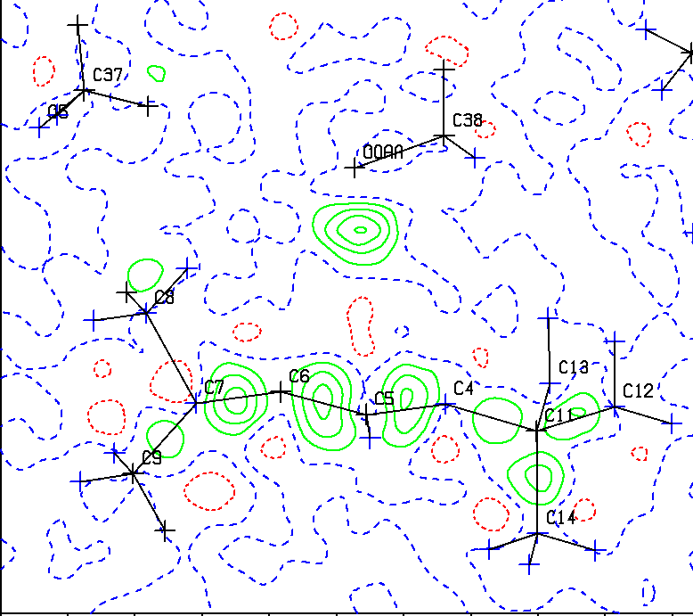

Slide 29
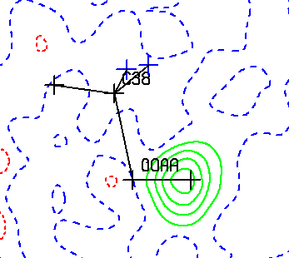
Contoured Difference Density Maps
Map showing of published model with H atom in wrong position (Red) and
Suggested alternative position (green)
H atom in proposed position. Methanol
refined with partial occupation.
Difference map without H contribution

Slide 30
SOFTWARE AVAILABILITY
Website: www.platonsoft.nl/xraysoft
~ 190000 lines of Fortran Source Code
Free for academics
LINUX/UBUNTU/X-WINDOWS – source code
MS-WINDOWS (Louis Farrugia) executable
MacOS: source code & executable
WINDOWS11/WSL/UBUNTU source code
RASPBERRY PI source code

Slide 31
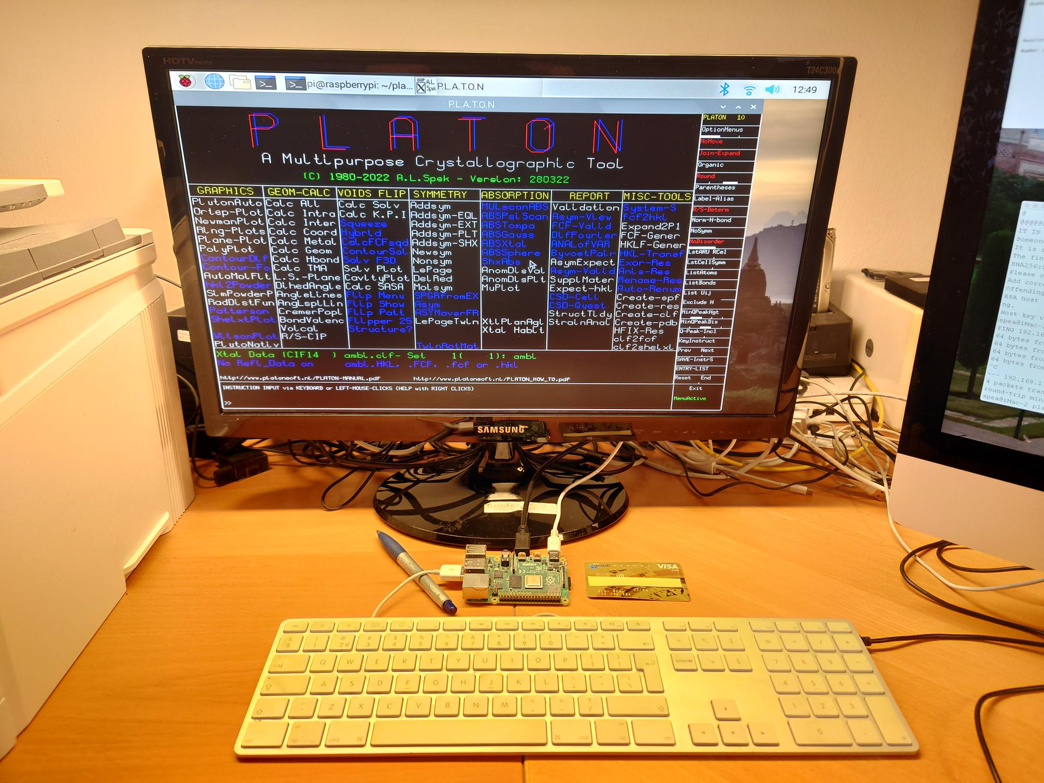
~50 US$ Raspberry Pi Linux Computer

