Slide 1
Validation of Structure Analysis Results or What Makes a Structure Report Valid?
Ton Spek
Utrecht University (NL)
ECS4-School, Warsaw, July 2-7, 2017

Slide 2
Structure Validation Before CIF
How it was when I started in crystallography as a student in 1966 at Utrecht University ...

Slide 3
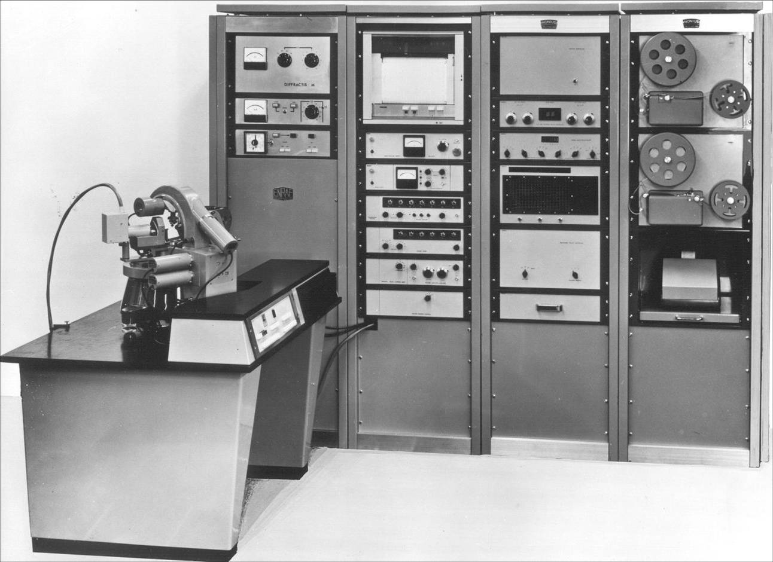
Data Collection around 1966
Nonius AD3 Diffractometer
One data set: weeks !

Slide 4
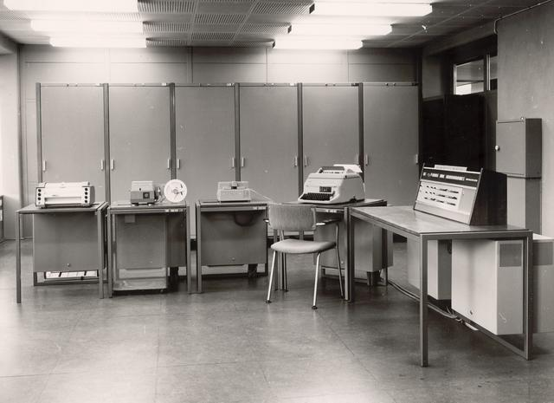
~1966, Electrologica X8 ALGOL60 ‘Mainframe’ (<1MHz)
60kB
Operator
Plotter
Output
Input
Console
Multiple Hours of computing time per structure

Slide 5
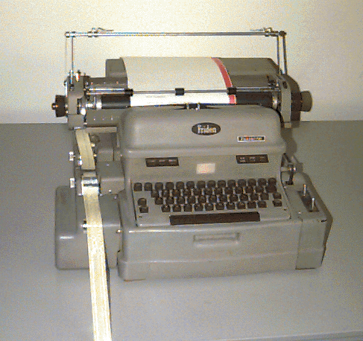
Flexowriter for the creation and editing of programs and data

Slide 6
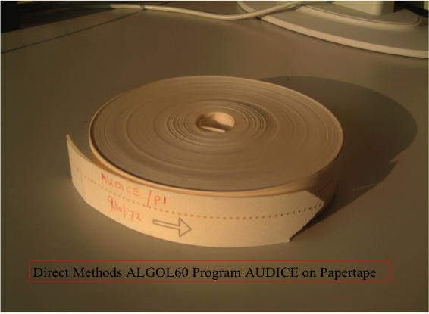
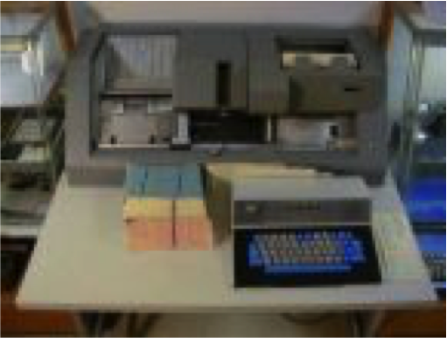
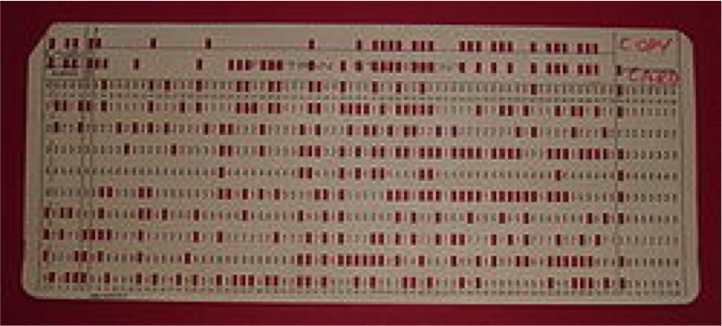
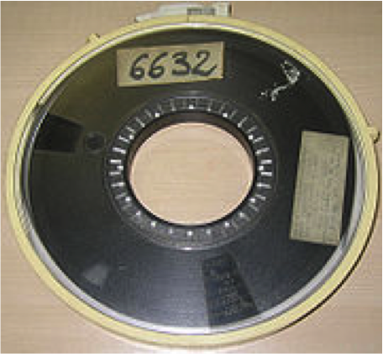

Slide 7
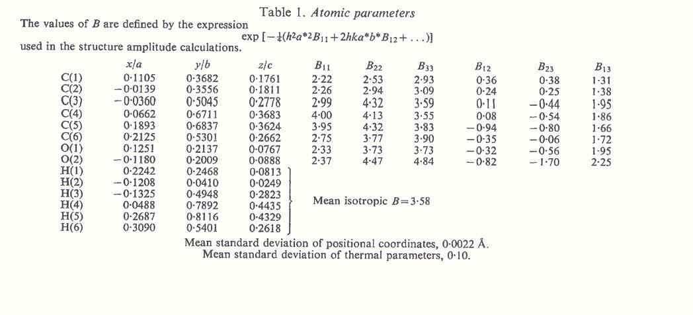
Archival of Model Parameters in a Publication (Acta Cryst.)
Notes:
7

Slide 8
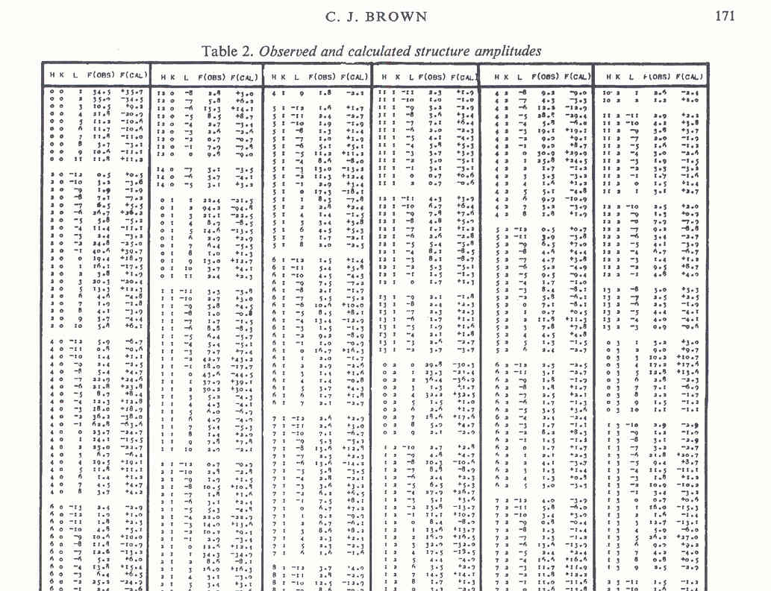
Archival of Reflection Data in a Publication (Acta Cryst.)
Notes:
8

Slide 9
Early Data Validation
Early (basic) validation was mainly done by the CSD, after publication.
The coordinate data were retyped into computer readable format from the publication and checked for internal consistency with the also retyped bonds and angles.
Authors of an erroneous paper were approached to resolve unresolved issues.
All this changed with the introduction of the computer readable archival standard: CIF.

Slide 10
Early IUCr checkCIF validation
CIF was early adopted by the Sheldrick/SHELXL92
Automated Structure validation, based on CIF, was also pioneered in the early 1990th by the editors of the IUCr journal Acta Cryst. C.
The reason was the explosion of structure reports that were submitted at that time.
Initially, CIF’s were mainly analysed for consistency, completeness and quality of the data and refinement result.
A validation report was created to support the editorial and refereeing process.

Slide 11
Today’s IUCr checkCIF
Today, IUCr/checkCIF is mainly based on the checkCIF tool in the PLATON program.
Easily available through the IUCr checkCIF server
Also available for in-house use with a locally installed PLATON executable (LINUX, Mac-OSX, MS-Windows.) that also offers supplementary analysis tools for the investigation of ALERT issues.
Input: CIF (+ FCF) created with SHELXL, OLEX2 etc.
Output: A CIF validation report (.chk) and an FCF
analysis report (.ckf) or the IUCr checkCIF report.

Slide 12
Why Structure Validation ?
To help authors to avoid obvious errors and pitfalls prior to publication and to point at (possibly interesting) issues to be investigated and discussed.
To notify referees, editors and readers about unusual/interesting issues to be considered.
Most journals now require a validation report, created by the IUCr checkCIF server, for papers that include a crystal structure report.

Slide 13
Does it work ?
Yes for the IUCr journals but unfortunately not always with chemical journals.
Significant knowledge of the crystallographic procedures (and underlying chemistry) will still be needed for a proper interpretation of ALERT messages that come with levels A, B, C & G and on how to act upon ALERT messages.
Unfortunately, not all authors, referees and chemical journals appear to have that knowledge available or involve crystallographers as referee.
Not always: See next illustrative example of an initially boring looking routine structure report.

Slide 14
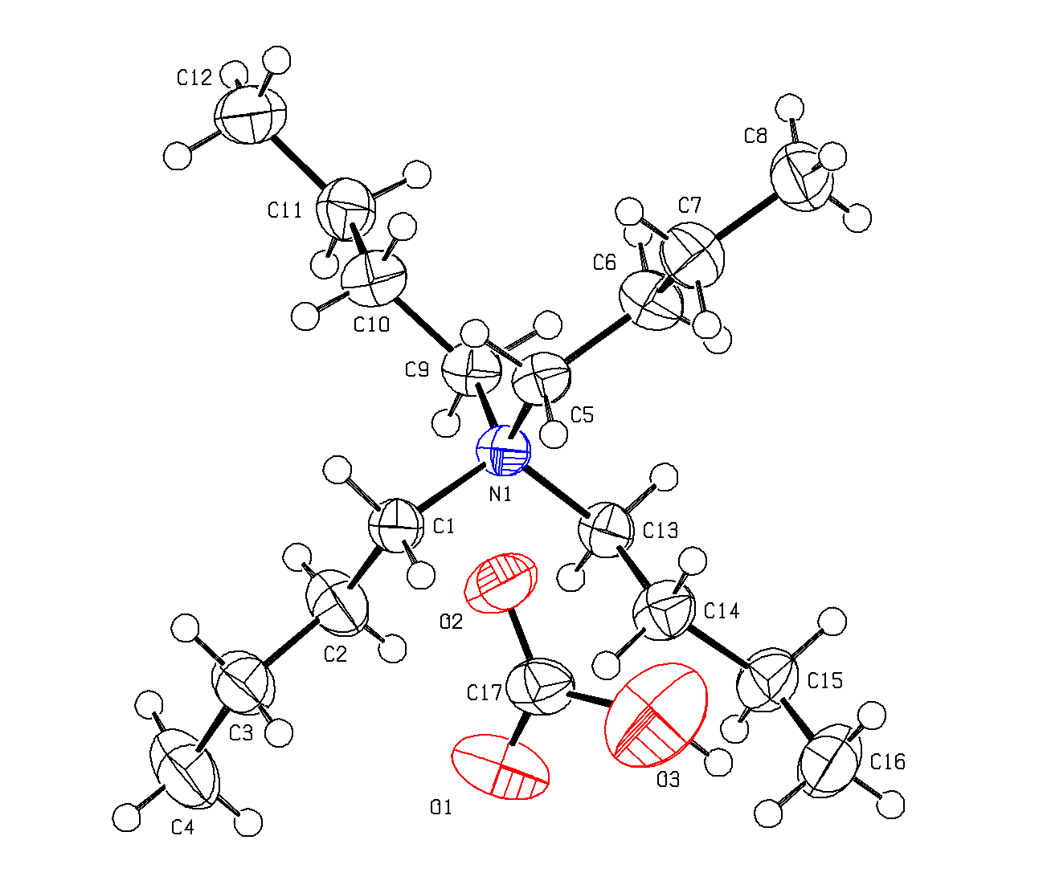
Tetrabutylammonium Hydrogencarbonate?
Boring?
Note the slightly
higher Uij for O3
Author’s interpretation of the experimental data

Slide 15
Boring ?
Published in the high-impact journal
Angew. Chem. Int. Ed.
2015, 54, 164-168
The authors see something unusual and interesting ….. in that structure.

Slide 16
Why an Interesting Structure ?
Title: “Crystallographic Snapshot of an Arrested Intermediate in the Biomimetic Activation of CO₂” with all the keywords to attract interest.
Product of the bubbling of CO₂ through a solution of n-tetrabutylammonium hydroxide
[N(C₄H₉)₄]⁺[OH]⁻ + CO₂ ➔ [N(C₄H₉)₄]⁺[HCO3]⁻
Study motivated by CO₂ fixation/conversion research. Hot! ….

Slide 17
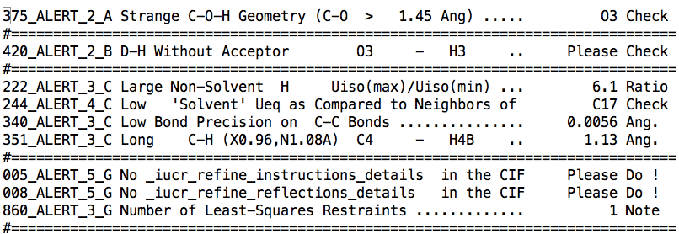
Selected Validation Issues
No reflection data available for independent analysis !

Slide 18
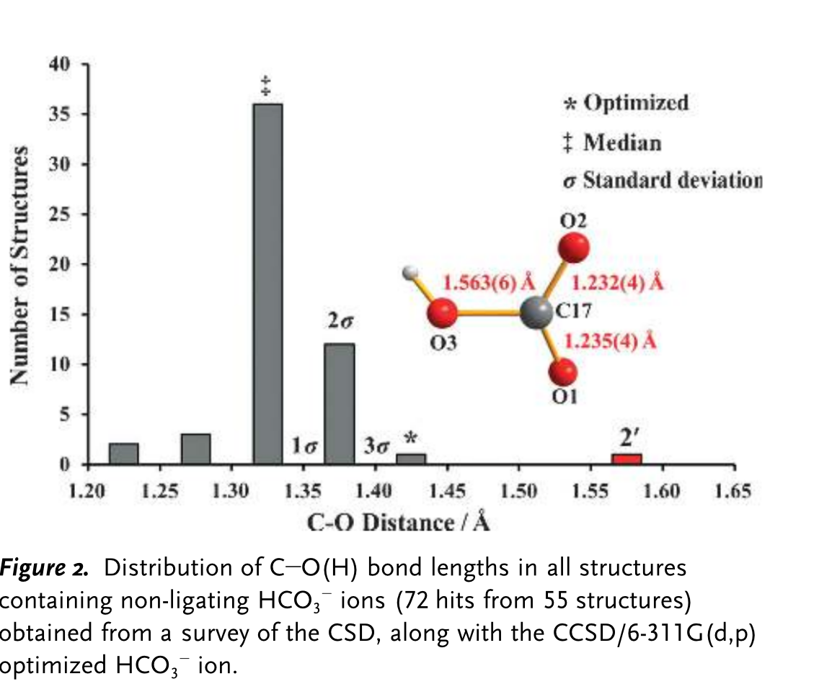
Interpretation Issues
The authors noticed that:
O3-H without acceptor
The unusually long C17-O3 bond of 1.563(6) Ang.
But interpreted that as:
“H-O…CO₂ , stabilized by interactions with the cation scaffold”
Referees apparently accepted that strange argument
An acetate anion might fit as well. Authors felt it ‘unnesessary to revisit the chemistry at this time’ when commented on ….
‘

Slide 19
A few month’s later …
A paper appeared entitled: ‘Comment on “Crystallographic Snapshot of an Arrested Intermediate in the Biomimetic Activation of CO₂”’
by J.A.C. Clyburn et al. (2015). Angew. Chem., 54,
7484-7487.
New data collection with acetate as anion => The previously described mystery species is certainly the common acetate anion (O-H ➔ CH₃)
Now supported by deposited reflection data in SHELXL2014 CIF format.

Slide 20
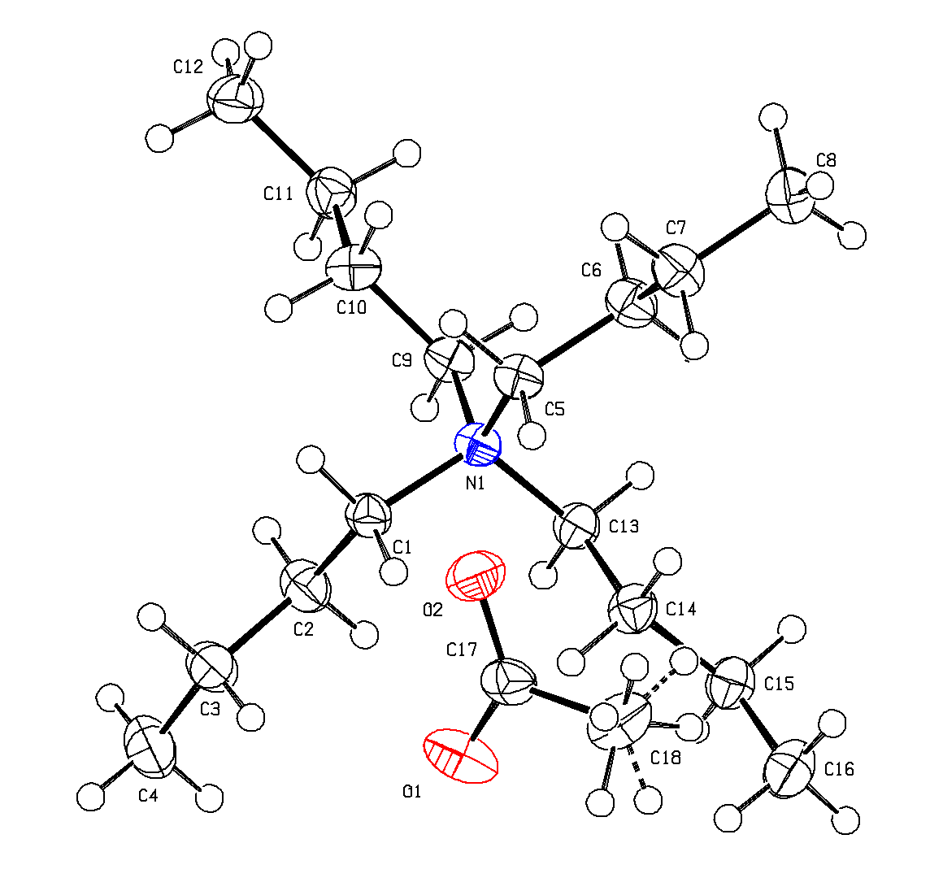
Comparison of the ‘hydrogen carbonate’ and acetate ORTEP’s
Observe the close resemblance of the displacement ellipsoids and a clear indication that one of the oxygen atoms should be a carbon atom.

Slide 21
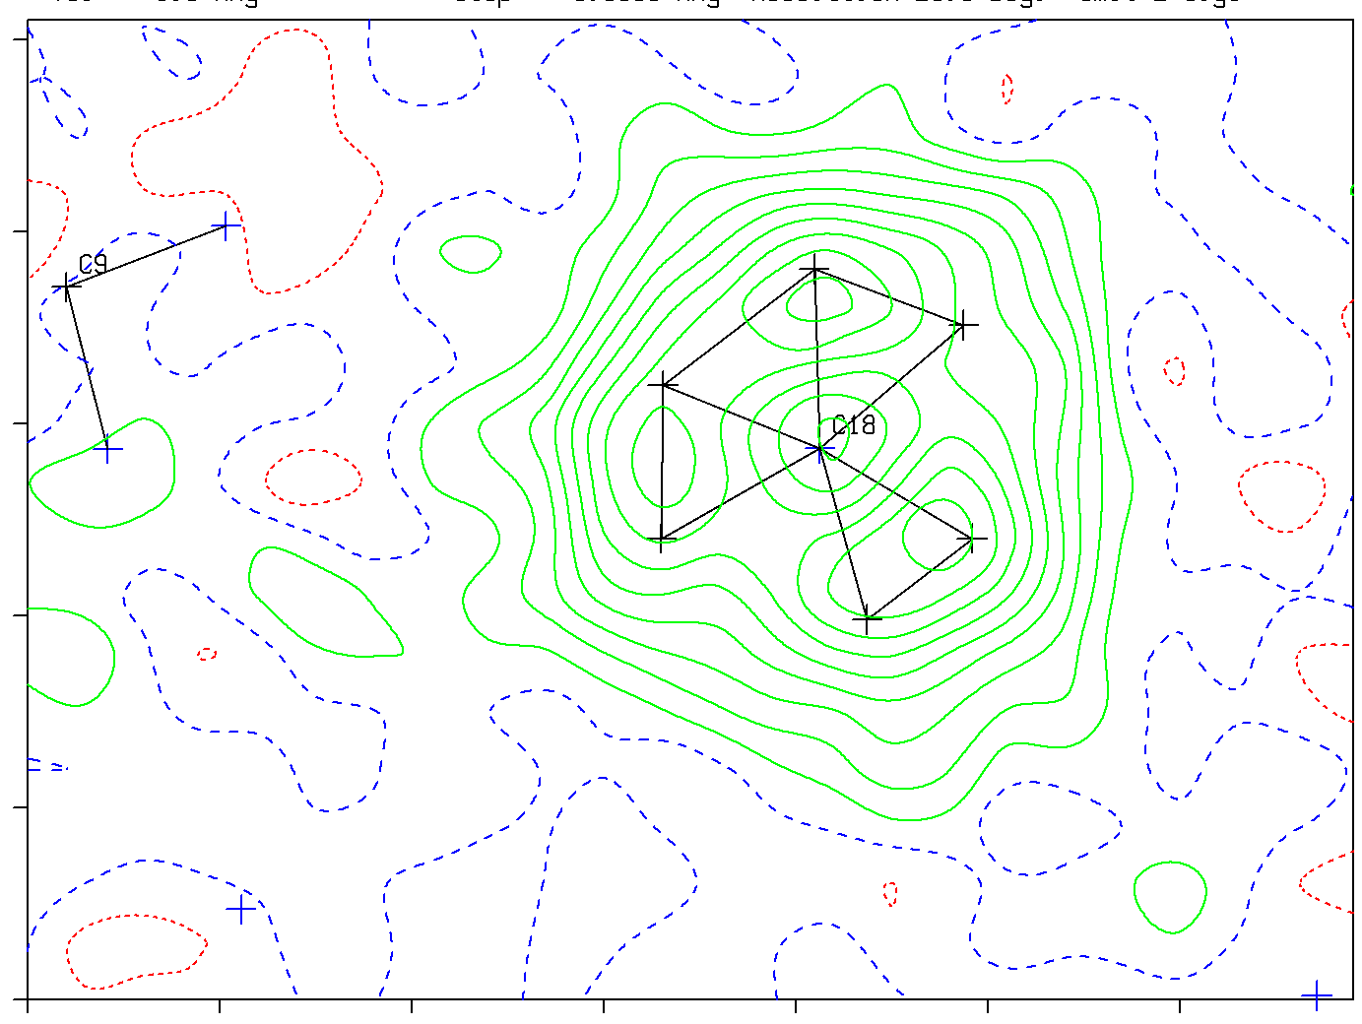
Contoured CH₃ density section in the acetate structure
We would expect to see a similar section prepared with the “HCO₃” data

Slide 22
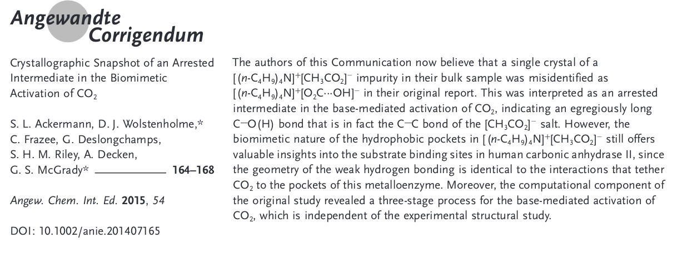
Original authors ‘Update’
Afterall a boring structure ….. but perfectly illustrating
my message that the experimental data should be
deposited as well in support of a structure report.
By-the-way, where did the acetate anion come from?

Slide 23
What are the issues that structure validation aims to address
Completeness and consistency of the parameter model data of the reported structure.
Completeness of the reported experimental data on which the study is based.
Completeness of the reported details of the data-reduction, structure solution and refinement.

Slide 24
Report & Archival
Report & Discuss any unusual procedure and result.
Supply sufficient archived and easy accessible information for an independent analysis of the data or use of the data for unrelated follow-up studies.
Validation is based on the CIF standard:

Slide 25
CIF as introduced in 1991
The main target of many X-ray studies is the 3D molecular structure in the form of coordinates, displacement parameters, bonds and angles etc.
The computer readable CIF file was introduced in the 1990’s as a replacement for the printed results.

Slide 26
CIF facilitates easy data transfer, archival (CSD), geometry calculations, graphics, publication (Acta Cryst.) and validation (checkCIF) of the results of a crystal structure.
However, A CIF, in its basic form, mainly reported the authors interpretation of the experimental diffraction data

Slide 27
However ….
A CIF in its basic form is insufficient for proper validation of a structure report, in particular in case of unusual, reported or claimed, results.
What is needed is detailed information of the refinement model, including the F_{obs}², F_{calc}² and sigma(F_{obs}²) listing file (FCF).
An FCF allows for statistical analysis of the fit of the authors structure model on the reflection data (missed twinning, absolute structure etc.).

Slide 28
Good Scientific Practice
In addition, it is good scientific practice to also supply and archive the unmerged set of observed data on which a study is based. The subject material might be unique or difficult to obtain !
This practice is now fully implemented in the SHELXL2016 refinement program with the embedding of the .res, .hkl (and .fab) files in an extended CIF format file. Other packages follow.
This allows for an alternative refinement with the archived data (e.g. A disorder model refinement versus a published SQUEEZE based refinement)

Slide 29
ALERTS A,B,C & G Level
All ALERTS should be inspected and possibly acted upon (in particular A-ALERTS with a suitable response)
The on-line documentation of an ALERT should be consulted.
Not all ALERTS are ERRORS but may point to interesting or unusual issues or just offer relevant information such as R & S assignments..
Sometimes, a combination of low level ALERTS (e.g. C or G level) may point to serious problems as well.
checkCIF is a learning process and is still developing with new ALERTS added or finetuned.

Slide 30
TESTS
Currently, 470 tests have been implemented
Testing the displacement ellipsoids
Testing short contacts (e.g. H … H)
Testing geometry
Testing for missed symmetry
Testing for missed twinning

Slide 31
PLATON Tools
Non-GUI terminal options
Validation - ‘platon -u name.cif’
SQUEEZE - ‘platon –q name.cif’
ORTEP - ‘platon –a name.cif’
ADDSYM - ‘platon –m name.cif
Etc.
GUI/Graphics - ‘platon name.cif’ for CALC, H-Bonds, TwinRotMat, Bijvoet etc.
Next: ‘platon –u example.cif’ validation

Slide 32
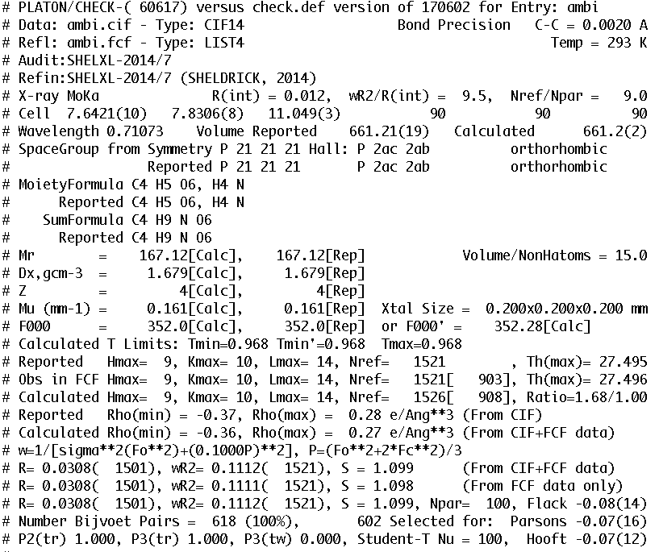

Slide 33
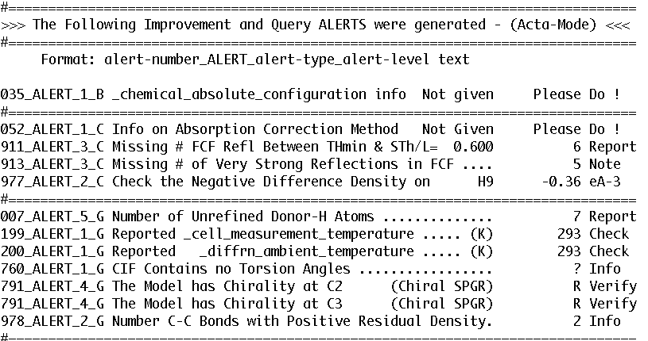

Slide 34
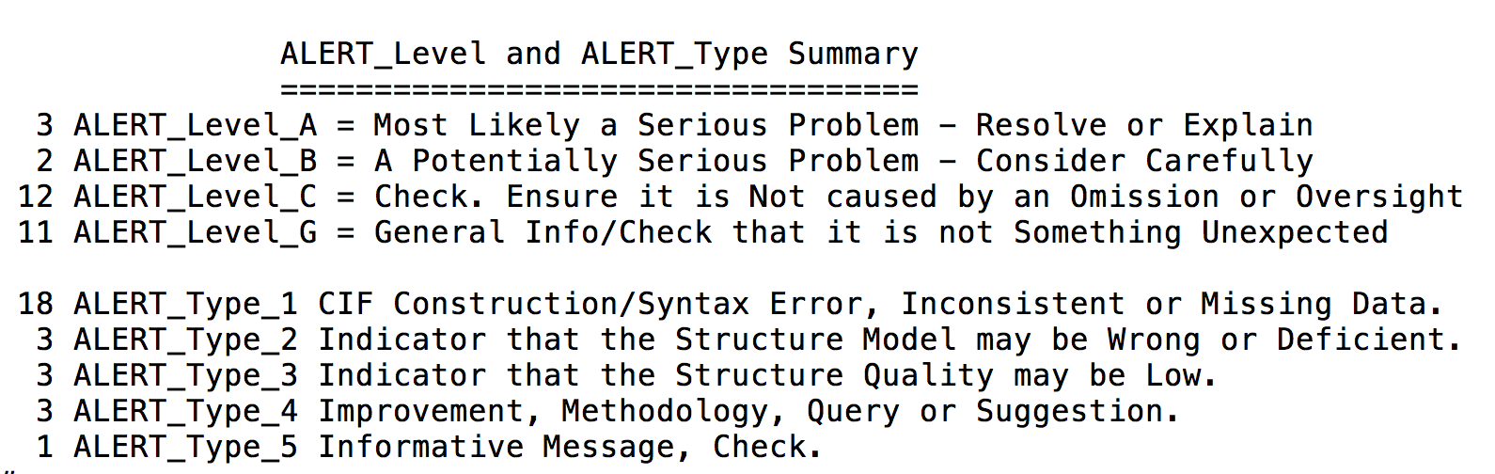

Slide 35
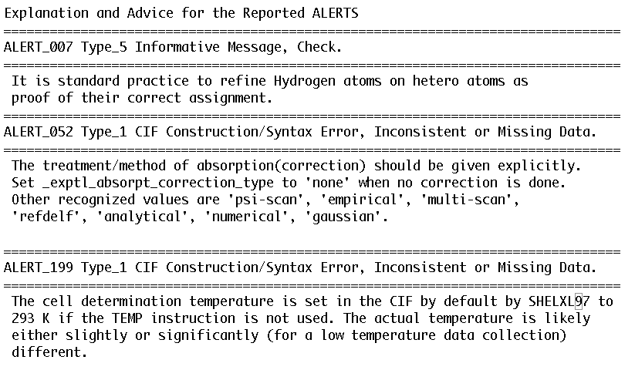

Slide 36
FCF-Validation (in .ckf) adds:
Analysis of the quality of the refinement
Analysis of the difference map (peaks)
Detection of void content (SQUEEZE)
Detection of missing reflections
Detection of outliers
Detection of missed twinning
Check of the reported absolute structure

Slide 37
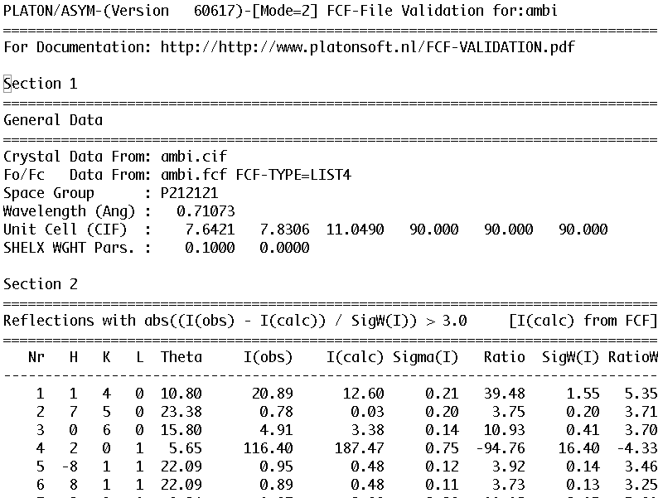

Slide 38
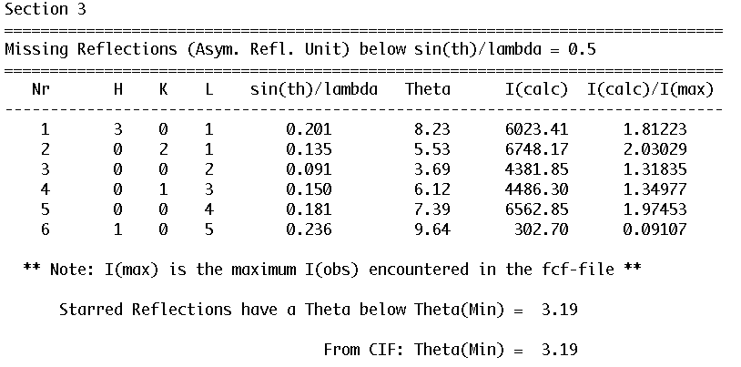

Slide 39
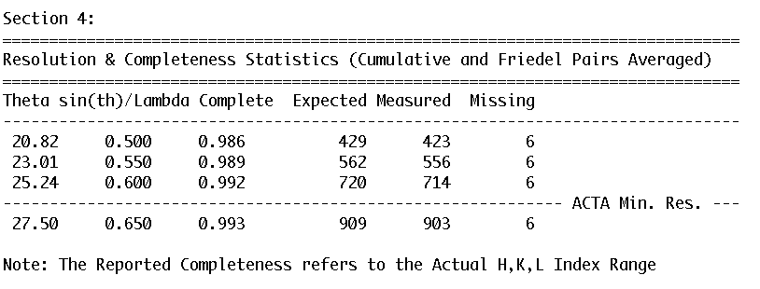

Slide 40
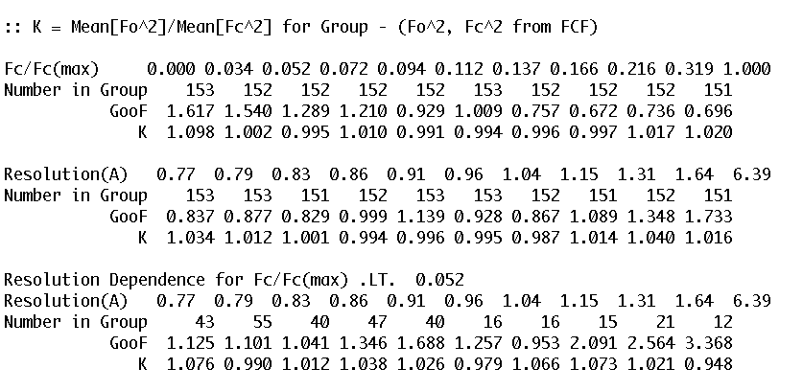

Slide 41
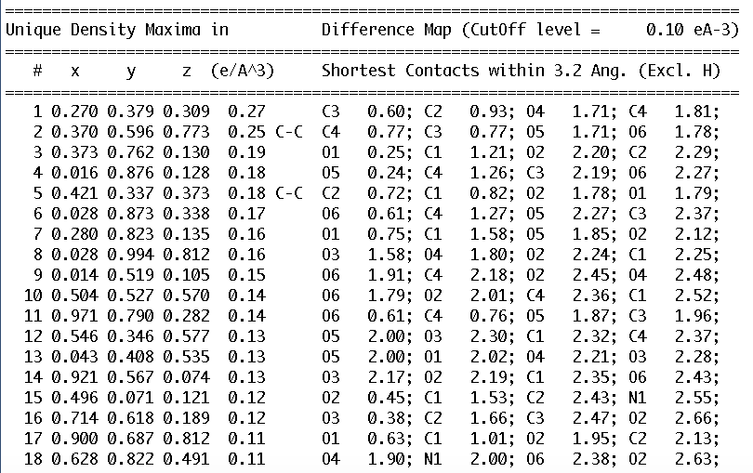

Slide 42
Difference Density Map (F_{o}-F_{c})
A difference electron density map is a very powerful validation tool.
Should not contain significant density excursions with |ρ_{min}| ~ ρ_{max} , say < 0.5 eÅ⁻³
Analysis with contoured maps is useful to check Hydrogen atom positions
A residual peak search list offers an overview of possible trouble spots with a structure

Slide 43
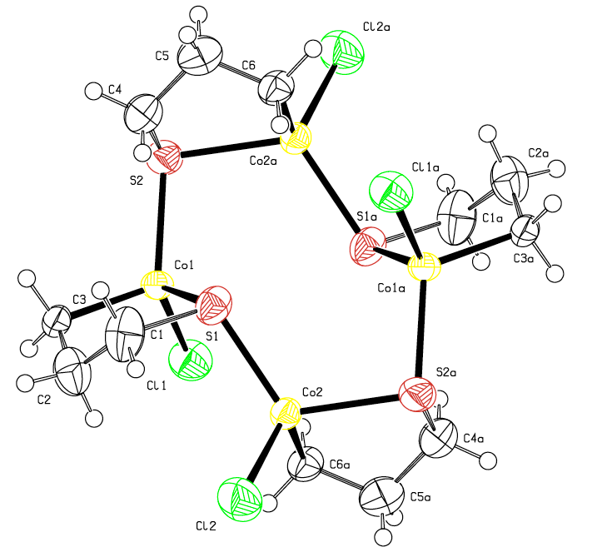
Acta Cryst. (2011). E67, m576-m577
Is this structure correct ?
[Co4Cl4(C3H6S)4]
R1 = 0.041
wR2 = 0.125

Slide 44
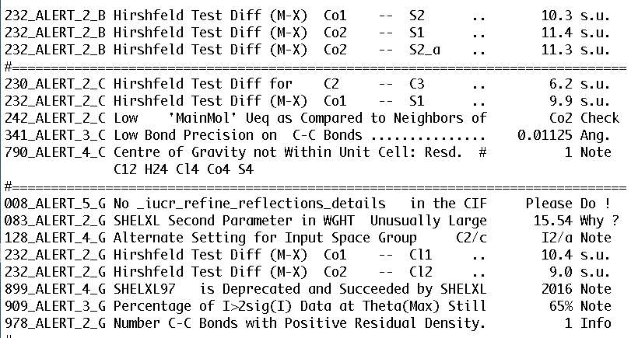

Slide 45
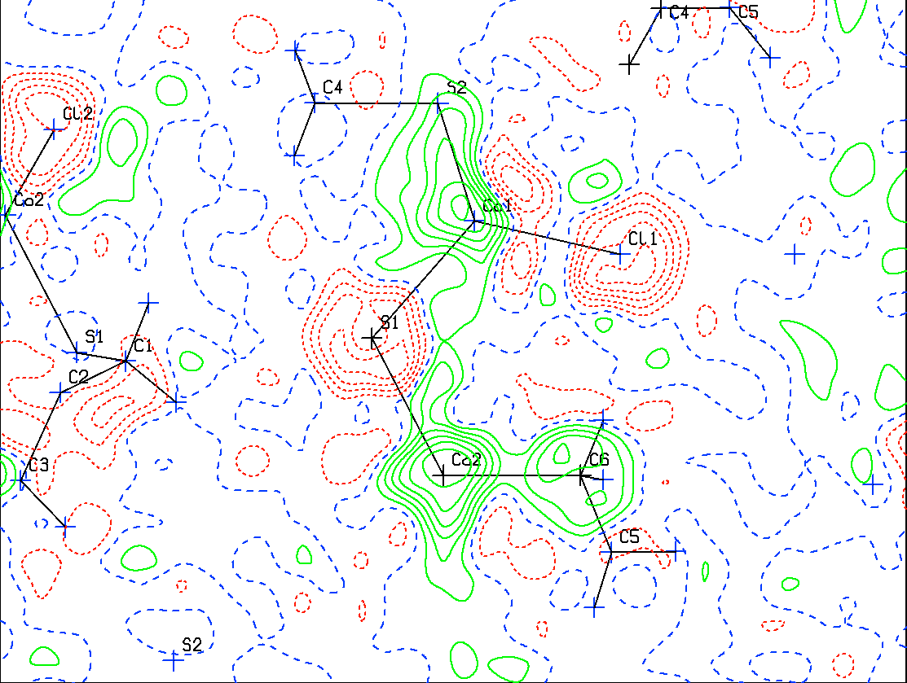

Slide 46
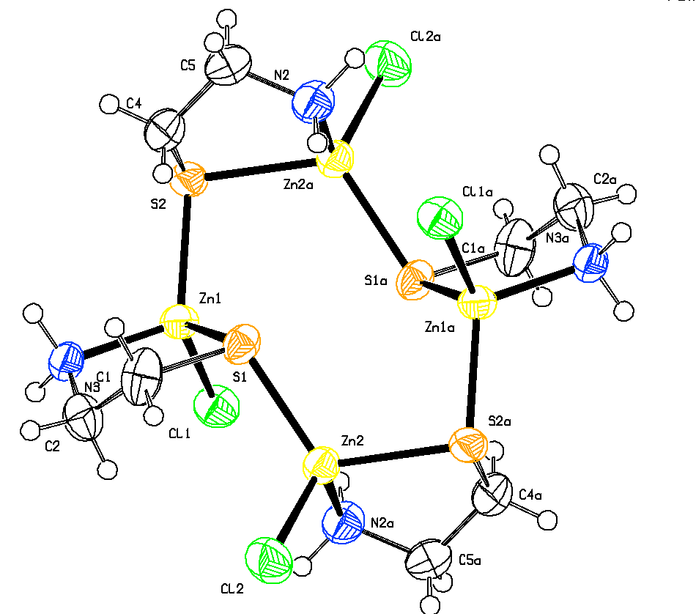
Co^{III} ➔ Zn^{II}
C3 ➔ N1
C6 ➔ N2
R1 = 0.028
wR2 = 0.075
Identical to:
Inorg. Chem.
(2006) 45, 8318
CSD:
Correction
proved with
reflection data

Slide 47
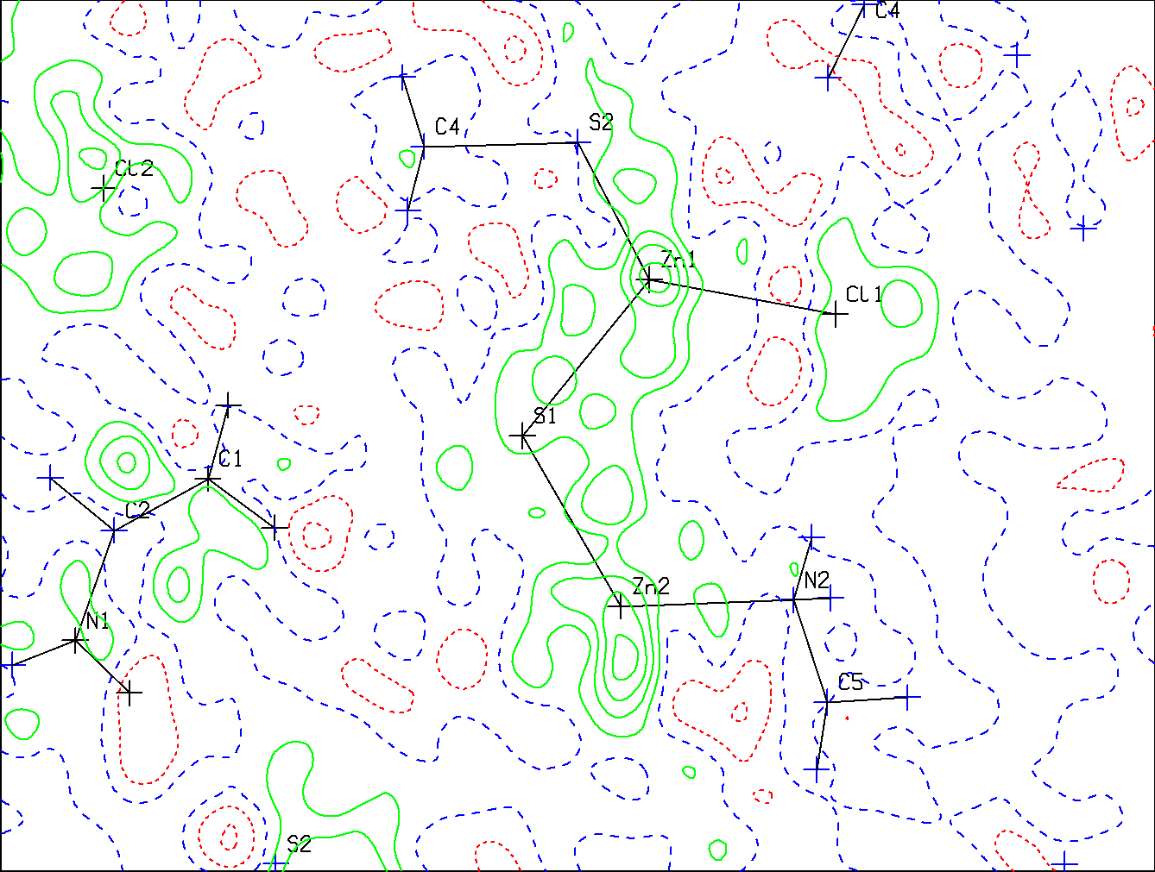
False Co-Complex ===➔ Zn-Complex
Contours at 0.1 e/Å³

Slide 48
Residual Density Peaks may be ..
Due to Unaccounted for Disorder
Unaccounted for Twinning
Missing or too many H-atoms
Misassigned atom types
Absorption artifacts (insufficient correction)
‘Bonding’ density on bonds
Note: SHELXL will not report residual density peaks at atom sites

Slide 49
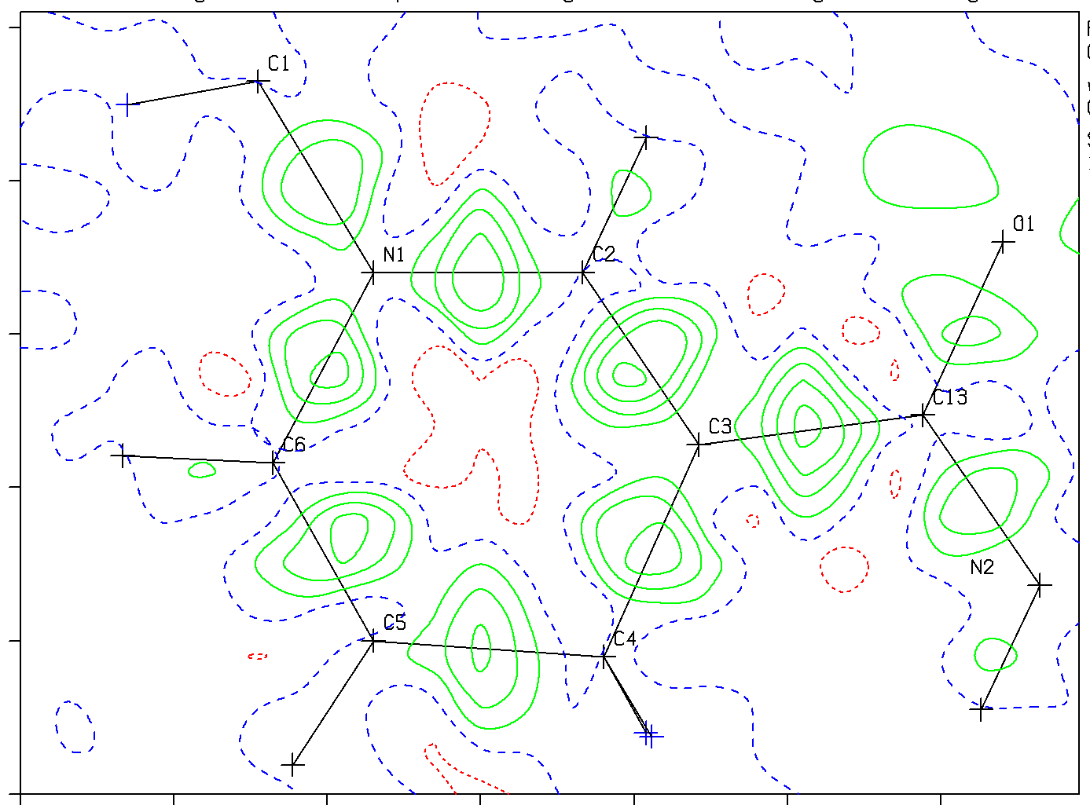
Density on Bonds for a Quality Structure

Slide 50
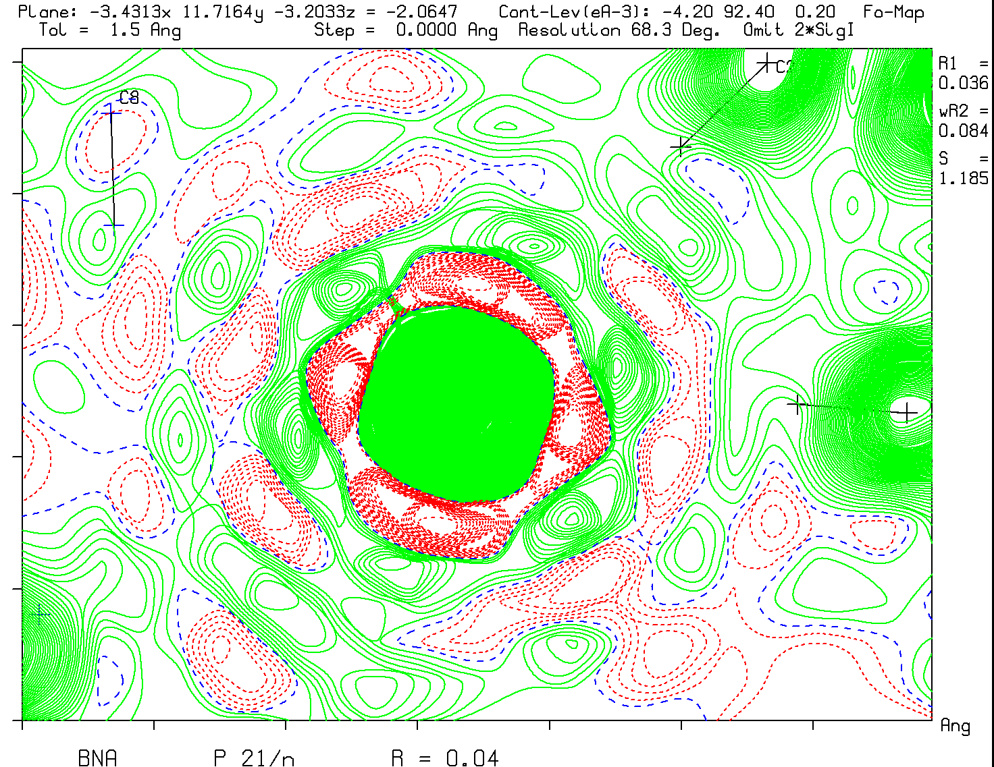
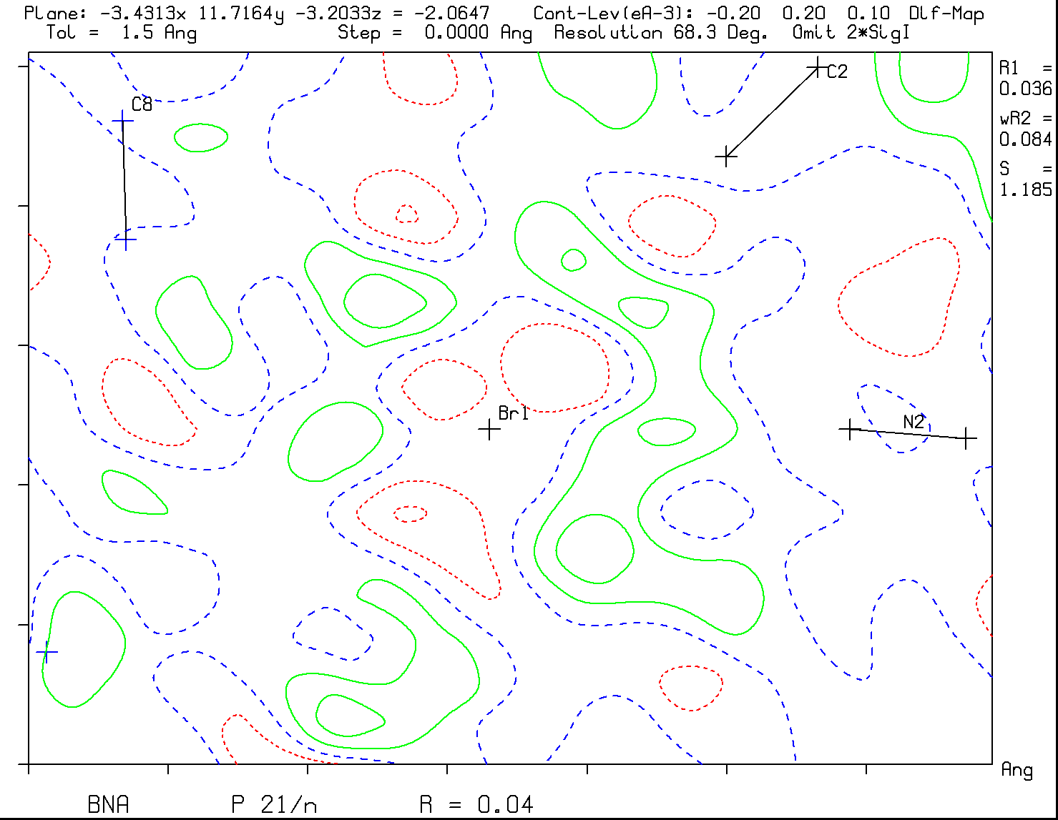
F(obs) and F(obs)-F(calc) Maps Large peaks in a difference map are not due to trancation ripples
Br
Br
Note the truncation ripples in the F(obs) map and absence in the F(obs)-F(calc) map

Slide 51
Wrong Structures
Wrong assumptions of the starting materials may lead to wrong interpretations (e.g. wrong element types)
Pseudo-symmetry may lead to false solutions with high R-values often explained to be due to poor data.
Perceived disorder can be an artefact of a wrong structure analysis.

Slide 52
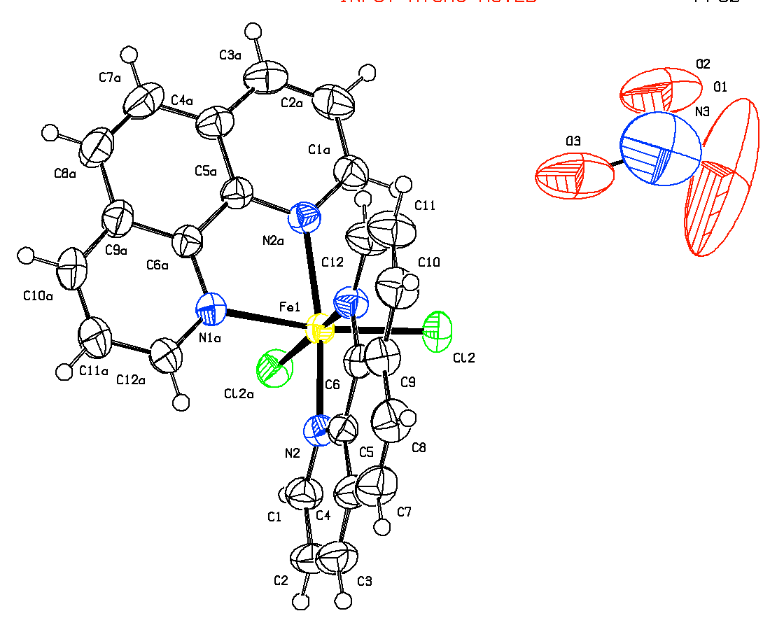
Problem Example from Chemical Journal
Eur. J. Inorg. Chem.
(2012) 4479-4485.
R1 = 0.08, wR2 = 0.30
Space Group C2/c
Fe-Complex on 2-axis
NO₃ Anion in general pos. Population = 0.5 !?
Charge Balance Problem

Slide 53
Problematic Structure
Problem: NO3⁻ in general position disordered over two symmetry related sites sounds strange (precedents ?).
Significant residual density peaks up to 2.5 e/Å³ but explained away as ‘With no chemical significance’
Reflection data would be needed for a detailed analysis of the issue but only a CIF was deposited.
Martin Lutz et al. resynthesised the compound following the authors protocol with a surprising result (Eur. J. Inorg. Chem. (2013) 2467-2469)
C2/c ➔ Cc and NO₃ ➔ NO₃ + Acetic acid + H₂O

Slide 54
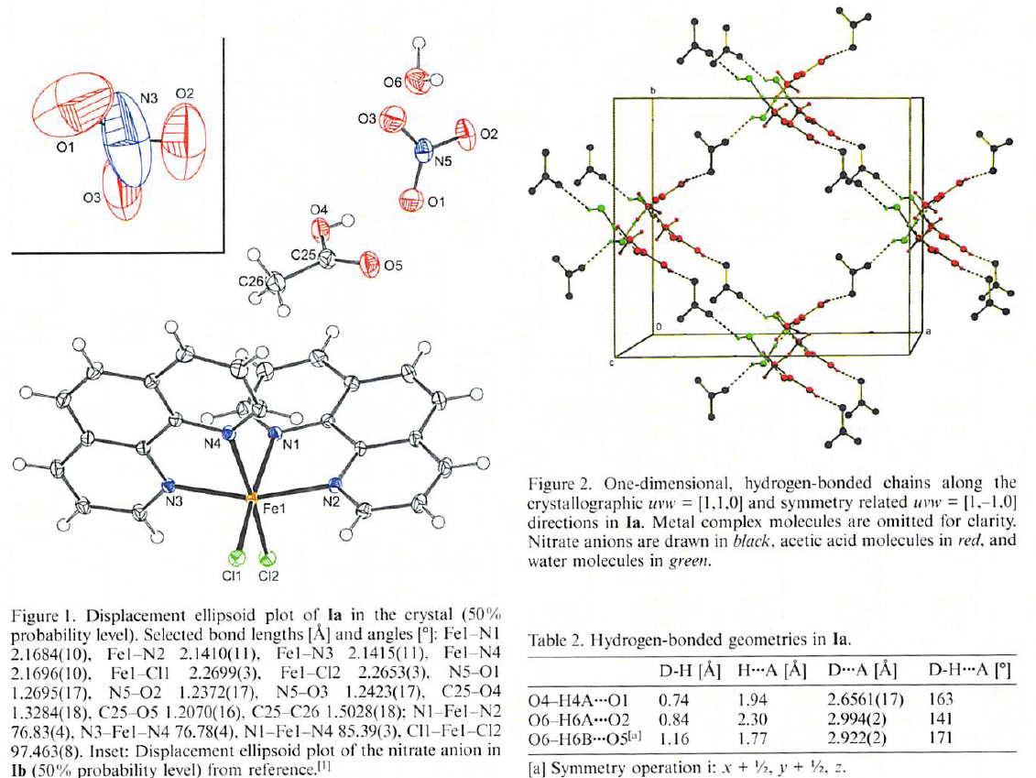
Biswas et al.
Lutz et al.

Slide 55
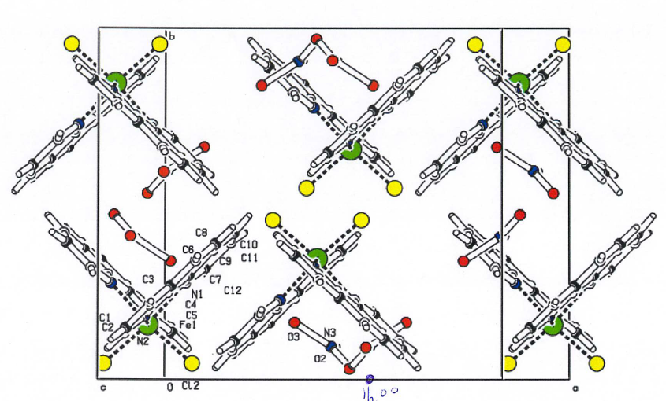
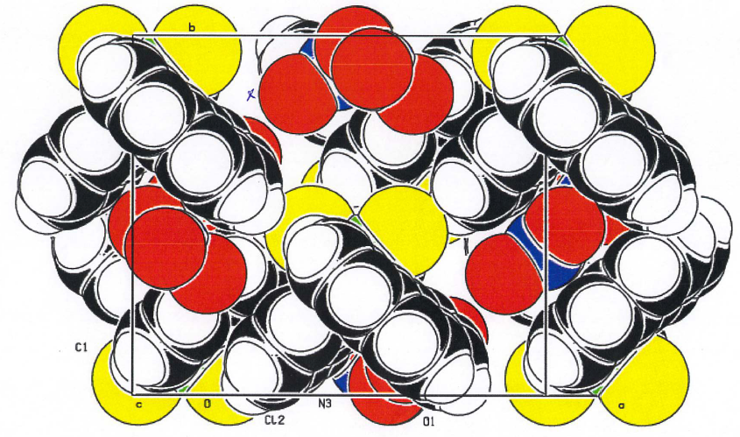
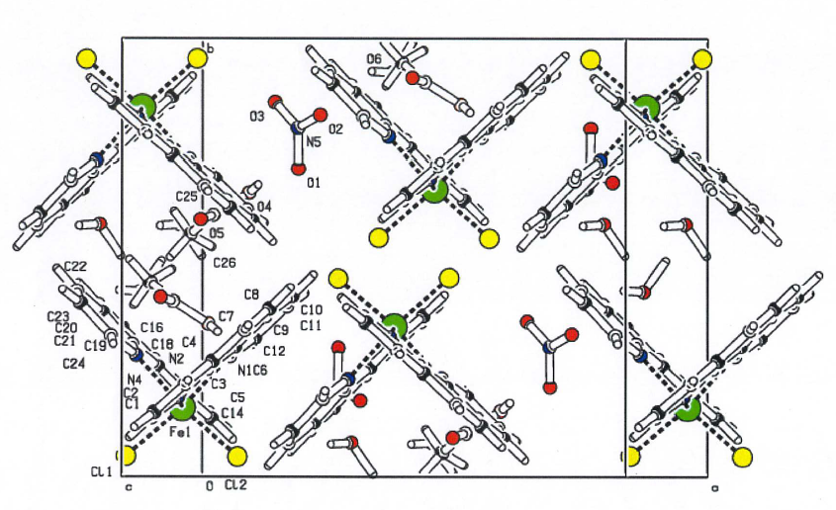
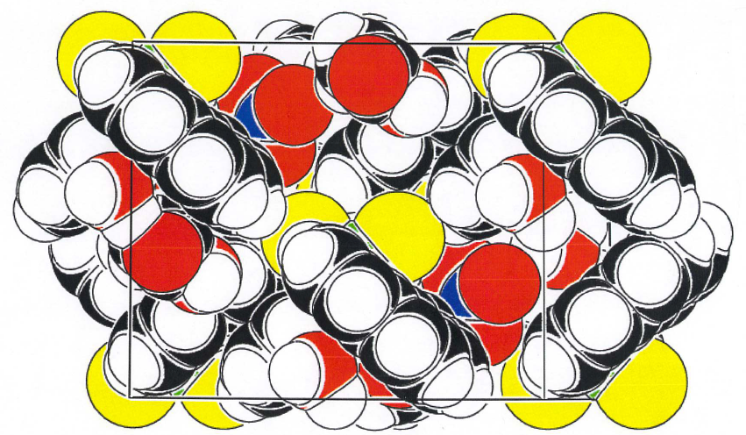
C2/c – Biswas et al. - VOIDS
Cc – Lutz et al.

Slide 56
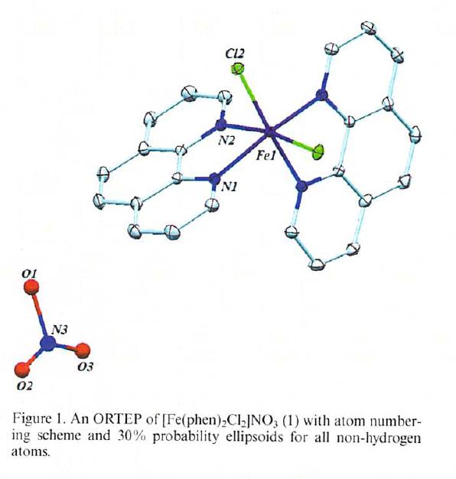
Follow-Up
- The authors maintain in their rebuttal
[Eur. J. Inorg. Chem. (2013) 2470]
their interpretation. ➔
- Referee conclusion (with no access
to the reflection data): Two different structures !!!
- I obtained the reflection data from one of the co-authors
A SQUEEZE test run on the authors data, with the NO₃⁻ removed, recovered 279 electrons from the voids left where only 128 were expected for an NO₃⁻ model.
- Run on Lutz et al. data, with NO₃ and solvents removed, recovered 285 electrons of the expected 296. Conclusion ?

Slide 57
Frauded Structures
Unfortunately, a significant number of fraudulent structure reports have been detected
Experimental data of published structures were used to create new structure reports by refining slightly modified structure models against the ‘stolen’ data.
Positive detection was possible in cases where reflection data for both structures had been deposited.

Slide 58
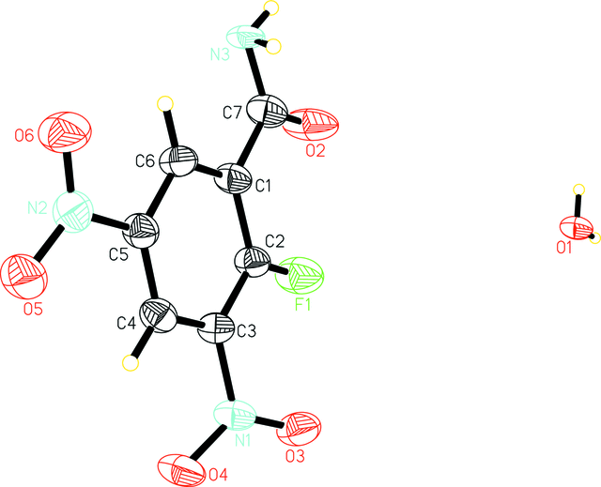
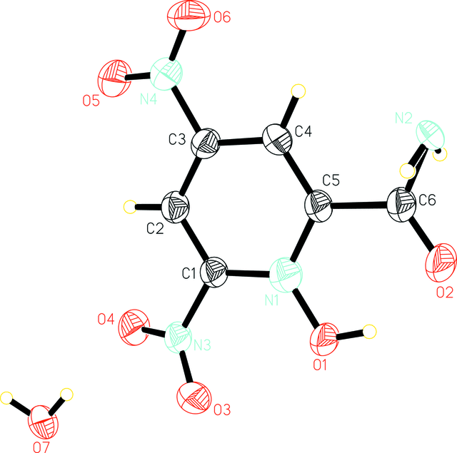
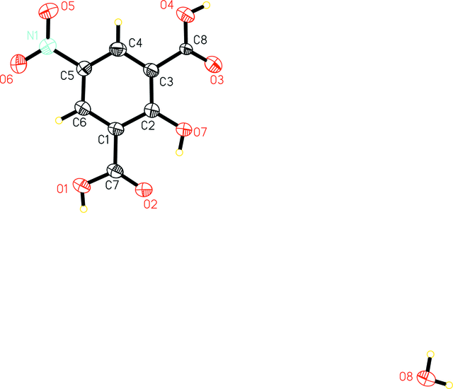
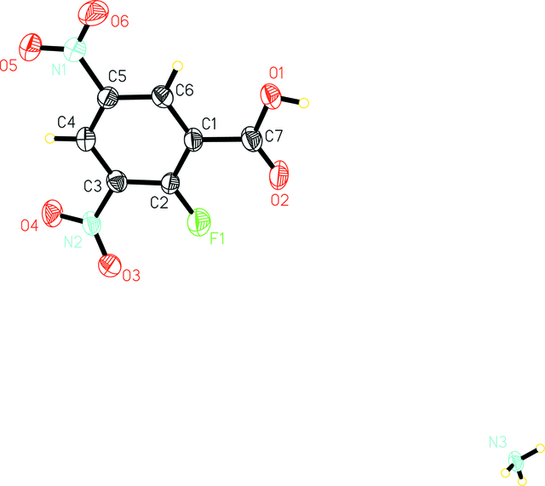
BogusVariations (with Hirshfeld ALERTS) on the Published Structure
2-hydroxy-3,5-nitrobenzoic acid (ZAJGUM)
OH=>NH2
NO2=>COOH
OH => F
H2O => NH3

Slide 59
Refinement based on Identical Data sets?
Platon includes an easy to use tool to compare two potentially similar FCF files:
Terminal window instruction:
platon –d fcf1.fcf fcf2.fcf

Slide 60
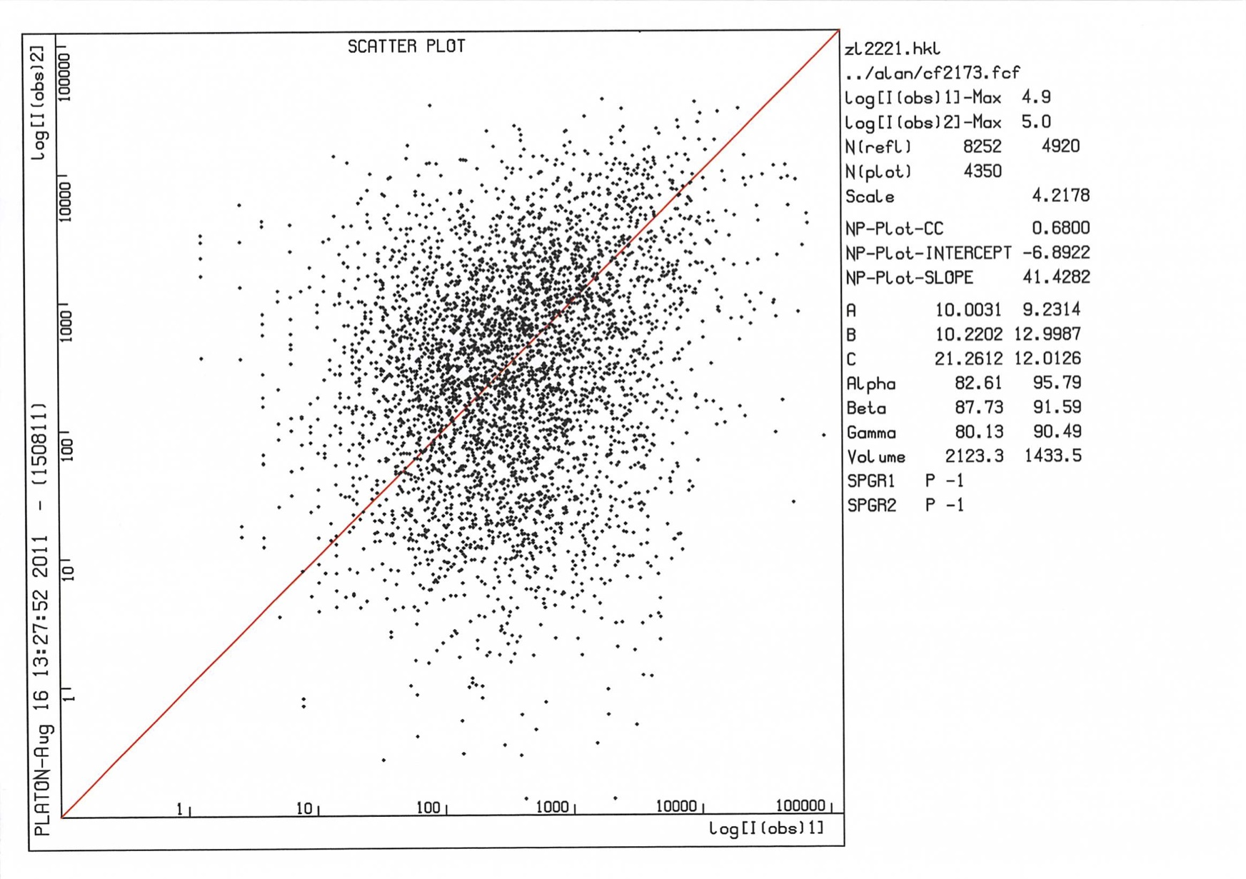
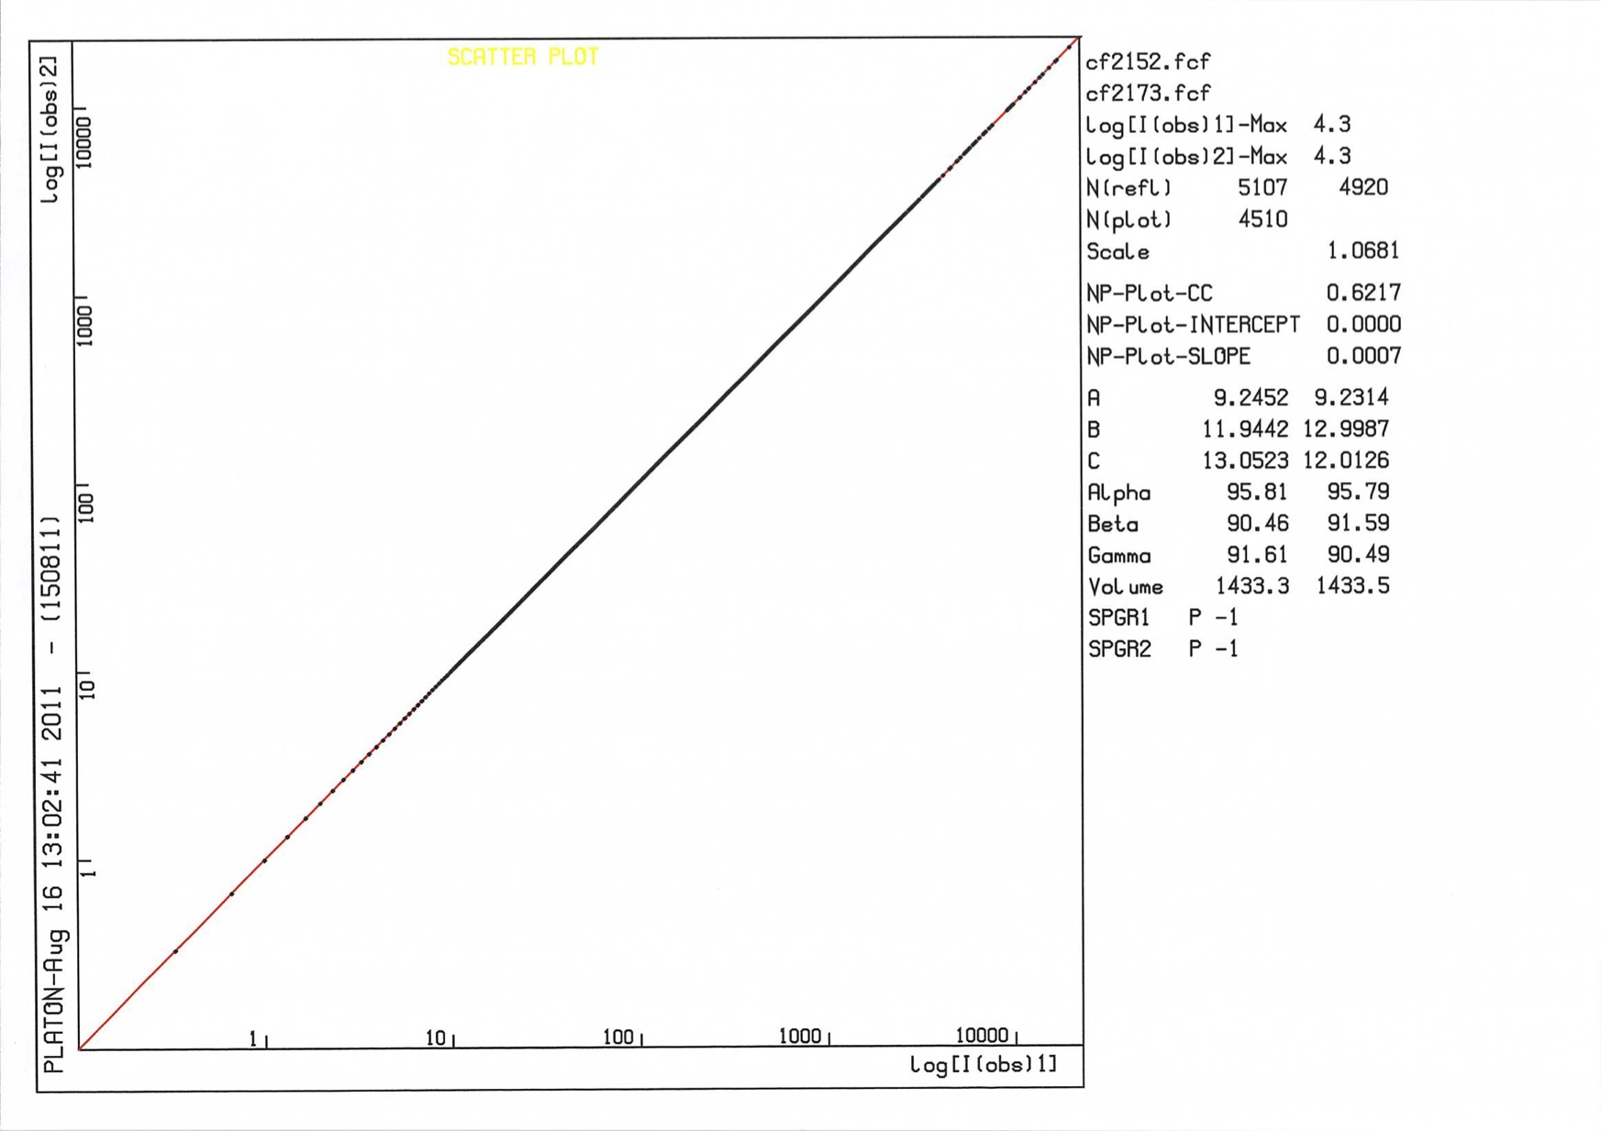
Scatter Plots of 2 Data Sets
Two Unrelated Data Sets
Two Identical Data sets

Slide 61
Invented Structures
Can crystal structures be invented ?
Yes, e.g. with forcefield calculations as part of structure prediction procedures.
‘Observed’ data can be created with an associated error model on I_{0bs} and σ(I_{obs})
Can we detect invented structure reports?
Following an example that was deliberately designed to challenge the validation system.

Slide 62
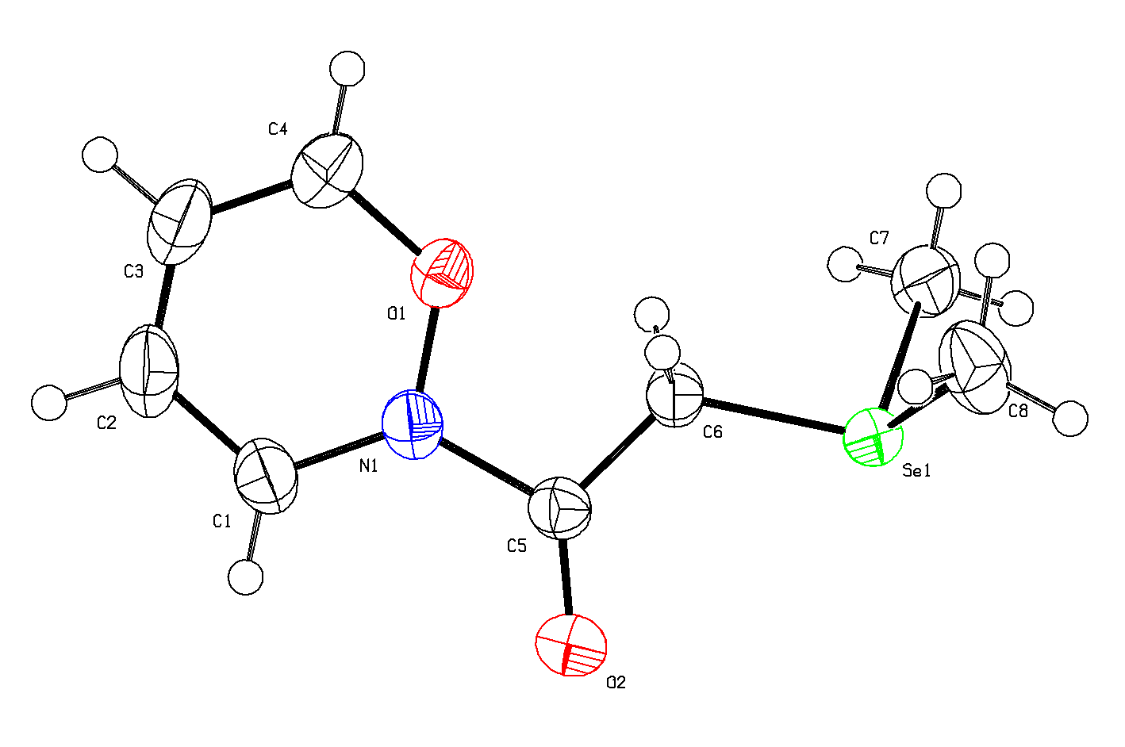
QUESTION: Is this Structure Correct ?
The Aug. 2015 IUCr/checkCIF reports no serious ALERTS
R1 = 0.0111
wR2 = 0.0339
S = 1.042
Rhomin -0.43
Rhomax 0.47
checkCIF:
No Voids
No Unusual Contacts
Slightly high Difference Density Range
What would a synthetic
chemist’s comment be ?

Slide 63
No, The Structure was Deliberately INVENTED
- This devious structure was
clevery created by Natalie
Johnson et al., Newcastle, UK,
aiming to beat checkCIF & FCF.
- Her thesis was that it is easy
to invent a fake data set that does
not raise checkCIF ALERTS.
- So does the deposition of an
FCF avoid frauded structures?
- She even created diffr. Images.
- Presented as an excellent
Poster during ECM-2015, Croatia.
But: Every crime leaves its traces …..
and we can learn from them.

Slide 64
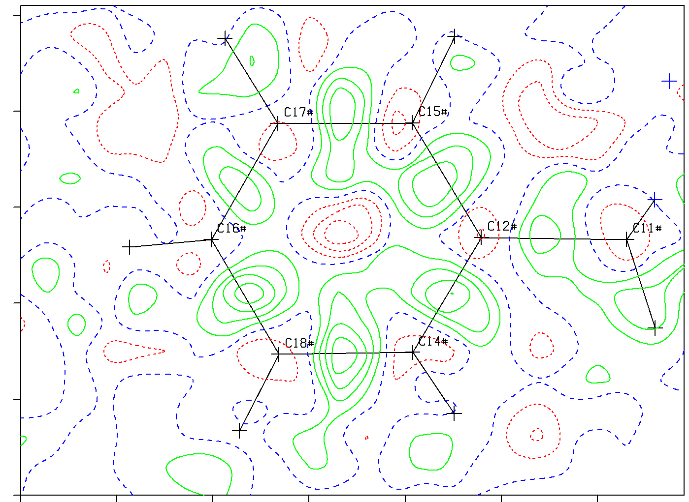
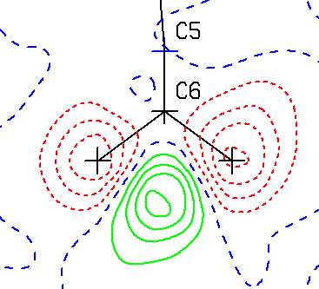
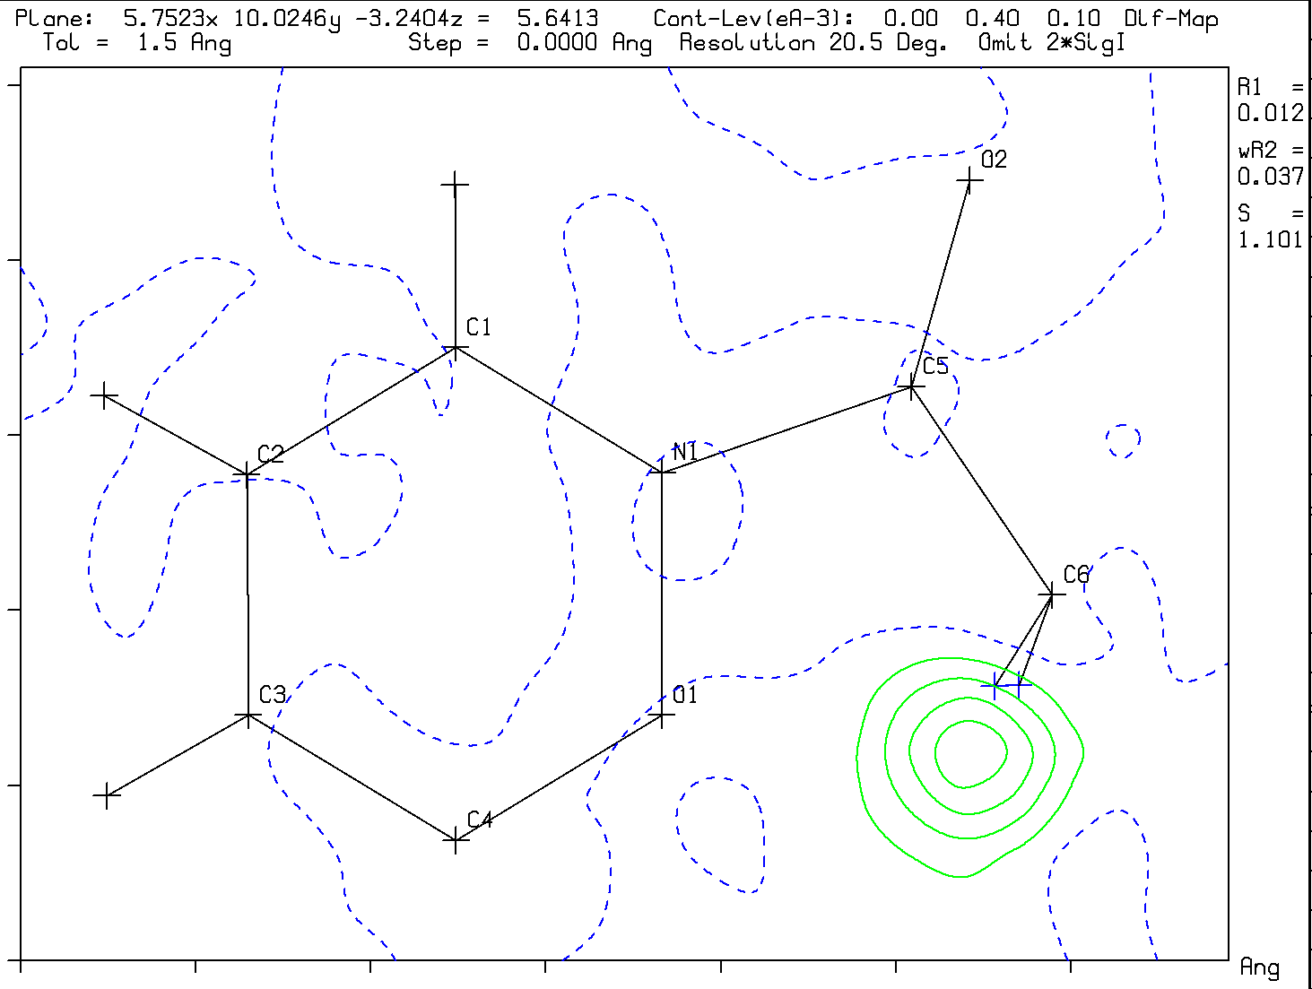
Clear traces of the ‘Crime’ are
in the Difference Density Map
Expected type of difference map
Difference map in the CH2 plane
The CH₂ Hydrogen atoms at calculated
positions are definitely not in F(obs)
Unusual Actual difference map Density

Slide 65
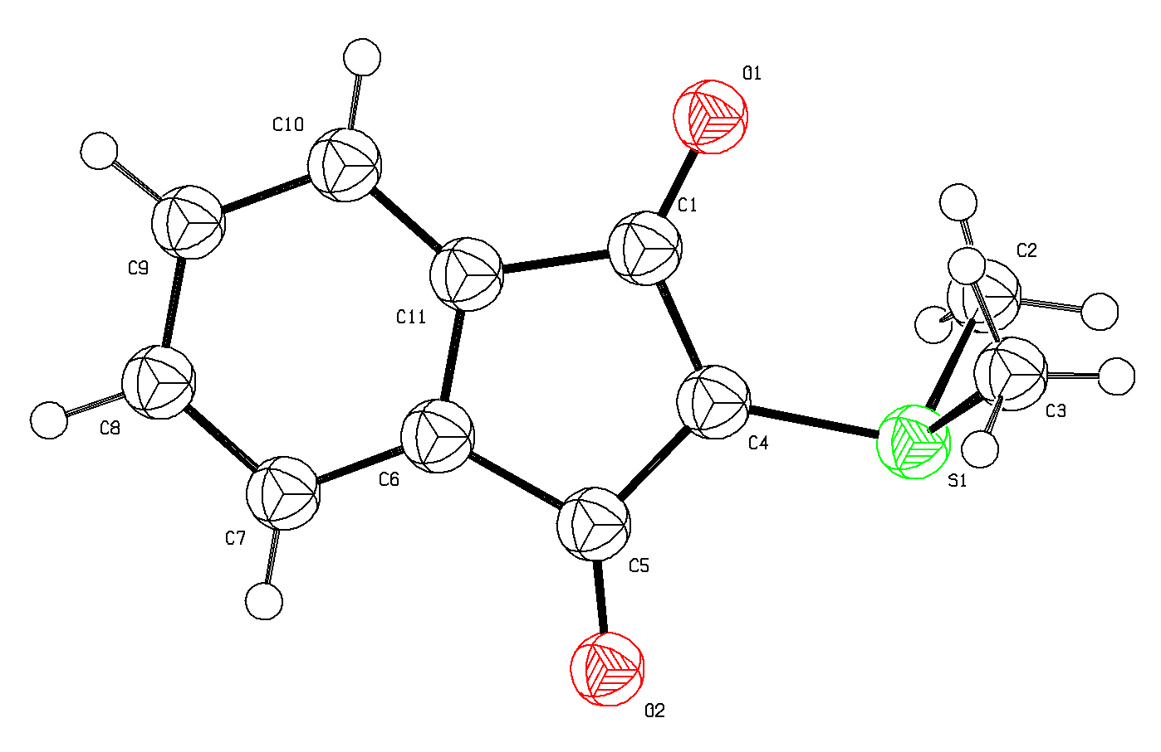

How was Structure ‘Natalie’ created ?
YLID
YLID
‘Starting Material’ (Bruker)
Chemical issue: Se⁺
No example in the CSD
for the 6-membered ring
System
Mogul : Se – C outlier
Se
NATALIE

Slide 66

CURRENT
PLATON/CHECKCIF
VALIDATION
REPORT FOR
‘NATALIE’

No H-density

No Density on Bonds

Slide 67
On the Positive side
(Reported) attempts to beat checkCIF are extremely helpful (thanks Natalie!), not only to address fraud attempts but also as a source for additional tests for the detection of author errors.
The two added ALERTS are excellent examples for this.
The newly introduced ALERTS are helpful for the detection of accidently misplaced Hydrogen atoms.
Analyses of the FCF may give further clues as shown next.

Slide 68
Look in Detail at the Reflection Data
Partly, such information is in the .ckf file created by PLATON/checkCIF from the FCF data or use e.g. tools available in PLATON
The Normal
Probability PLOT is
not perfect for
the fake ‘Natalie’
structure with its low
R-factor values

Slide 69
Look in Detail at the Reflection Data
Partly, such information is in the .ckf file created by PLATON/checkCIF from the FCF data or use e.g. tools available in PLATON
The Normal
Probability PLOT is
not perfect for
the fake ‘Natalie’
structure with its low
R-factor values

Slide 70
Look at the sigma(I) versus sqrt(I) Plot
‘Nardelli’ (Bruker) versus non-fake Bruker data
Poisson Statistics

Slide 71
Common Validation Issues
Acta Cryst. expects data sets to be essentially complete up to sin(theta)/lambda = 0.6 Å⁻¹. This does not imply to delete all data beyond that value as ‘the Acta Standard’. Those data should be kept.
Supplying a VRF with a good argument explaining the reason for an A or B Alert in the case at hand should be sufficient

Slide 72
Formula & Z
- The Moiety Formula should be consistent with the reported Z value. There should be generally no problem with one species only in a general position (Z = general position multiplicity)
- The proper choice of Z in the case of multiple species in the asymmetric unit (and their order) is likely best dictated by the underlying chemistry.

Slide 73
Missed Symmetry Messages
Tests are done to detect and report on missed or pseudo-symmetry. Those tests look for symmetry relations within the model parameters compatible with the lattice symmetry.
Details can be investigated with the ADDSYM tool in PLATON.
Reflection data will be needed for the definite analysis.

Slide 74
Valid versus Value
A structure report is ‘valid’ when the reported results include the experimental data, the authors interpretation of the data, the way that those results were obtained and all non-standard issues discussed.
The value of the report depends on what new information is obtained. The value of heavily constrained and restrained structures might be limited.

Slide 75


Slide 76
Final Comments
CheckCIF provides a list of issues that need to be addressed, either with a correction or giving an acceptable explanation (in the paper or VRF in the CIF)
ALERTS come in levels A, B & C and report possible error, missing data or quality issues. G-ALERTS are generally informative and not necessarily errors but still need to be looked at seriously.
A & B ALERTS should never automatically lead to the rejection of a paper but should be investigated by a trained crystallographer.
Everything unusual marked as ‘new’, ‘unexpected’ etc. in a paper should be approached with healthy mistrust.

Slide 77
Diffraction Images
Sometimes, the availability of an unmerged reflection file is not sufficient to evaluate unresolved or unusual issues with a structure.
In such a case, access to the diffraction images might be needed
Info about weak but important unindexed reflections might be relevant or info about streaks etc.
Standard archival of info related the integration process into the CIF might be helpful.

Slide 78
Finally
Validation should not lead to rejection of good and interesting science.
What is needed is a full account of what has been done and why and why this result is the best attainable.
Problems should not be hidden with tricks to avoid ALERTS.
All relevant data should be archived.

Slide 79
Thank you !
Please send suggestions and examples (with data) of
(annoying) issues to:
a.l.spek@uu.nl
More info:www.platonsoft.nl
(including this powerpoint presentation)

